Slide 1
Chemistry Notes
Measurement of Energy Transfer in Matter

Slide 2
Learning Objectives
I can …
State that PC and CC always have associated energy changes
Define terms: system, energy, heat, exotehrmic, endothermic, activation energy
Draw diagrams representing exo- and endothermic reactions
Explain how a calorimeter measures energy changes
Preform energy calculations using q = mcΔT

Slide 3
Matter and Energy
Matter Can Posses Energy
Matter
Changes in Temperature and Pressure create phase changes
Entropy of Matter is Influence by Energy
Energy Affects the States of Matter
Matter transfers energy in different ways
Changes in Energy can be measured

Slide 4
Measuring Energy Transfer
Whenever there is a PC or CC there is also an associated change in energy.
This change in energy takes place between the system (the participants in the reaction or change) and the surroundings).
System = objects/substances under consideration
Ex: planets, asteroids, etc. in a solar system
Ex: circulatory organs, life in an ecosystem
Ex: atoms, molecules, chemicals, etc.

Slide 5
Measuring Energy Transfer
Heat is a measure of thermal energy transfer (q)
Energy = capacity to do work
Heat moves from hot to cold places
Units for heat and thermal energy are Joules (J)
Thermal energy is also measured in calories
1 calorie = 4.184 Joules
Etymology of the word calorie – next slide

Slide 6
Interesting Bunny Trail
The Caloric Theory
Heat was a invisible fluid that repelled itself
Evidence for theory
When you mixed hot an cold fluids the hot would disperse into the cold (it self-repelled).
Count Rumford – theory killer
Prussian cannon borer
If caloric flows from hot to cold it should at some point run out – it did not
Later James Prescott Joule supported Rumford’s findings

Slide 7
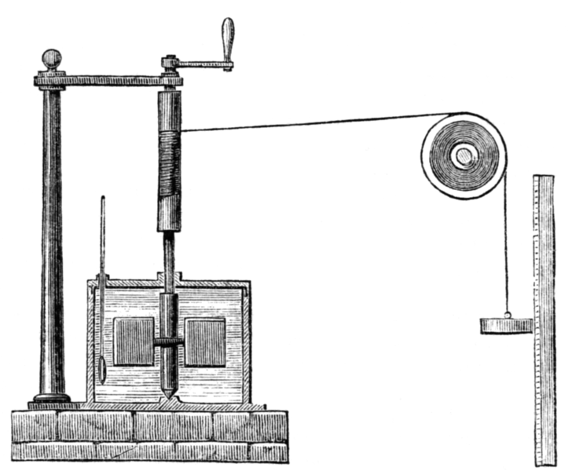
Interesting Bunny Trail
Joule's used this apparatus for measuring the mechanical equivalent of heat in which the “work" of the falling weight is converted into the “heat" of agitation in the water.
Caloric was not a real fluid but heat was created as a result of work on a system
Joule found that the same amount of work produced the same amount of heat
838 foot-pounds or 4.184 J/g*ºC

Slide 8
Measuring Energy Transfer
So we can measure heat!!!
Can we measure how much heat is in one molecule of methane?
We can measure the amount of energy released when we burn methane.
So we only can measure changes in energy, not the amount of actual energy a molecule possess.

Slide 9
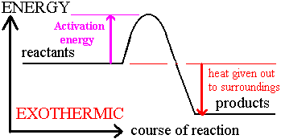
Measuring Energy Transfer
Exothermic reactions → products of a chemical change have less energy, therefore, heat is given off to surroundings

Slide 10
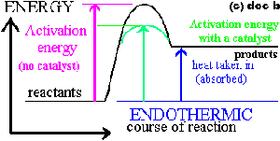
Measuring Energy Transfer
Endothermic reactions → products of a chemical change have more energy than the reactants, therefore, heat is absorbed from surroundings

Slide 11
Exothermic processes | Endothermic processes
making ice cubes | melting ice cubes
formation of snow in clouds | conversion of frost to water vapor
condensation of rain from water vapor | evaporation of water
a candle flame | forming a cation from an atom in the gas phase
mixing sodium sulfite and bleach | baking bread
rusting iron | cooking an egg
burning sugar | producing sugar by photosynthesis
forming ion pairs | separating ion pairs
Combining atoms to make a molecule in the gas phase | splitting a gas molecule apart
mixing water and strong acids | mixing water and ammonium nitrate
mixing water with an anhydrous salt | making an anhydrous salt from a hydrate
crystallizing liquid salts (as in sodium acetate in chemical handwarmers) | melting solid salts
nuclear fission | reaction of barium hydroxide octahydrate crystals with dry ammonium chloride
mixing water with calcium chloride | reaction of thionyl chloride (SOCl₂) with cobalt(II) sulfate heptahydrate

Slide 12
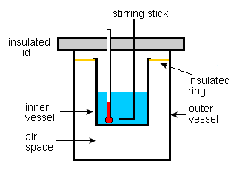
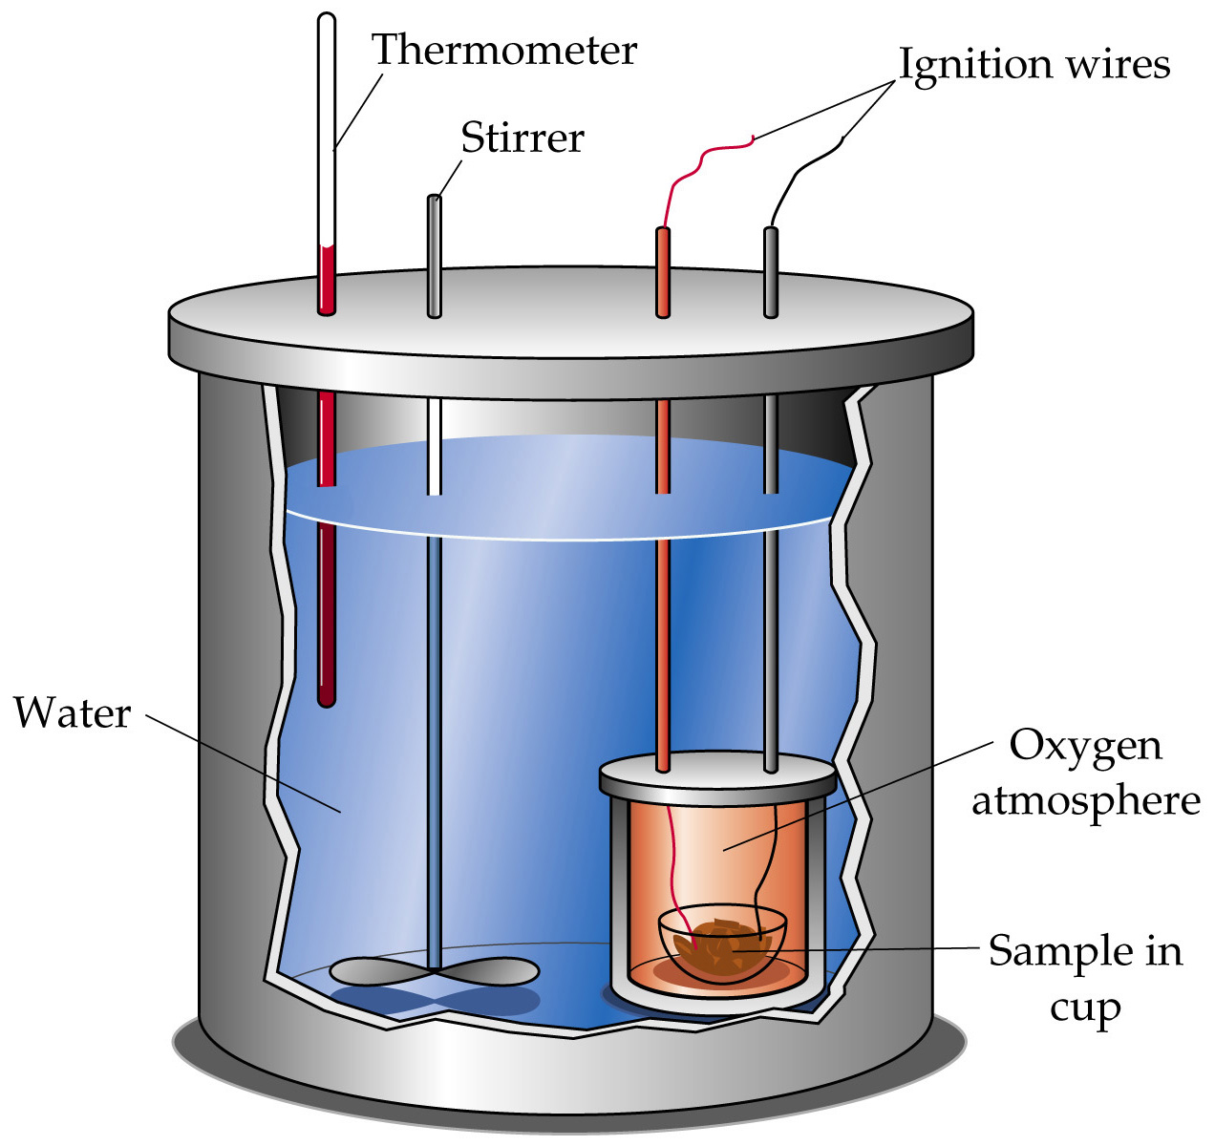
Measuring Energy Transfer
How do we measure heat?
Calorimeter device used to measure the energy given off or absorbed during a chemical reaction.

Slide 13
Measuring Energy Changes in Matter
To calculate energy lost or gained from a reaction →
q = mcΔT
Ex: how much heat is lost when solid aluminum with a mass of 4110 g cools from 660.0ºC to 25.0ºC? (Specific Heat = 0.903 J/g*ºC)
q = mcΔT
q = (4110 g) (0.903 J/g*ºC) (660°-25.0°)
q = 2,360,000 J

Slide 14
Measuring Energy Changes in Matter
Specific Heat – the heat needed to raise one gram of a substance one degree Celsius
Specific heat of water – 4.184 J/g*ºC
c = specific heat

Slide 15
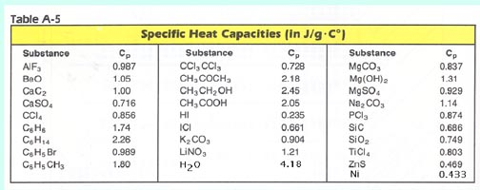
Measuring Energy Changes in Matter
q = mcΔT can be used to predict the final temperature of a system
q = mcΔT can be used to determine the specific heat of an unknown substance
This allows you to determine its identity

Slide 16
Measuring Energy Changes in Matter
To calculate energy final energy of a system →
q_{sub} = q_{H2O}
mcΔT = mcΔT
(500 g) (0.903 J/g*ºC) (100°-T_{f}) = (10 g) (4.184 J/g*ºC) (T_{f}-25.0°)
Put T_{f} second for warmer substance
Put T_{f} first for cooler substance

Slide 17
Summary
Can you…
State that PC and CC always have associated energy changes
Define terms: system, energy, heat, exotehrmic, endothermic, activation energy
Draw diagrams representing exo- and endothermic reactions
Explain how a calorimeter measures energy changes
Preform energy calculations using q = mcΔT

