Slide 1
Earth Science Notes
Lecture 1.1
Measurement

Slide 2
Objectives
I can…
Explain how measurement goes along with METHODOLOGY in obtain reliable knowledge.
Explain why standards of measurement are so important.
Recall how the Metric System was created and why we use it.
Define fundamental units for mass, volume, etc.
Define density and tell how its different from base units

Slide 3
Previously…
We stated that reliable knowledge came from using reliable methods (i.e. the scientific Method.
We concluded that in order to get accurate answers we had to possess a philosophy of doing science – we had to be Empirical.

Slide 4
Question…
How does measurement partner with methodology to lead us to reliable answers about nature?
Write the answer in the space below:
____________________________________________________________________________________________________________________________________________________________

Slide 5
Need for Measurement Standards
“Weights and measures may be ranked among the necessaries of life to every individual of human society. They enter into the economical arrangements and daily concerns of every family. They are necessary to every occupation of human industry; to the distribution and security of every species of property; to every transaction of trade and commerce; to the labors of the husbandman; to the ingenuity of the artificer; to the studies of the philosopher; to the researches of the antiquarian; to the navigation of the mariner, and the marches of the soldier; to all the exchanges of peace, and all the operations of war. The knowledge of them, as in established use, is among the first elements of education, and is often learned by those who learn nothing else, not even to read and write. This knowledge is riveted in the memory by the habitual application of it to the employments of men throughout life.”
JOHN QUINCY ADAMS - Report to the Congress, 1821

Slide 6
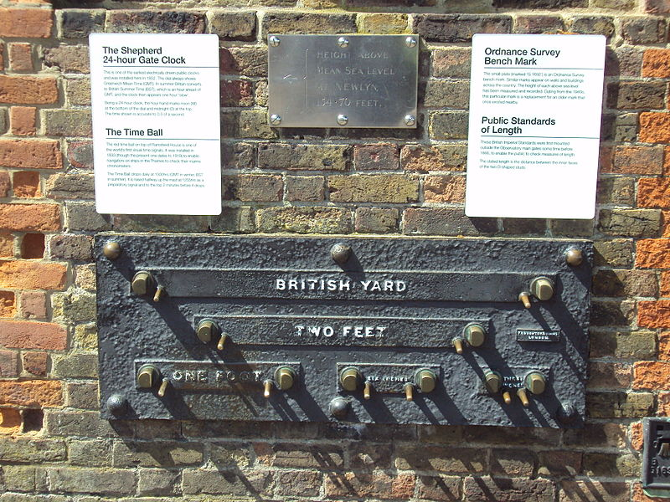
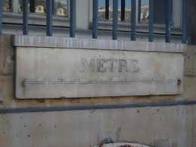
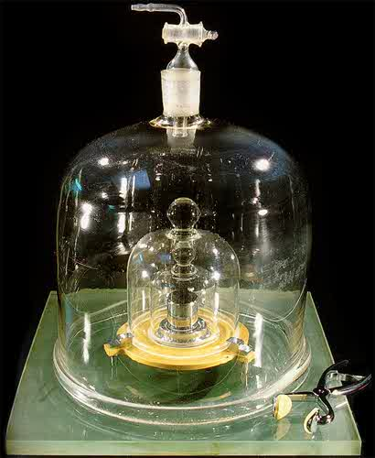
Need for Measurement Standards

Slide 7
The Metric System
Louis XVI charged a group of scientists to develop a new system of measurement. Their work laid the foundation for the "decimal metric system", which has evolved into the modern Metric System.
The System was actually spread across Europe by Napoleon. He made its use mandatory.

Slide 8
Types of Units in the Metric System
Mass: the amount of matter in an object
Measured in grams (g)
The SI units are kg
Not the same as weight
If you weighed 100 lbs on earth you would weigh 1/6 that on the moon
If you had the mass of 100 kg you would have that same mass on the moon.
Mass is measured with a balance.

Slide 9
Types of Units in the Metric System
Volume: the amount of space occupied by an object.
Measured in liters (l)
Other acceptable metric units are: ml, cm³, m³, etc.
Note: 1 cm³ = 1 ml
Liters are comparable to gallons, ounces, etc. in the standard US measurements.
Volume can be calculated (l x W x h) or it can be found by using a graduated cylinder.

Slide 10
Types of Units in the Metric System
Length: distance between two points.
Measured in meters (m)
Other acceptable metric units are: mm, cm, km
Meters are comparable to miles, yards and feet in the standard US measurements.
Length can be found many different ways.
Meter stick
Metric ruler

Slide 11
Types of Units in the Metric System
Temperature: average kinetic energy of particles
Measured in Kelvin (K) or Celsius (ºC)
Comparable to degrees Fahrenheit
Convert Celsius to Kelvin by adding 273⁰
Time: interval between two occurrences
Measured in seconds (s)

Slide 12
Types of Units in the Metric System
The units for density are “derived” metric units. Meaning it is made up of at least two fundamental units.
Density: mass per unit volume
Measured in g/cm³, g/ml, kg/m³

Slide 13
So why the Metric System?
Here convert these two Measurements
Convert: 2 miles to feet
Answer: 10,560 ft.
Convert: 2 kilometers to meters
Answer: 2000 m
What benefit is there to using a simpler means of measurement (besides it being simpler)?
It decreases error – which leads to more reliable results.

Slide 14
Self-Assessment
Can I…
Explain how measurement goes along with METHODOLOGY in obtain reliable knowledge.
Explain why standards of measurement are so important.
Recall how the Metric System was created and why we use it.
Define fundamental units for mass, volume, etc.
Define density and tell how its different from base units

