Slide 1
Earth Science Notes
Evidence for Plate Tectonics

Slide 2
Objectives
I can…
State multiple lines of evidence that support the Plate Tectonic Theory.
Cite specific evidence that supports the Plate Tectonic Theory.

Slide 3
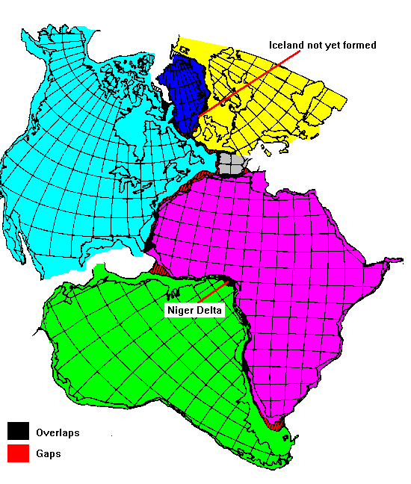
Evidence for Plate Tectonics
Shape of Continents
Recall this was the initial observation that led to the idea of continental drift.
The shapes of many continents are such that they look like they are separated pieces of a jig-saw puzzle.
Important to note. This was only circumstantial evidence.

Slide 4
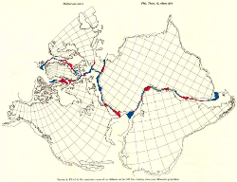
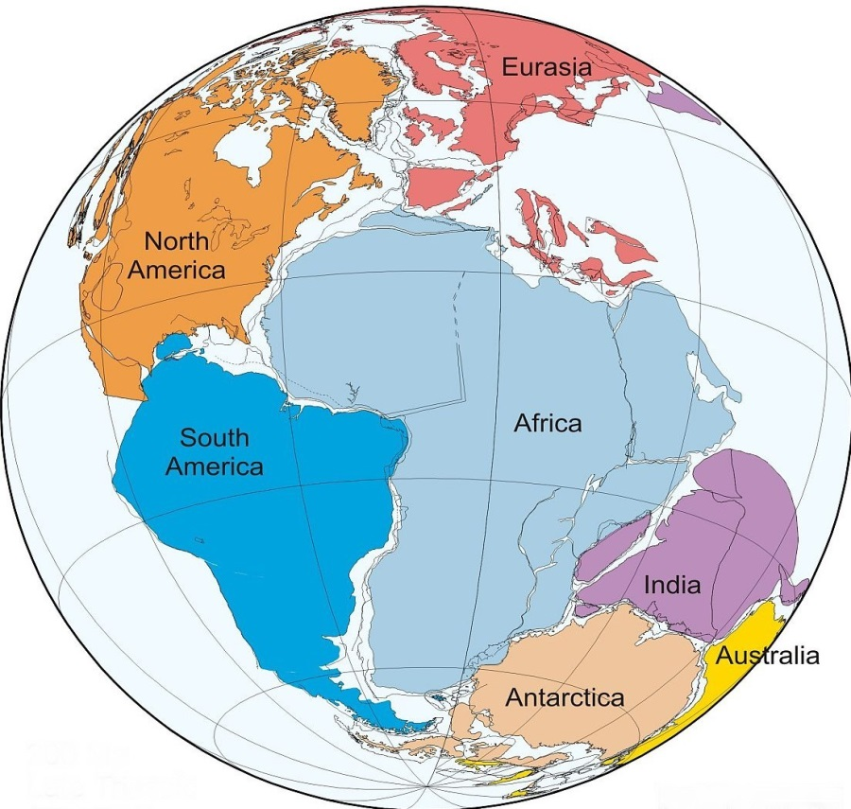
Evidence for Plate Tectonics
Continental Fit
Not only do South America and Africa look like they fit together, but to a lesser extent …
North America looks as if it could fit with Northern Africa and Western Europe.
India, Australia, and Antarctica look as if they fit together.

Slide 5
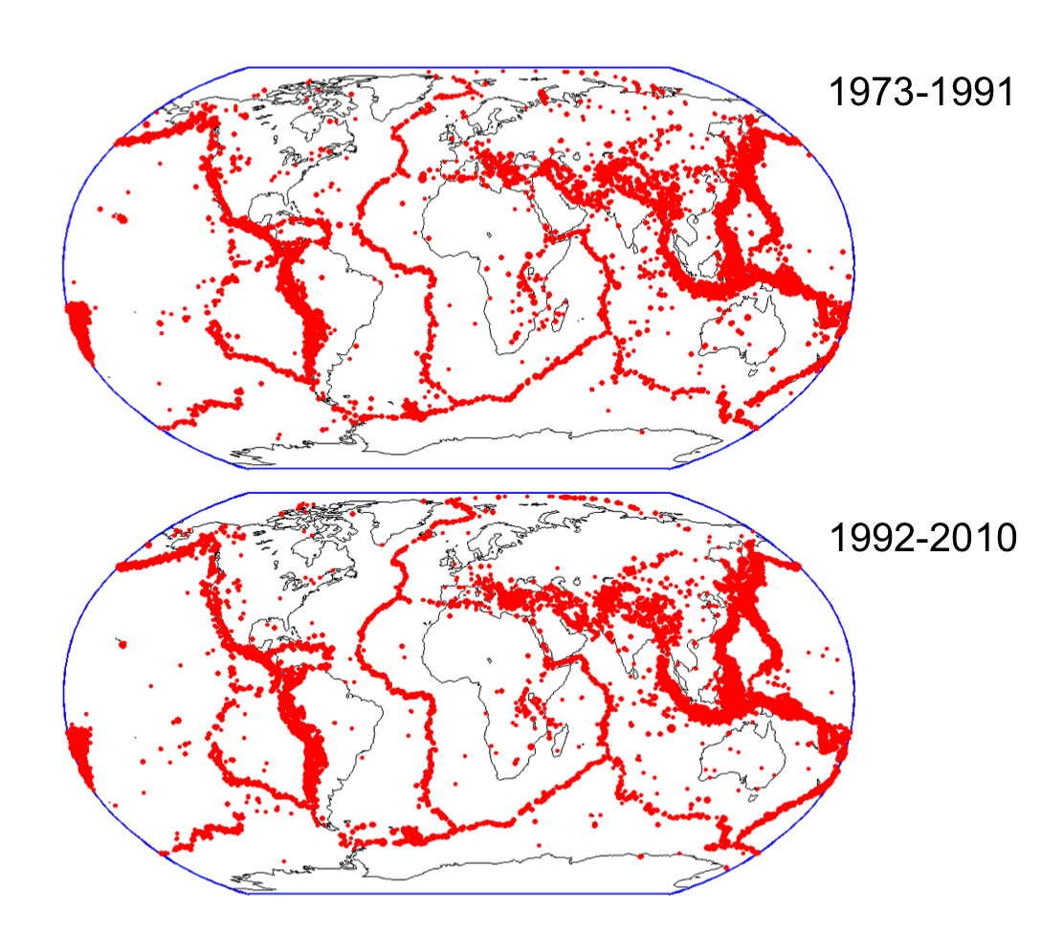
Evidence for Plate Tectonics
Seismic Activity
We can accurately locate epicenters of Earthquakes. The map here shows the location of these Earthquakes.
This is the best evidence of the plates themselves

Slide 6
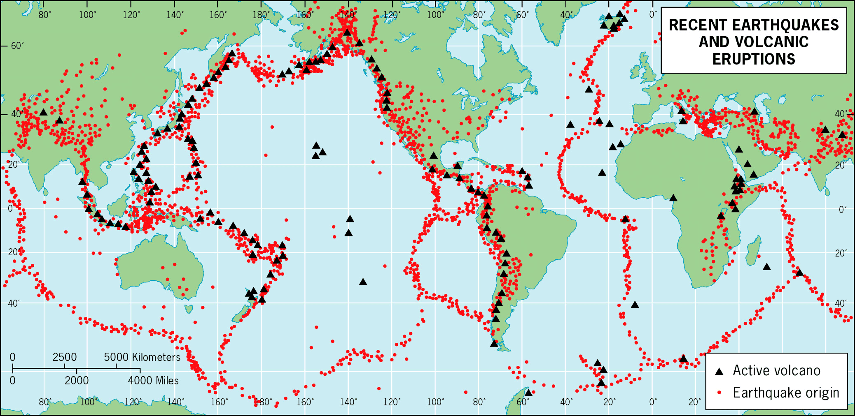
Seismic Evidence
Seismic Activity
We can accurately locate epicenters of Earthquakes. The map here shows the location of these Earthquakes.
This is the best evidence of the plates themselves

Slide 7
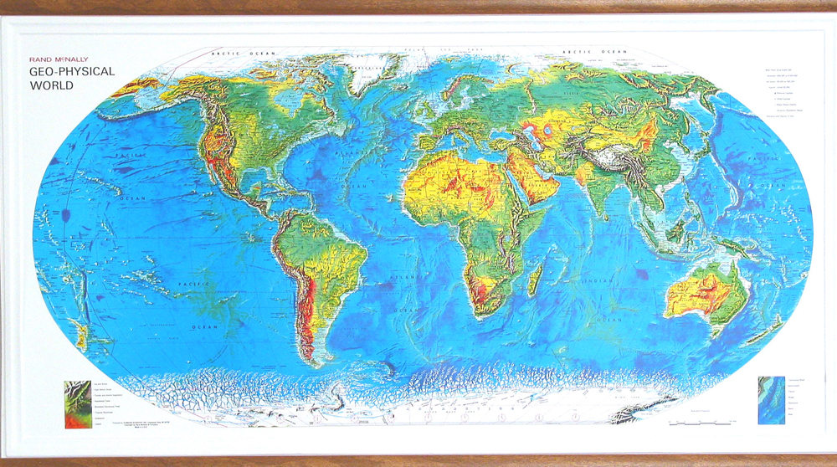
Seismic Evidence
Mountain building and trench formation occurs along these established plate boundaries.

Slide 8
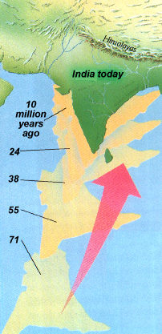
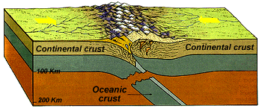
Seismic Evidence
A great example of mountain building is the Himalaya Mountains in Asia.
The Mountains are actually getting higher.

Slide 9
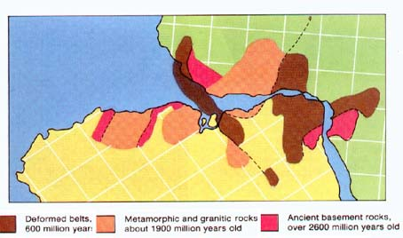
Evidence for Plate Tectonics
Geological Evidence
When we examine the rock formations along coast lines that seem to fit together here is what we find.
If we reassembled Africa and S. America we see congruence in the rock types and their ages.

Slide 10
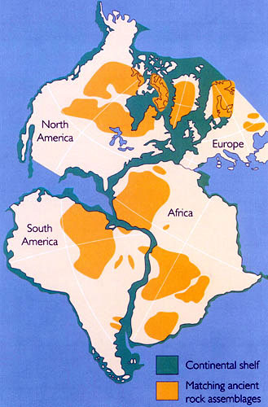
Geological Evidence
Notice where rock of similar age is located on each continent.

Slide 11
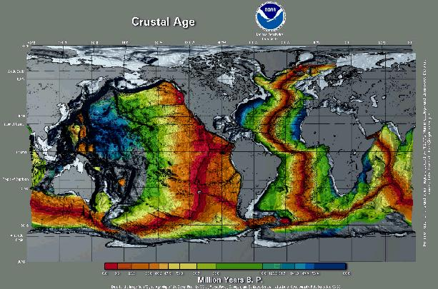
Geological Evidence
Age of rocks near mid-ocean ridges are younger than rocks farther away. The map below shows just that.

Slide 12
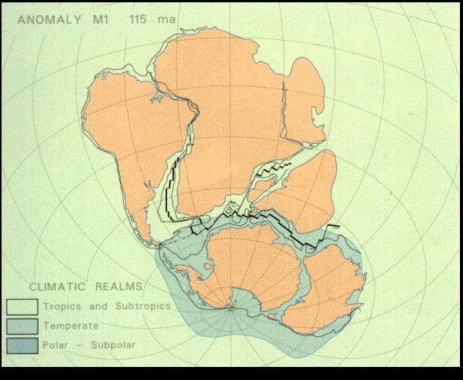
Geological Evidence
Younger rocks near the mid-ocean ridge suggest the crust is moving outward from the ridge. We determine the age of these rocks by examining the polarity of the rocks. We will discuss this more later.

Slide 13
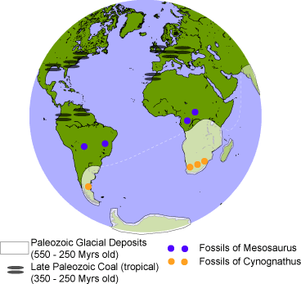
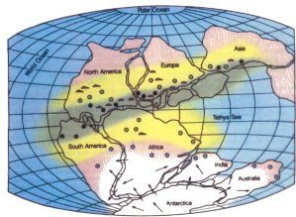
Geological Evidence
Many of the worlds coal deposits are found along the “gray belt.”
The gray belt is a long narrow region that coincides with the tropical regions of Pangaea.
Compare the maps.

Slide 14
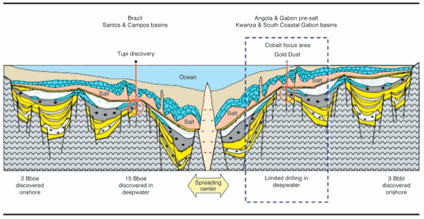
Geological Evidence
Here is a chart used by offshore mining companies for the purpose of mining salt. The map shows symmetrical deposits on each side of the mid-Atlantic ridge.

Slide 15
Geological Evidence
Mining companies use the PT Theory to find new mining cites.

Slide 16
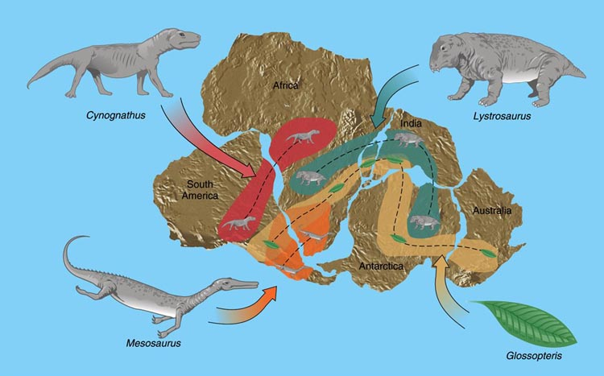
Evidence for Plate Tectonics
Fossil Evidence
Fossils of the same species of organism are found at points where two continents seemed to have diverged from.

Slide 17
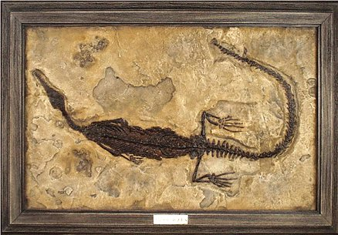
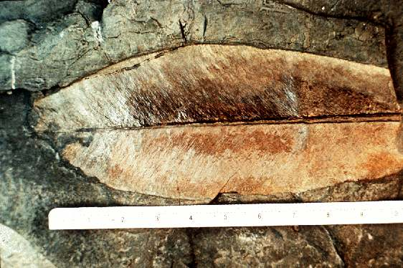
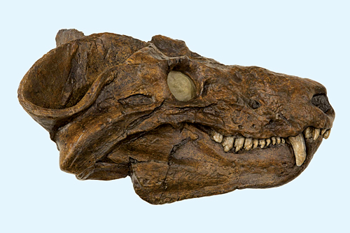
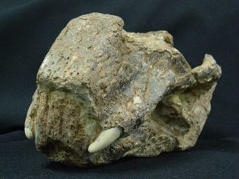
The Fossils
Mesosaurus (TL)
Glossopteris (TR)
Cyanognathus (BL)
Lystrosaurus (BR)

Slide 18
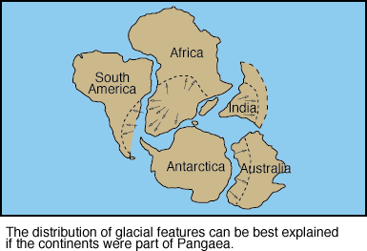
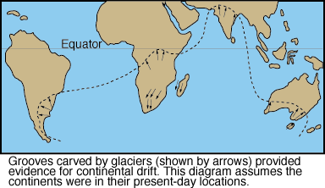
Climate Evidence
Climate Evidence
There is also similar glacial features, like striations, (grooves in rock made by glaciers) in areas of South America, Africa, India, and Australia.

Slide 19
Summary of Evidence
Continental Fit
Seismic Activity
Earthquakes, Volcanos Mountains
Geological similarities along coast line
Age and type of Rock
Gray Belt and other mineral deposits
Fossils
Glossopteris, Cyanognathus, etc.
Climate
Striations from glaciers

Slide 20
Summary of Evidence
What does all this evidence tell us?

Slide 21
Assessment
Can I…
State multiple lines of evidence that support the Plate Tectonic Theory.
Cite specific evidence that supports the Plate Tectonic Theory.

