Slide 1
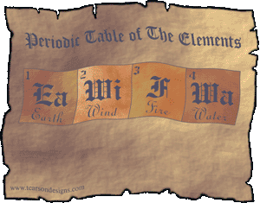
Chemistry Notes
Foundations of the Periodic Table

Slide 2
Foundations of the Periodic Table
John Dalton unites the atomic theory with the concept of chemical elements
  Dalton calculated the first relative masses of atoms and compounds
Since Dalton’s explanation of elements, chemists struggled to classify elements

Slide 3
Activity
Remove the pieces of colored paper and begin to group them in whatever order seems the most logical to you.

Slide 4
Activity
Discuss with your neighbors:
What was your logic in classifying / organizing the pieces?
What obstacles did you run into during this activity? How did you deal with them?
What is this activity trying to demonstrate?

Slide 5
Chart Logic
ROY G. BIV = from left to right
Dark to Light = bottom to top
Blend of colors = from left to right (e.g. Y → Y/G → G → G/B)

Slide 6
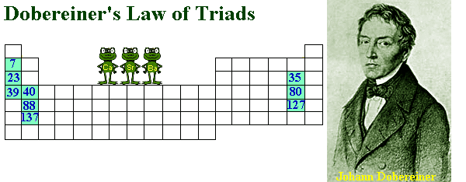
Foundations of the Periodic Table
Johann Döbereiner (1817) – first to try and classify elements
  Organized elements into groups of three called triads
Some triads classified by Döbereiner are:
  Cl, Br, and I
  Ca, Sr, and Ba
  S, Se, and Te
  Li, Na, and K
Average the smallest and largest element in the triad. What do you get?

Slide 7
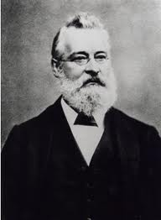
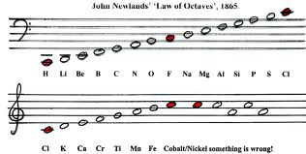
Foundations of the Periodic Table
John Newland (1863) – Noted that there was a repetition of properties every eighth element when atoms were arranged according to their atomic masses – Old Periodic Law
  Referred to this repetition as the Law of Octaves
    Like octaves of musical notes

Slide 8
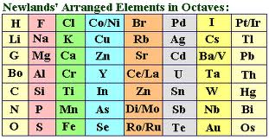
John Newlands Periodic Table

Slide 9
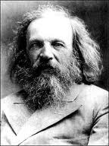

Foundations of the Periodic Table
Dimetri Mendeleev

Slide 10
Foundations of the Periodic Table
Dimetri Mendeleev (1869) – Considered the father of the modern periodic table.
Mendeleev’s organizational scheme vertically grouped elements with similar properties.
  arranged atoms according to atomic mass also
  Elements of smaller mass → P/C properties repeated after every seventh element
  Elements of larger mass → P/C properties repeated after every seventeenth element

Slide 11

Foundations of the Periodic Table
    This phenomenon in which physical and chemical properties of elements are periodic functions of their atomic mass is called the Periodic Law.
    So the PT is a visual representation of this law.

Slide 12
Foundations of the Periodic Table
Dimetri Mendeleev (cont.)
  Mendeleev realized that there were undiscovered elements.
  Mendeleev left blank spots in the periodic table for these undiscovered elements

Slide 13
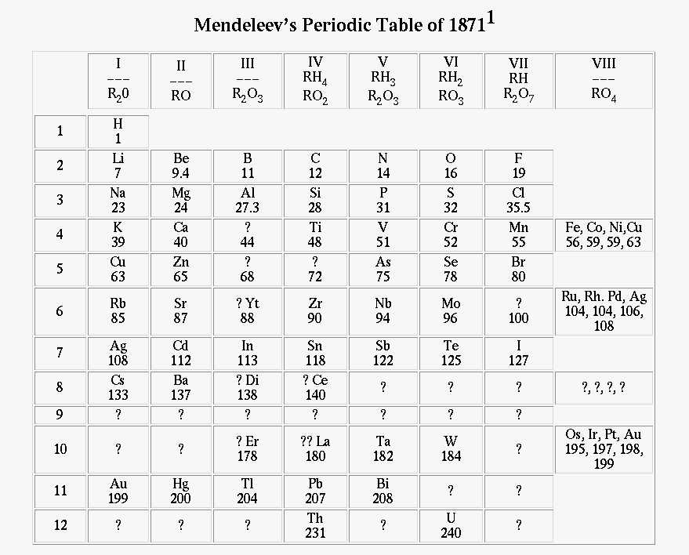

Slide 14
Foundations of the Periodic Table
Dimetri Mendeleev (cont.)
  In 1879, Mendeleev’s periodic table received a powerful boost in acceptance when it predicted the existence of gallium, germanium, and scandium.

Slide 15
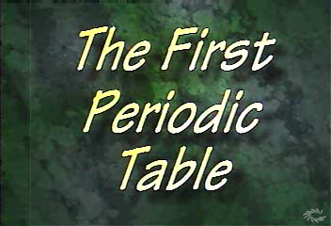

Slide 16
Foundations of the Periodic Table
Noble Gases
Mendeleev's table was fairly accurate but there were a few more needed modifications
His table lacked Noble gases
  William Ramsay established the last group on the periodic table – the inert gases
    He noticed that there was a difference in the density of N₂ recovered from the air and the N₂ recovered from various compounds.
      Ramsay found the difference was due to the presence of Argon
      Ramsay also discovered helium (thought only to exist in the sun)

Slide 17
Foundations of the Periodic Table
Modifications (cont.)
Some properties of elements did not coincide with the groups they were in.
  Tellurium (Te) and Iodine (I)
    Iodine behaved like a halogen.
  This problem was solved by Henry Mosley.

Slide 18
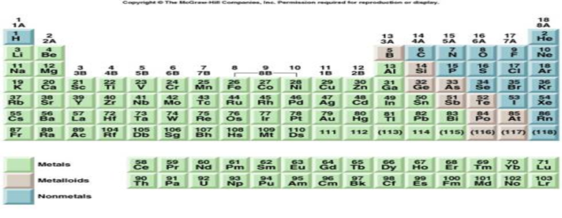
If this PT were arranged according to atomic mass these two elements would be in the wrong groups. Are there others like this?

Slide 19
Foundations of the Periodic Table
Henry Mosley
Soon after Rutherford discovers the proton, Mosley subjected known elements to X-rays
He derives a relationship between the x-ray frequency and the number of protons
  This means he was able to measure the number of protons in each atom with accuracy and precession
When Moseley arranged the elements according to increasing atomic numbers and not atomic masses, some of the inconsistencies associated with Mendeleev's table were eliminated.
  Te and I were placed in the correct groups

Slide 20
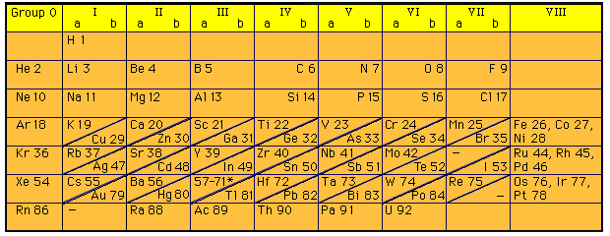
Foundations of the Periodic Table
Henry Mosley (cont.)
The modern periodic table is based on Moseley's Periodic Law (Modern Periodic Law).
  Shown below is a periodic table from 1930:

Slide 21
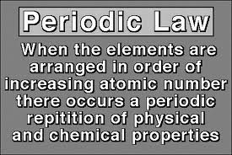
REMEMBER! REMEMBER! REMEMBER!

Slide 22
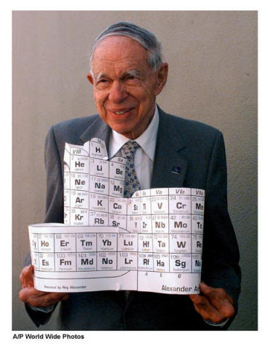
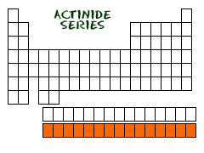
Foundations of the Periodic Table
Modifications (cont.) –
Glenn Seaborg discovered elements 94 to 102 and reconfigured the periodic table by placing the lanthanide/actinide series at the bottom of the table.

Slide 23
Foundations of the Periodic Table
The Modern Periodic Table
Was arrived at by way of scientific process
  Ideas / observation
  Mistakes / incomplete data
  Discovery
  Organization / classification
Look at the development of the PT on the following slides

Slide 24
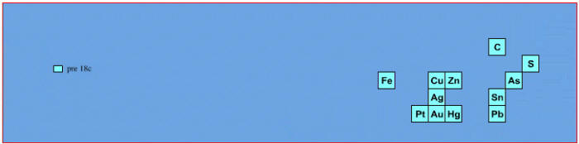
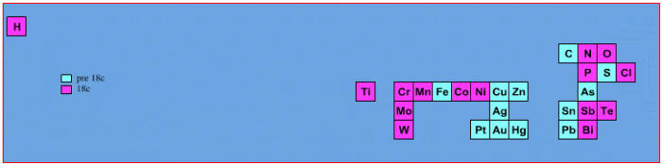
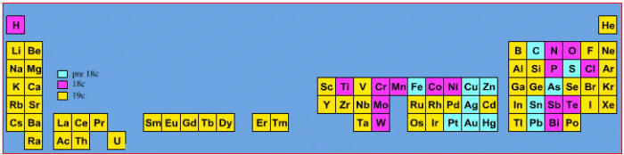
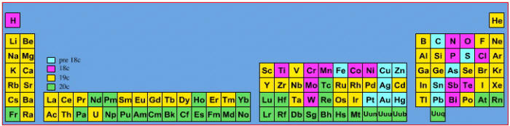
Elements known before 1700, plus those discovered between 1700 and 1799:
Elements known before 1700:
Elements known before 1800, plus those discovered between 1800 and 1899:
Elements known before 1900, plus those discovered between 1900 and 2005:

Slide 25
1 H |  |  |  |  |  |  |  |  |  |  |  |  |  |  |  |  | 2 He
3 Li | 4 Be |  |  |  |  |  |  |  |  |  |  | 5 B | 6 C | 7 N | 8 O | 9 F | 10 Ne
11 Na | 12 Mg |  |  |  |  |  |  |  |  |  |  | 13 Al | 14 Si | 15 P | 16 S | 17 Cl | 18 Ar
19 K | 20 Ca | 21 Sc | 22 Ti | 23 V | 24 Cr | 25 Mn | 26 Fe | 27 Co | 28 Ni | 29 Cu | 30 Zn | 31 Ga | 32 Ge | 33 As | 34 Se | 35 Br | 36 Kr
37 Rb | 38 Sr | 39 Y | 40 Zr | 41 Nb | 42 Mo | 43 Tc | 44 Ru | 45 Rh | 46 Pd | 47 Ag | 48 Cd | 49 In | 50 Sn | 51 Sb | 52 Te | 53 I | 54 Xe
55 Cs | 56 Ba | * | 72 Hf | 73 Ta | 74 W | 75 Re | 76 Os | 77 Ir | 78 Pt | 79 Au | 80 Hg | 81 Tl | 82 Pb | 83 Bi | 84 Po | 85 At | 86 Rn
87 Fr | 88 Ra | ** | 104 Rf | 105 Db | 106 Sg | 107 Bh | 108 Hs | 109 Mt | 110 Ds | 111 Rg | 112 Cn | 113 Uut | 114 Uuq | 115 Uup | 116 Uuh | 117 Uus | 118 Uuo
* Lanthanoids |  | 57 La | 58 Ce | 59 Pr | 60 Nd | 61 Pm | 62 Sm | 63 Eu | 64 Gd | 65 Tb | 66 Dy | 67 Ho | 68 Er | 69 Tm | 70 Yb | 71 Lu
** Actinoids |  | 89 Ac | 90 Th | 91 Pa | 92 U | 93 Np | 94 Pu | 95 Am | 96 Cm | 97 Bk | 98 Cf | 99 Es | 100 Fm | 101 Md | 102 No | 103 Lr
Legend
Before 1800 (34 elements): discoveries during and before the age of enlightenment.
1800-1849 (24 elements): scientific and industrial revolutions.
1850-1899 (26 elements): the age of classifying elements; application of spectrum analysis techniques: Boisbaudran, Bunsen, Crookes, Kirchhoff, and others "hunting emission line signatures".
1900-1949 (13 elements): development of old quantum theory and quantum mechanics.
1950-1999 (16 elements): "post atomic bomb" era; synthesis of atomic numbers 98 and above (colliders, bombardment techniques).
2000-present (5 elements): recent synthesis.

Slide 26
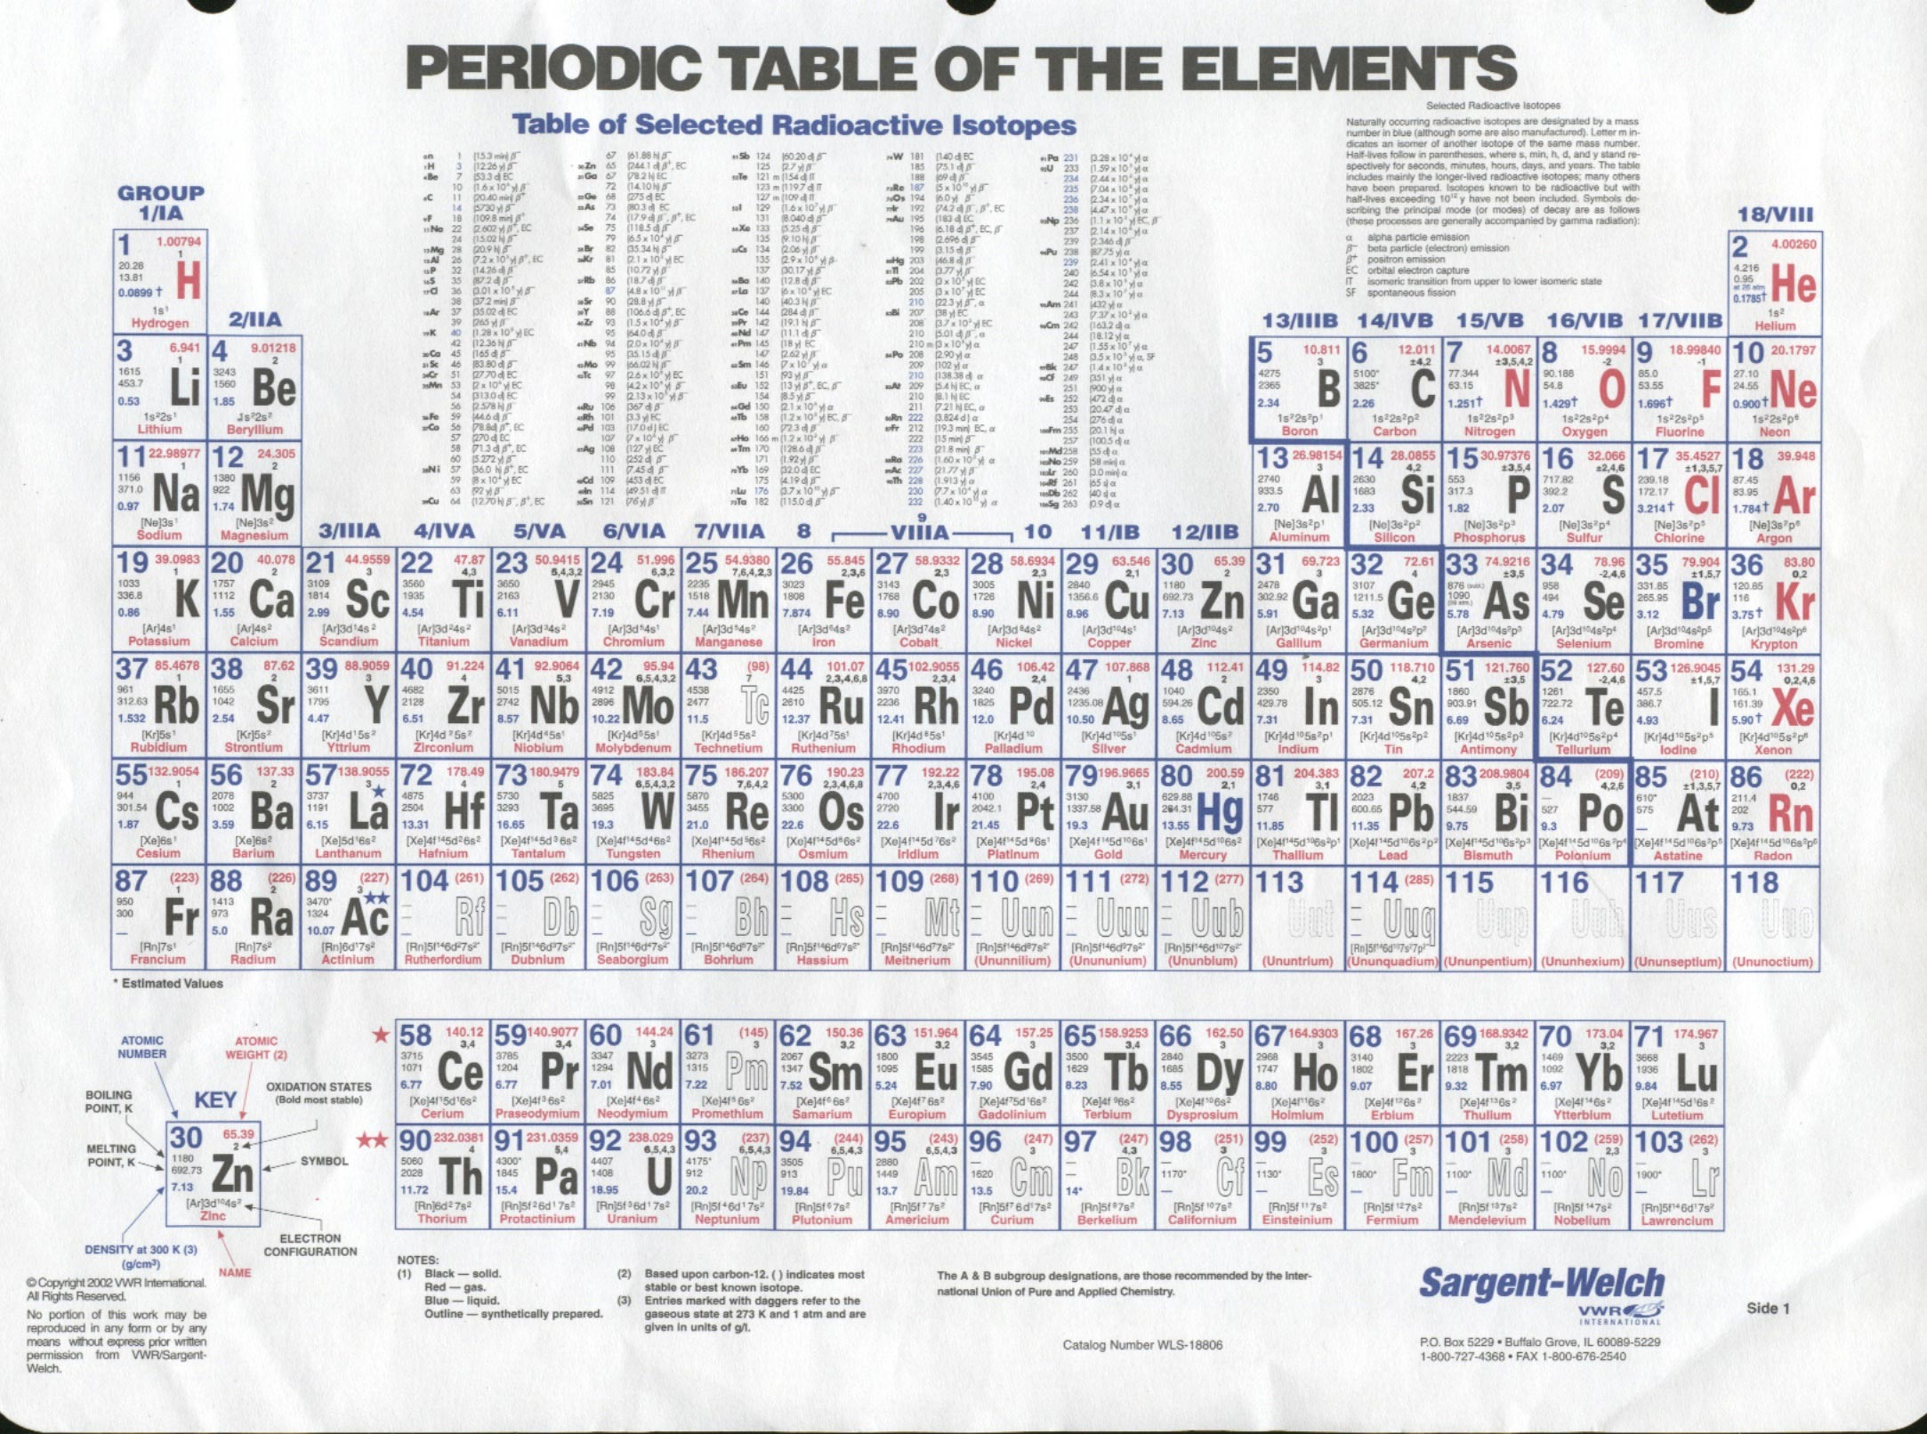
This is how we got our Periodic Table

Slide 27
Summary
I can …
Describe the contributions of each scientist to the development of the PT
  Differentiate law of Triads, Octaves and modern Periodic Law
State modern Periodic Law
Explain how discoveries led to modifications of the PT

