Slide 1
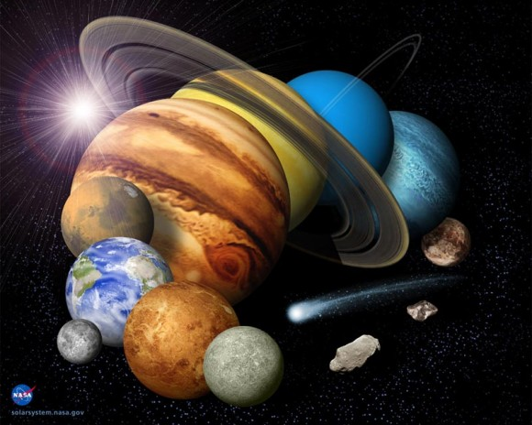
Earth Science Notes
The Planets of our Solar System

Slide 2
Objectives
I can…
Recall Key feature about the planets in our solar system.
Compare and Contrast structural features of the planets.

Slide 3
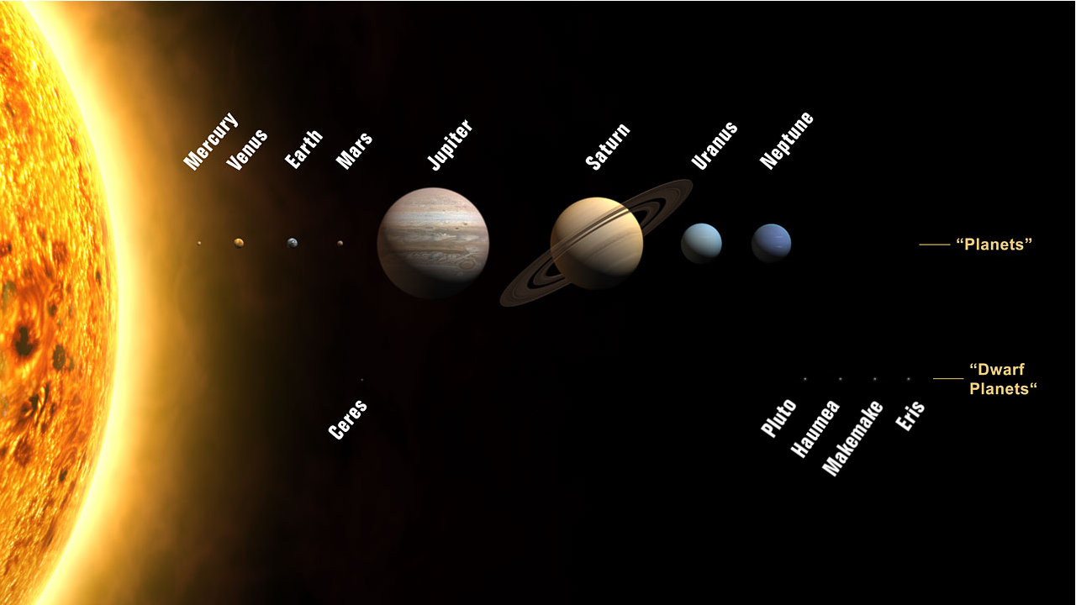

Slide 4
Instructions
Read through these notes and identify key features that each planet possess.
Prepare to ask questions
You will be quizzed over:
Relative size of planets
Relating mass to gravitational pull
Similarities between planets
Unique qualities of each planet
Structure of planets

Slide 5
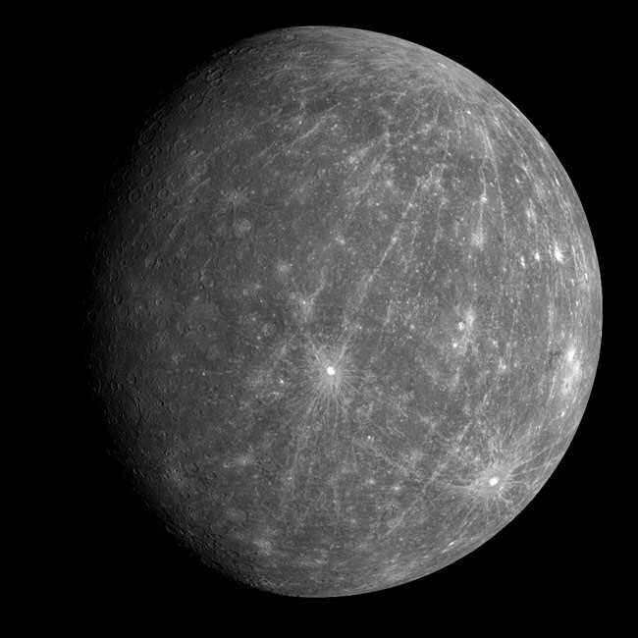
Mercury
The smallest planet in the SS.
About the size of our moon.
Completes one revolution every 59 days.
Virtually no atmosphere.
Gravity is about 38% of what Earth’s.
A basketball player could dunk on a 26 ft. high rim on Mercury.

Slide 6
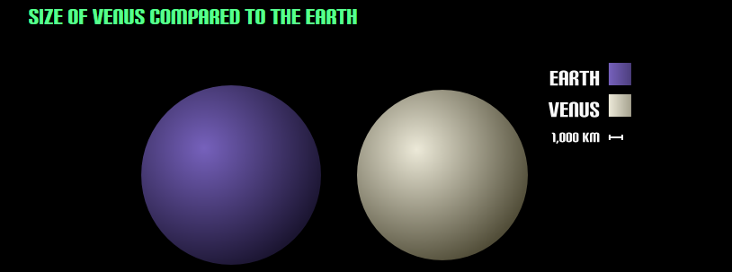
Venus
The hottest planet in the SS at 875ºF. Hotter than Mercury.
Mercury has no atmosphere to trap heat.
Venus has a thick atmosphere, 100 times thicker than Earth, and its almost all CO₂.
Super-megadeath- greenhouse effect
Venus rotates once every 243 days.
Atmospheric pressure on Venus is 92 times greater than Earth.
We experience about 15 psi on Earth, on Venus we would have 1,380 psi.
Venus is sometimes called Earth’s twin.

Slide 7
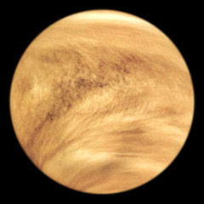
Venus
Is the second brightest object in the sky.
Earlier civilizations called Venus the Bright Morning Star.
All planets in the SS revolve around the sun in a CCW fashion except Venus.
This is called retrograde motion.
Venus has clouds that consist mainly of Sulfuric acid.

Slide 8
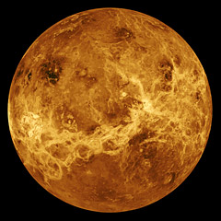
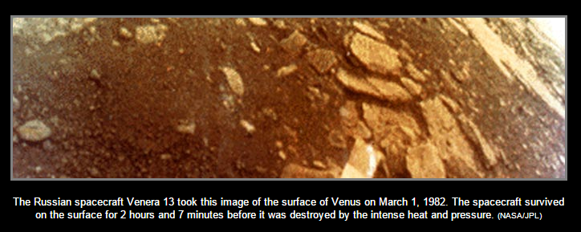
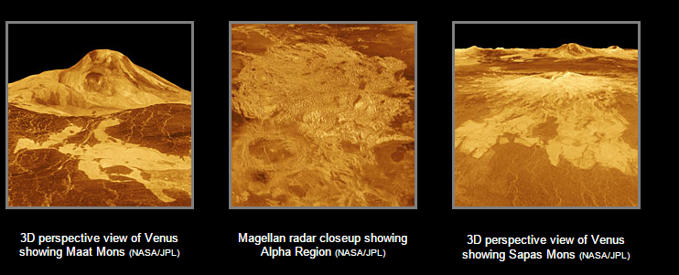
Venus
Below are images of Venus’s Landscape taken using radar.

Slide 9
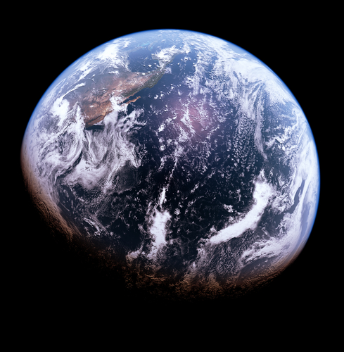
Earth
- We’re Good

Slide 10
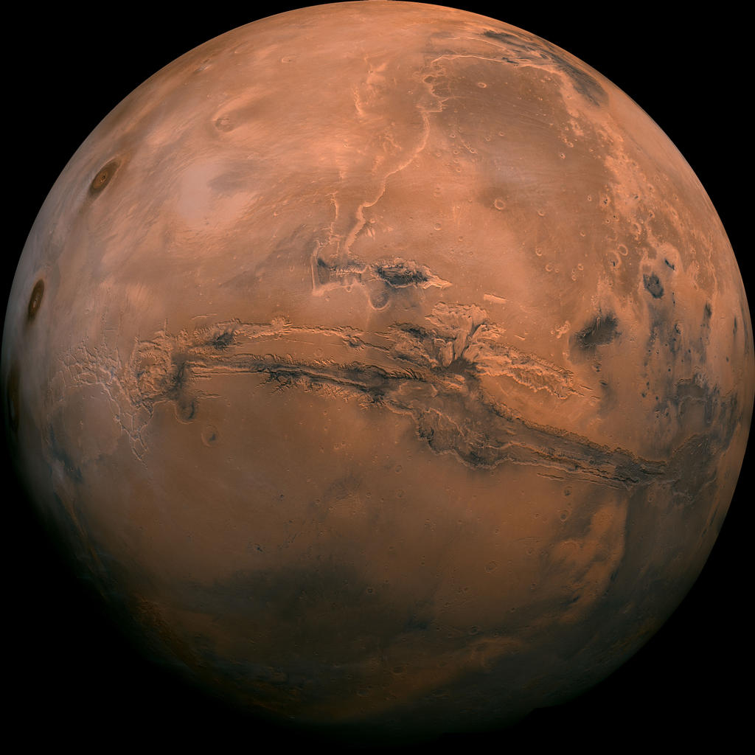
Mars
Arid, rocky, cold
Has a thin carbon dioxide atmosphere.
Home to largest mountain in the SS – Olympus Mons
Scientist believe their may have been water on mars surface at one time.
Scientist are searching for traces of life (microbes) in is soil.

Slide 11
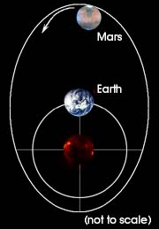
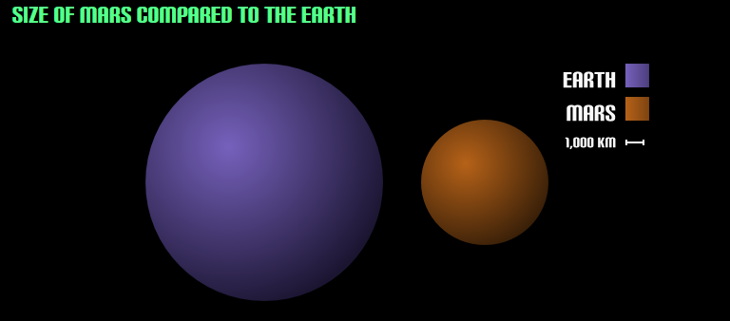
Mars
Mars is about ½ the size of Earth.
Has very extreme season due to a very elliptical orbit
Dust storms are the largest in the SS, they may last for months.
On Mars the Sun appears about ½ as large as it does from Earth.
Sunset on Mars – courtesy of NASA

Slide 12
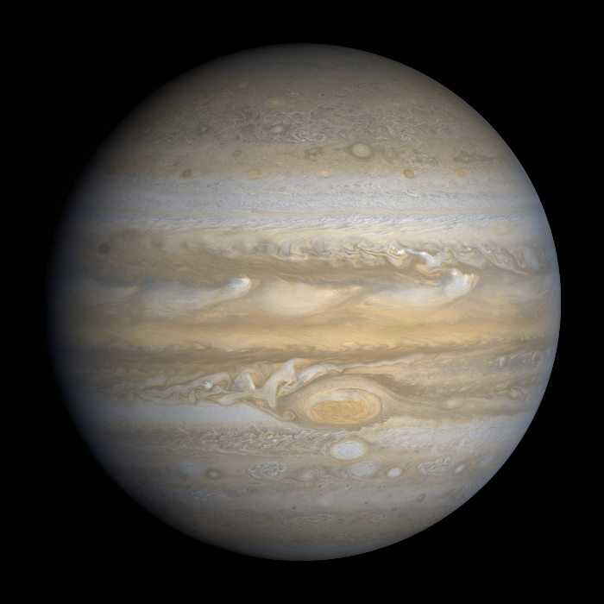
Jupiter
Composed primarily of gas and therefore is known as one of the Gas Giants.
Jupiter is the largest planet in out SS.
In a way Jupiter behaves like its own SS, with 63 known moons orbiting it and one of them (Ganymede) is larger than Mercury.
Jupiter exerts pull on the other planets in the SS.

Slide 13
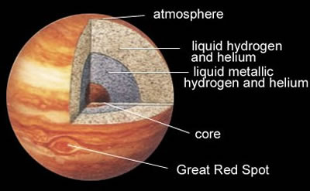
Jupiter
Atmosphere is primarily Hydrogen
Cloud belts are comprised of ammonia crystals and sulfur.
The surface is comprised of ice, liquid and metallic hydrogen, rock and other metals.

Slide 14
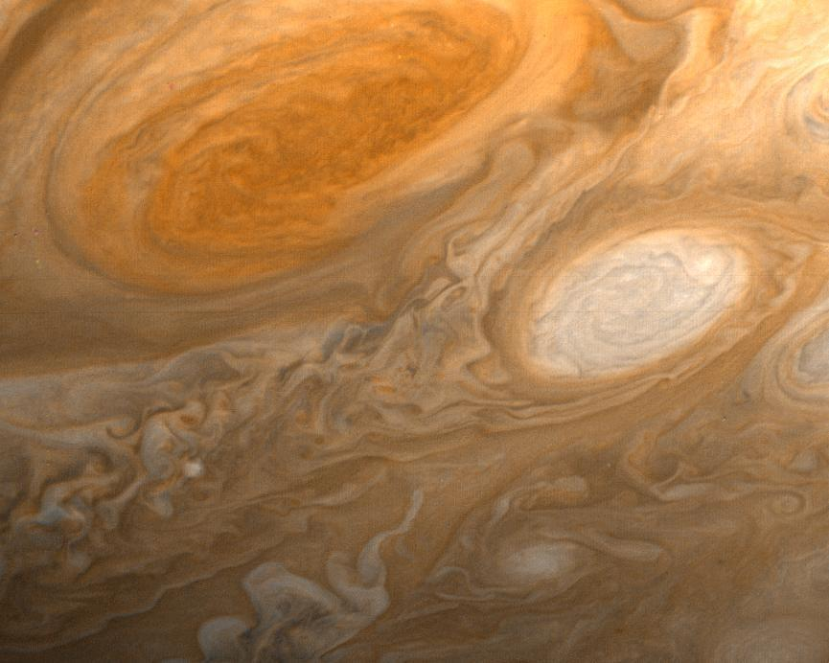
Jupiter – The Red Spot
The famous Red Spot is a high pressure system of gas/clouds, like a hurricane (which are around areas of low pressure).
The storm never stops because the gases never move over land. The storm is feed by Jupiter’s internal heat.
The spot is ever-changing and at times absorbs other nearby storms

Slide 15
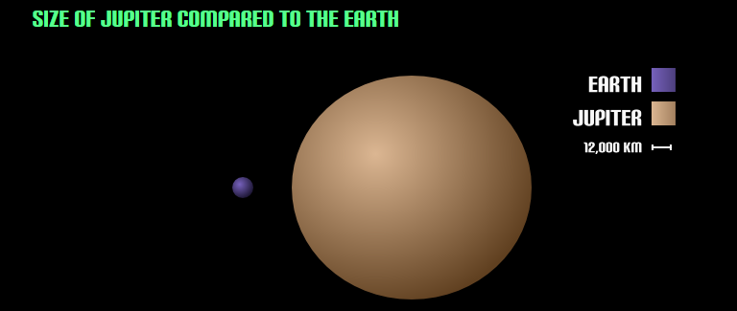
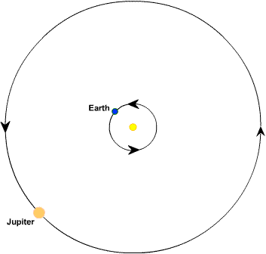
Jupiter
2 ½ times larger than more massive than all other planets combined.
Jupiter's diameter is 11.2 times that of Earth’s.
It would take 1,321 Earths to match Jupiter's volume.
Rotates once about every 10 hours.
This flattens the planet a little.
Revolves every 12 Earth years.

Slide 16
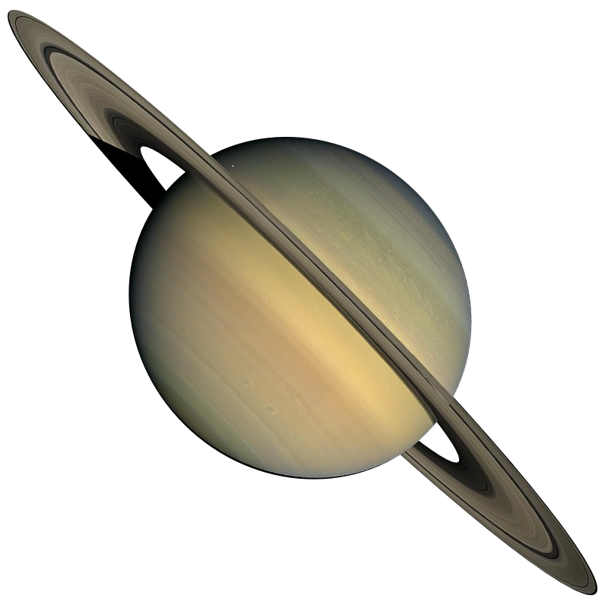
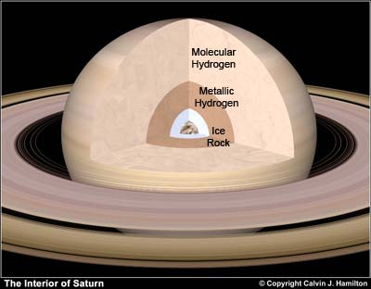
Saturn
Is made of mostly hydrogen gas. These layers of hydrogen get progressively denser as they get closer to the core of the planet.

Slide 17
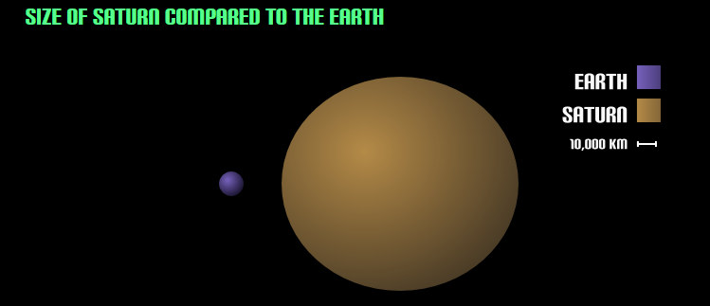
Saturn
Clouds are made of ammonia crystals and ice.
Saturn has 150 moons, of them Titan and Rhea are the largest.
Titan has a nitrogen-rich atmosphere. Its surface has frozen lakes of methane and landscapes with frozen nitrogen.
Contains the most extensive ring system in the SS.

Slide 18
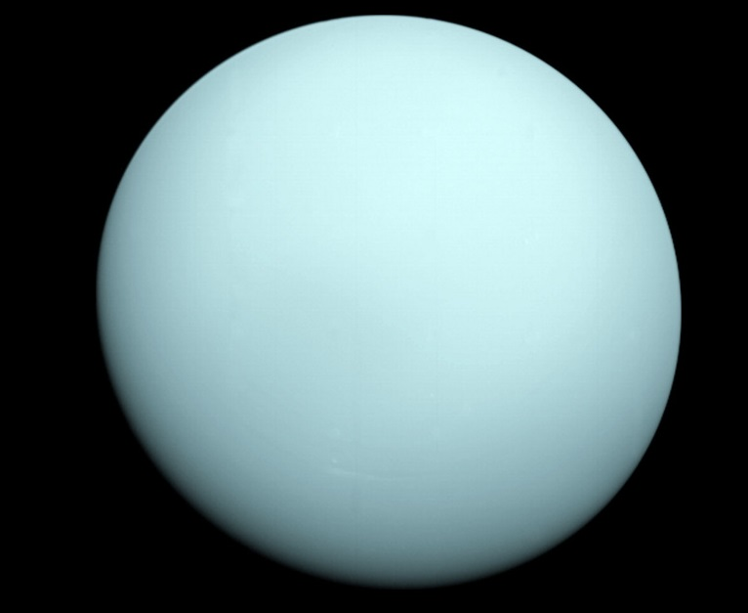
Uranus
Hits the coldest temperatures of any planet.
Even colder than Neptune, which is much farther away.
Not sure why.
Completes a rotation about every 17 hours.
Takes 84 years to complete 1 revolution.

Slide 19
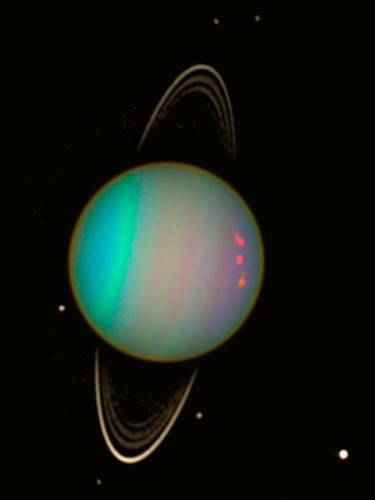
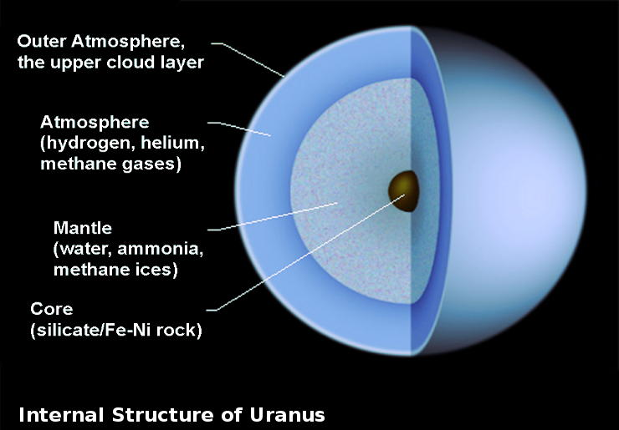
Uranus
Has the oddest tilt – the planet rotates on its side. IT has an orbital tilt of 98 degrees.

Slide 20
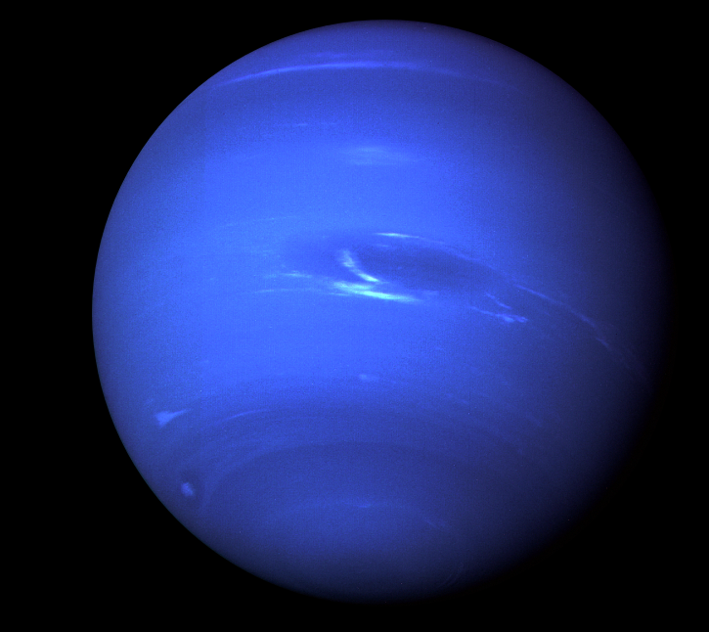
Neptune
Is very similar is structure to Uranus.
IS smaller than Uranus but has more mass.
Deep blue color due methane clouds in atmosphere absorbing red light and reflecting blue.
Was the only planets whose existance was inferred mathematically.

Slide 21
Neptune
Is very similar is structure to Uranus.
IS smaller than Uranus but has more mass.
Deep blue color due methane clouds in atmosphere absorbing red light and reflecting blue.
Was the only planets whose existance was inferred mathematically.

Slide 22
The Planets
There are Eight total planets in our Solar System.
The inner 4 planets are called the Terrestrial Planets.
This is because they all have a hard surface.
The outer 4 planets are called the Gas Giants
This is because these planets have enough mass/gravitational pull to hold onto lighter gases like hydrogen and helium.
Uranus and Neptune are also called the Ice Giants

Slide 23
Other Stuff in Our Solar System
We will discuss these next time:
Asteroids
Meteoroids / Meteors / Meteorites
Comets
Debris

