Slide 1
Earth Science Note
Atmosphere: Structure and Composition

Slide 2
Objectives
I can…
State the evidence for explanations about origins of Earth’s Atmosphere.
Describe the five layers of the atmosphere.
Give details about the ozone layer and the ionosphere.
Explain how temperature changes with altitude.
Explain how energy is transferred within the atmosphere.

Slide 3
How did the Atmosphere Form?
Early Atmosphere
Gases produced are thought to similar to those created by modern volcanoes
(H₂O, CO₂, SO₂, CO, S₂, Cl₂, N₂, H₂) and NH₃ (ammonia) and CH₄ (methane)
Thought to be no free O₂ at this time (not found in volcanic gases).
Ocean Formation - As the Earth cooled, H₂O produced by out gassing could exist as liquid in the Early Archean, allowing oceans to form.

Slide 4
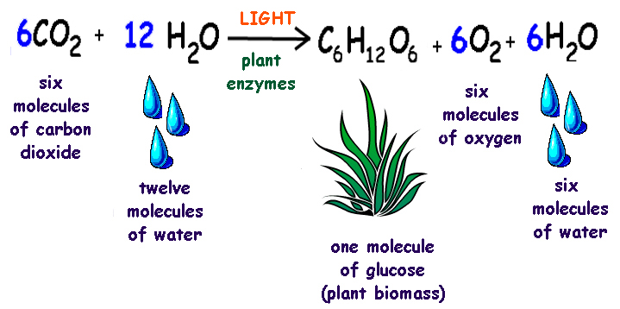
How did the Atmosphere Form?
Earth’s Evolving Atmosphere
Oxygen Production
Photochemical dissociation - breakup of water molecules by ultraviolet light
At these levels O₃ (Ozone) can form to shield Earth surface from UV
Photosynthesis – early bacteria, plants produced oxygen
CO₂+ H₂O + sunlight = organic compounds + O₂ - produced by cyanobacteria, and eventually higher plants - supplied the rest of O₂ to atmosphere. Thus plant populations grew
2 H₂O + uv radiation = 2 H₂ + O₂
and
2 O₂ + uv radiation = O₃ + O
and
O + O₂ = O₃

Slide 5
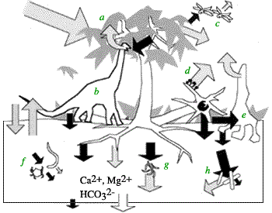
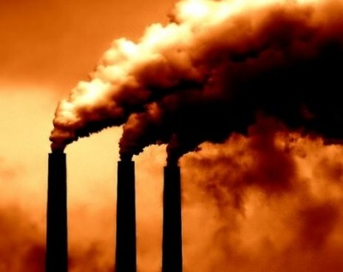
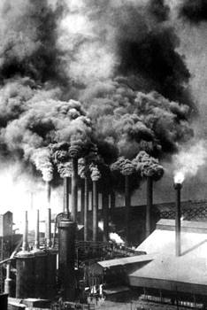
How did the Atmosphere Form?
Earth’s Evolving Atmosphere
Oxygen Consumers
Chemical Weathering - through oxidation of surface materials (early consumer).
Animal Respiration (much later) → CO₂
Burning of Fossil Fuels (much, much later) → CO₂ and CO

Slide 6
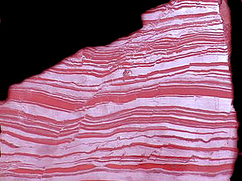
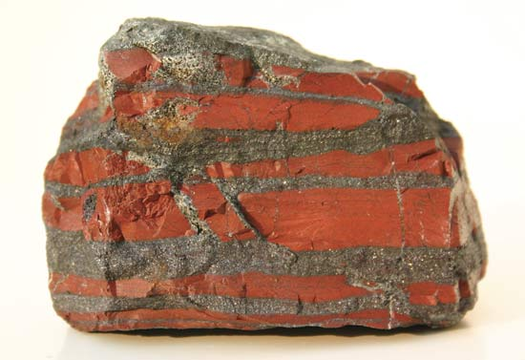
How did the Atmosphere Form?
Evidence from the Rock Record of increasing Oxygen in Atmosphere
Banded Iron Formations – these are deep water deposits in which layers of iron-rich minerals alternate with iron-poor layers, like the sample (right).
Reason for the alternating bands is believed to be due to fluctuation of oxygen in the atmosphere. With there be a lot of photosynthetic cyanobacteria, oxygen levels rose and fell with the populations of cyanobacteria.
This feature is common in rocks dated between 2.0 - 2.8 B.Y. old.

Slide 7
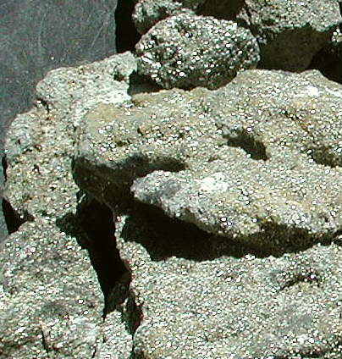
How did the Atmosphere Form?
Evidence from the Rock Record of increasing Oxygen in Atmosphere
Minerals that only form in non-oxidizing environments: Pyrite (Fools gold; FeS₂), Uraninite (UO₂). These were found below banded Iron.
These minerals are easily dissolved out of rocks under present atmospheric conditions and have therefore must have formed in an oxygen-poor atmosphere.
FeS₂ + O₂ → FeO + S
Notice: O₂ knocks S out of the Iron compound

Slide 8
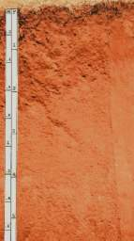
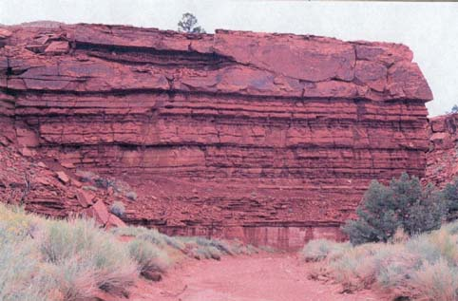
How did the Atmosphere Form?
Evidence from the Rock Record of increasing Oxygen in atmosphere
Red Beds - Formations are red because of the highly oxidized mineral hematite (Fe₂O₃), that probably forms in an oxygen-rich atmosphere. These are found above banded iron formations.
This evidence leads scientists to the conclusion that Early Earth’s atmosphere was oxygen-poor and over time became oxygen-rich.

Slide 9
How did the Atmosphere Form?
Biological Evidence
Chemical building blocks of life could not have formed in the presence of atmospheric oxygen.
Chemical reactions that yield amino acids are inhibited by presence of very small amounts of oxygen.
Oxygen prevents growth of the most primitive living bacteria such as photosynthetic bacteria, methane-producing bacteria and bacteria that derive energy from fermentation.
Conclusion - Since today's most primitive life forms are anaerobic, the first forms of cellular life probably had similar metabolisms.
Today these anaerobic life forms are restricted to low oxygen habitats such as swamps, ponds, and lagoons.

Slide 10
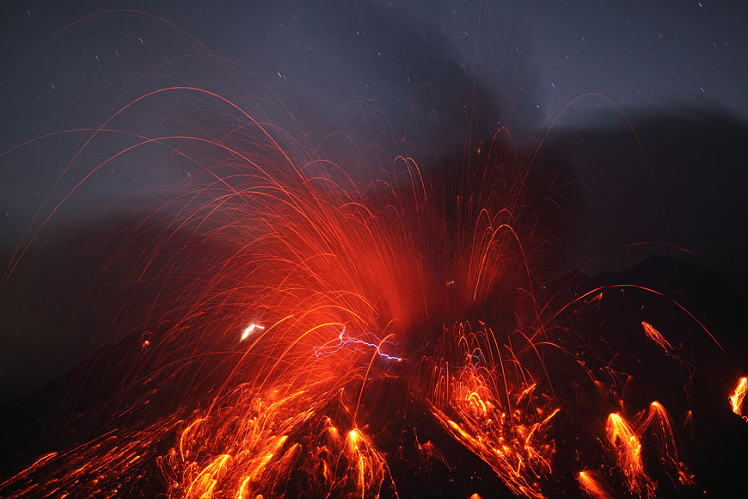
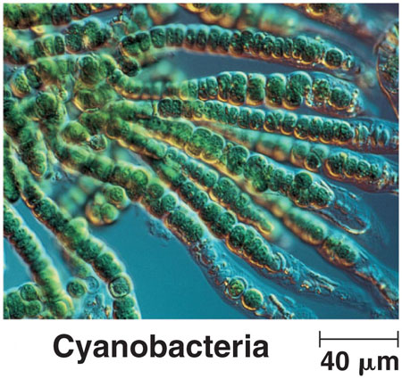
How did the Atmosphere Form?
In a nutshell: Thought to be produced from:
Early volcanoes – releasing carbon dioxide and nitrogen
Early organisms – releasing oxygen

Slide 11
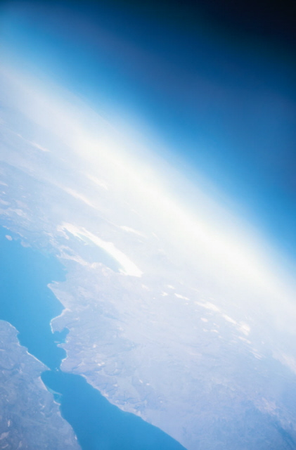
Atmospheric Composition
The current atmosphere has become a thin layer of gas that protects life form harmful solar radiation.
The atmosphere is mostly gases
78% nitrogen
21% oxygen
1% trace elements
Dust, salt, pollen, and water

Slide 12
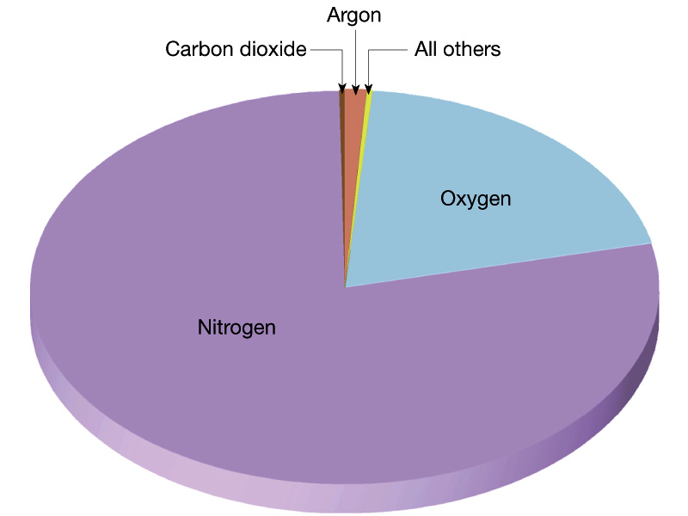
Atmospheric Composition

Slide 13
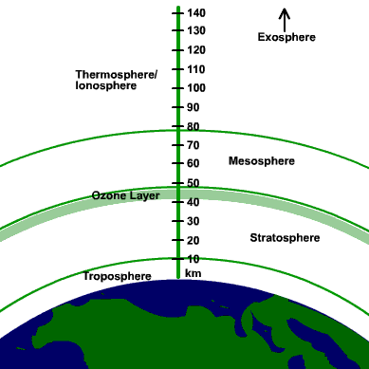
Atmospheric Structure
The atmosphere has five main layers; each with very specific characteristics.
The Layers
Troposphere
Stratosphere
Mesosphere
Thermosphere
Exosphere

Slide 14
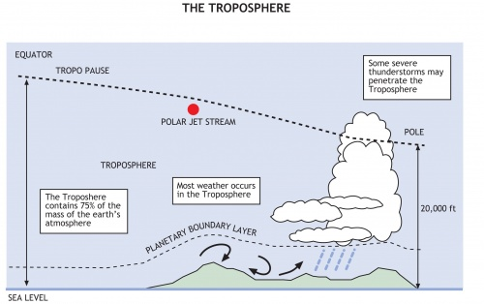
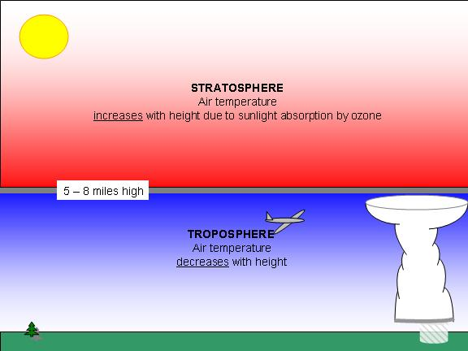
Atmospheric Structure
The Troposphere
From the ground to 10 km (about 6 ¼ miles)
Where air particles are the closest together
Where air pressure is at its greatest.
Where we live and where the weather occurs.

Slide 15
Atmospheric Structure
The Stratosphere
Above Troposphere, where the are continues to thin
99.9% of all the Earth’s air mass is in the first two layers of the atmosphere
Contains THE OZONE LAYER (remember this).
(see next slide)
Air temperature actually begins to increase with altitude (unlike the troposphere), The ozone in this layer actually absorbs the solar radiation and “holds the heat.”

Slide 16
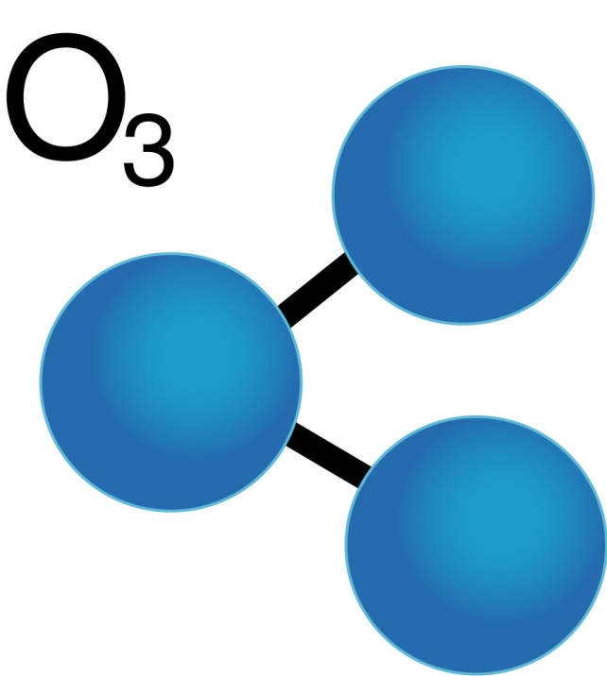
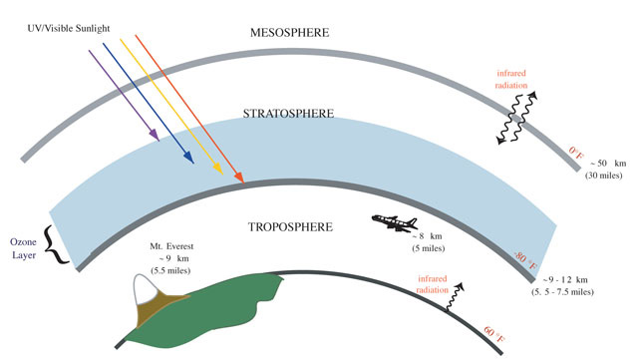
Atmospheric Structure
The OZONE LAYER
Made up of oxygen molecules consisting of 3 atoms.
Shields life from harmful UV rays of the sun.
There are about 3 ozone molecules for every 10 million air molecules (N₂, O₂, etc.).

Slide 17
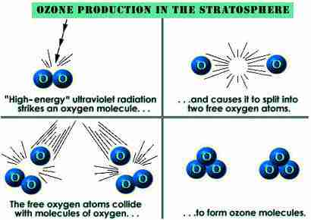
The OZONE LAYER

Slide 18
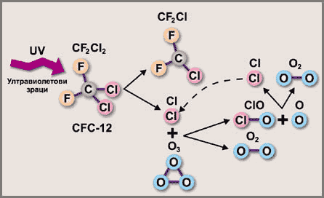
The OZONE LAYER
Ozone layer is destroyed by CFC
CFC are chlorofluorocarbons
Be able to explain diagrams

Slide 19
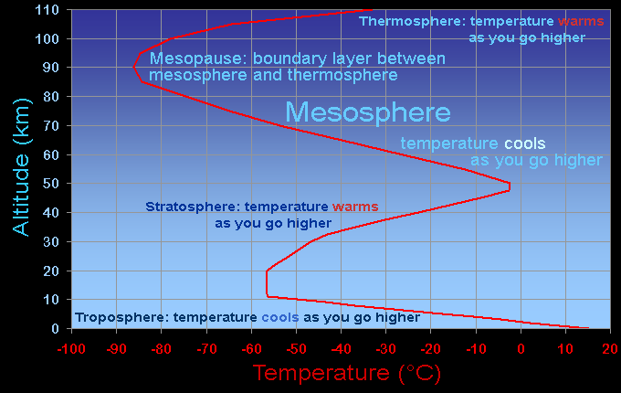
Atmospheric Structure
The Mesosphere
(the middle child)
This is the middle layer of the atmosphere.
Temperature begins to drop again. This is because there air particles are so few, there are not to absorb energy from the sun

Slide 20
Atmospheric Structure
The Thermosphere
Perhaps the thickset layer of Earth’s atmosphere.
Approx. 100 to 500 km
Temperatures here get very hot because…
This layer receives A LOT of solar radiation, with little above it
Air density is so low, high solar radiation means few particles can absorb more energy (have more KE).
Contains the IONOSPHERE
(See next slide)

Slide 21
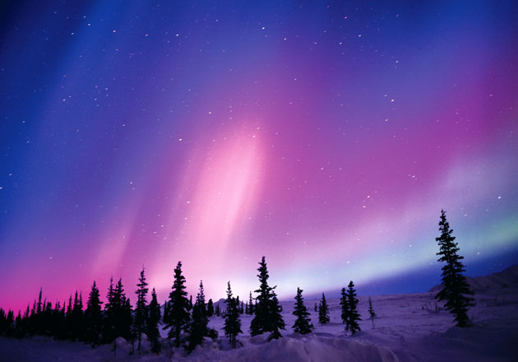
Atmospheric Structure
The IONOSPHERE
Layer of charged atoms (ionospheric plasma)
Atoms ionize due to the extremely high temperatures of the thermosphere.
Interacts with free protons and electrons from space that interact with the ionosphere to give us the aurora borealis.

Slide 22
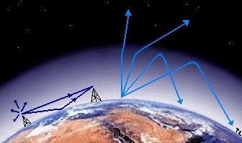
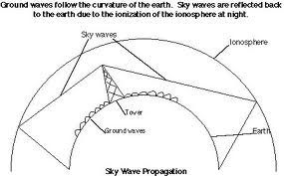
Atmospheric Structure
The IONOSPHERE
The ionosphere plays an important role in radio wave propagation.
The free electrons in this layer cause radio waves to reflect and refract.
This allows us to send a signal to some one that is blocked by the curve of the Earth.

Slide 23
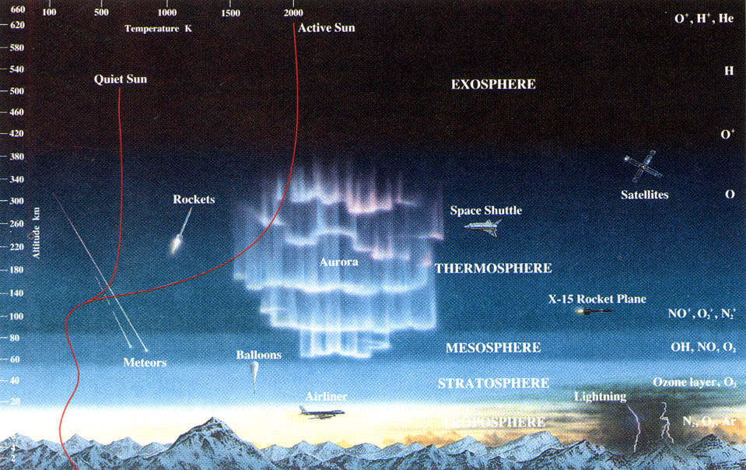
Atmospheric Structure
The Exosphere
The outermost layer of the atmosphere.
Gradually transitions into space, Virtually no particles

Slide 24
Summary of Temperature Change Across Atmospheric Layers
First you must understand what temperature is.
It is the Average Kinetic Energy of Particles. Not how warm something feels.
What can affect the temperature of air?
Solar Radiation (SR) → Energy is conserved so the increase is SR = an increase in KE = and increase in Temperature.

Slide 25
Summary of Temperature Change Across Atmospheric Layers
What can affect the temperature of air?
Density of Air → denser air can absorb more energy. More particles = more energy absorbed = increased temperature.
Ozone molecules in the stratosphere are larger than other air molecules (i.e. N₂, O₂) and they are more concentrated, therefore they can absorb a lot of energy and consequently cause the increase in temperature of air.
The mesosphere has very low temperatures because of the lack of gas particle in that layer.

Slide 26
Summary of Temperature Change Across Atmospheric Layers
Going from the ground UP:
Troposphere → warmer at the surface because its closest to the ground which is radiating heat back to the air.
Stratosphere → ozone is concentrated in this layer and absorbs UV light from the sun. More light is absorbed at higher altitudes, so its warmer as you move higher in this layer.

Slide 27
Summary of Temperature Change Across Atmospheric Layers
Going from the ground UP:
Mesosphere → temperature decreases with height because there is no ozone and few other particles, and it is not receiving radiation from the surface of Earth.
Thermosphere → temperature increases with height. This is due to the presence of some particles that absorb a lot of radiation.
Exosphere → temperatures are dependent on sunlight. This layer is nearly a vacuum.

Slide 28
Energy Transfer in the Atmosphere
Energy originating from the sun travels through space by means of radiation.
Radiation = transfer of energy by waves
Once that energy hits Earth’s atmosphere the radiation is absorbed by molecules and atoms in the atmosphere.

Slide 30
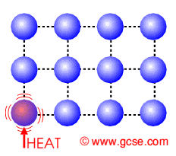
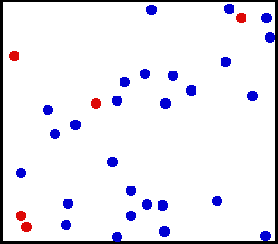
Energy Transfer in the Atmosphere
These molecules that absorb radiation become agitated and vibrate more (i.e. get hotter). These molecules begin to transfer energy to other molecules by bumping into them.
This is conduction, the transfer of energy through contact.

Slide 31
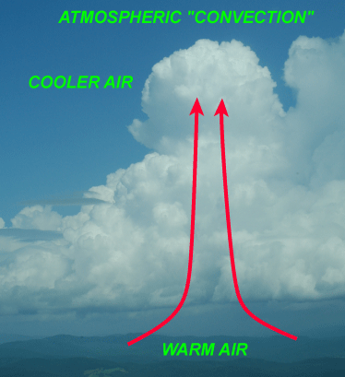
Energy Transfer in the Atmosphere
As portions of the atmosphere become warmer than others, the warmer air rises and carries with the energy. This is called Convection.
Convection = transfer of energy by moving particles

Slide 32
Assessment
Can I…
State the evidence for explanations about origins of Earth’s Atmosphere.
Describe the five layers of the atmosphere.
Give details about the ozone layer and the ionosphere.
Explain how temperature changes with altitude.
Explain how energy is transferred within the atmosphere.

