Slide 1
Earth Science Notes
Weather

Slide 2
Objectives
I can…
Explain the relationship between atmosphere and weather.
Explain how wind is formed.
Describe the factors that affect the weather.
pressure, precipitation, humidity, etc.

Slide 3
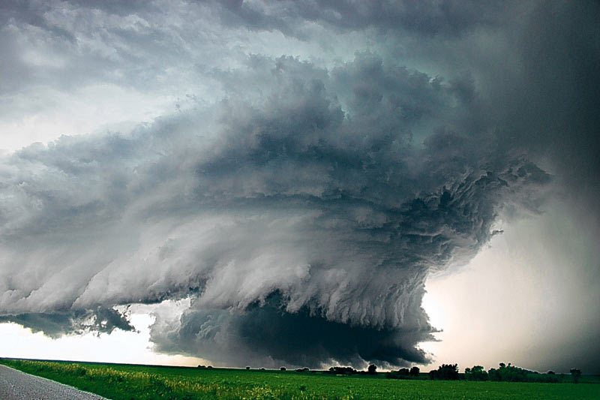
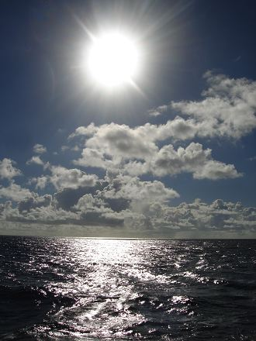
Atmosphere and the Weather
Weather – refers to the state of the atmosphere at a specific place and time
What is it like outside at this time?

Slide 4
Information in a Weather Forecast
Cloudy with Snow
2°F / -17°C
Barometric Pressure : 30.38 in (1030.2 mb)
Wind Speed: Calm
Relative Humidity: 91%
Dew point 0°F
Visibility 6.00 mi

Slide 5
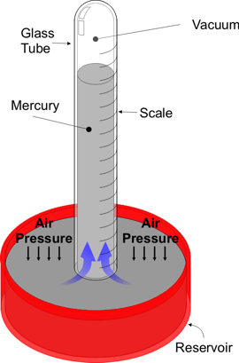
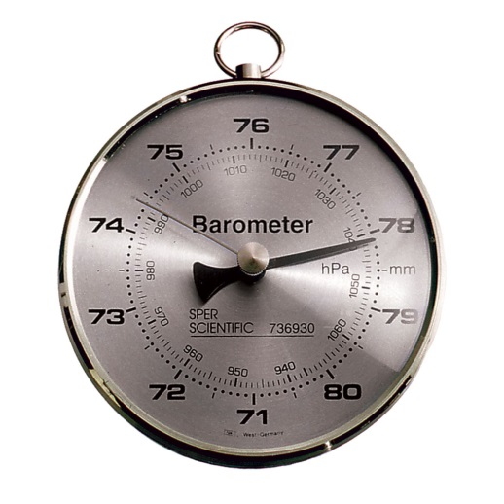
Atmosphere and the Weather
Atmospheric Pressure: Force created by mass of air (also called barometric pressure)
Tool for measurement – barometer
Units of measurement – mmHg, atm, Pascals
Air pressure decreases the farther you get from the earth

Slide 6
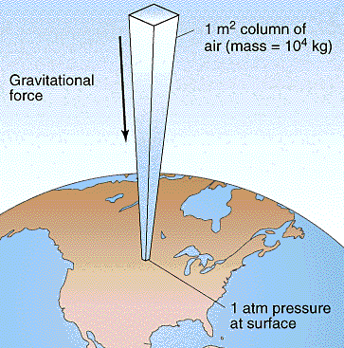
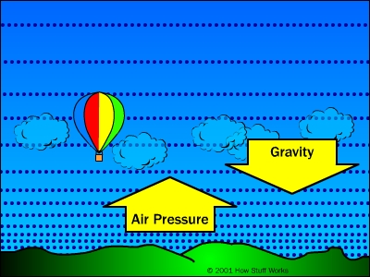
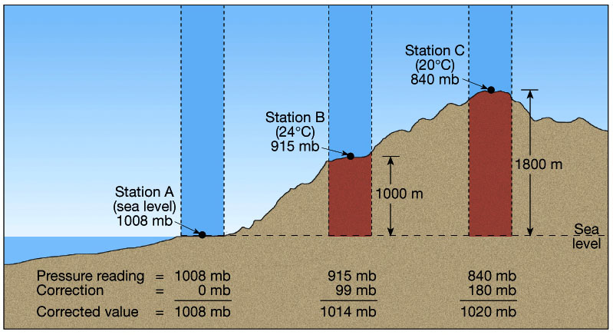
Atmospheric Pressure

Slide 7
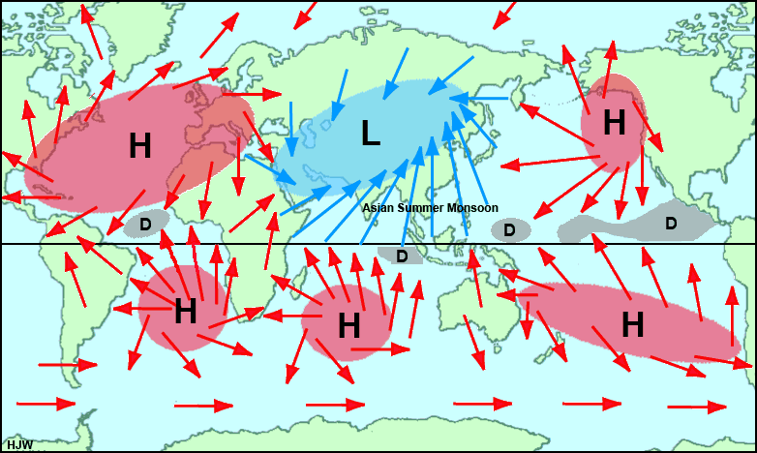
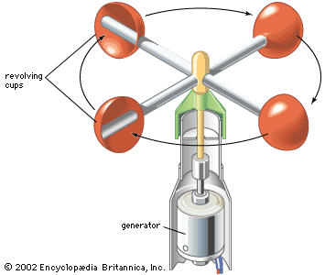
Atmosphere and the Weather
Wind – wind moves from areas of high pressure to areas of low pressure
Anemometer – measures wind speed

Slide 8
Atmosphere and the Weather
How does wind form?
Uneven heating of the Earth
What causes uneven heating?
Different amounts of sunlight from the sun
This is due to the curvature of the Earth
Density of the air
Denser air falls

Slide 9
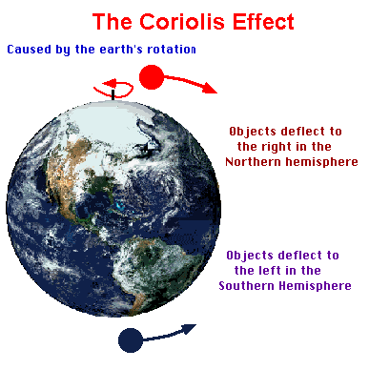
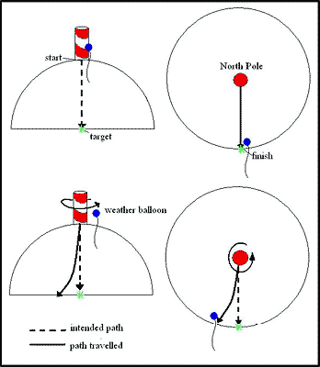
Atmosphere and the Weather
The Coriolis Effect: movement of air due to the rotation of the Earth

Slide 10
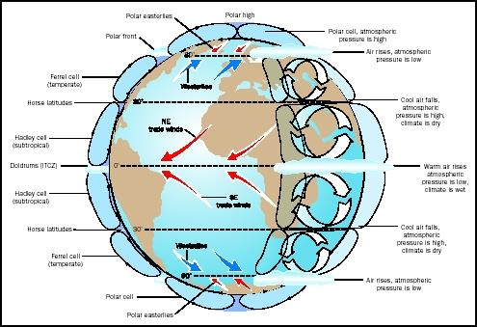
Atmosphere and Wind

Slide 11
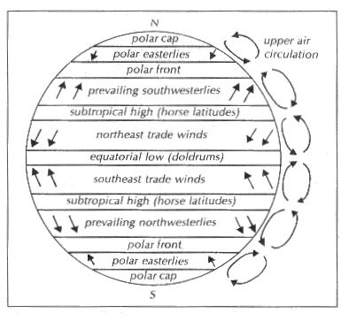
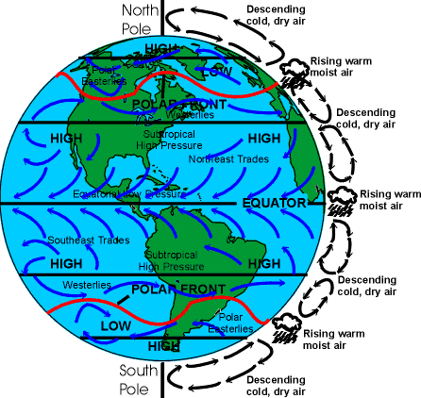
Atmosphere and Wind

Slide 12
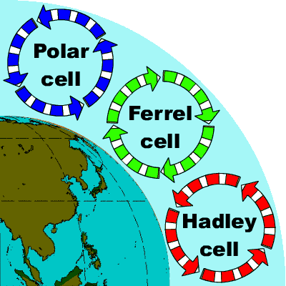
It is believed the cell is a forced phenomena, induced by interaction between the other two cells. The stronger downward vertical motion and surface convergence at 30°N coupled with surface convergence and net upward vertical motion at 60°N induces the circulation of the Ferrel cell. This net circulation pattern is greatly upset by the exchange of polar air moving southward and tropical air moving northward. This best explains why the mid-latitudes experience the widest range of weather types.

Slide 13
Atmosphere and the Weather
Global Winds to Remember:
Polar easterlies
Dense air sinks moves away from poles
Westerlies
Occurs around 30° latitude, what we experience
Trade winds
Less dense air moves toward to poles, then sinks as it cools. The Coriolis effect deflects the wind to the west.
Equatorial doldrums
Hot air with very low density creates low pressure
Air is very still (doldrums = a fit of sloth and dullness)

Slide 14
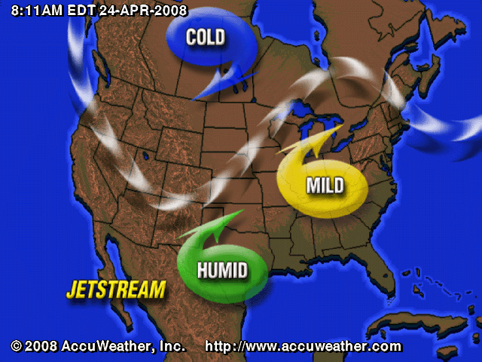
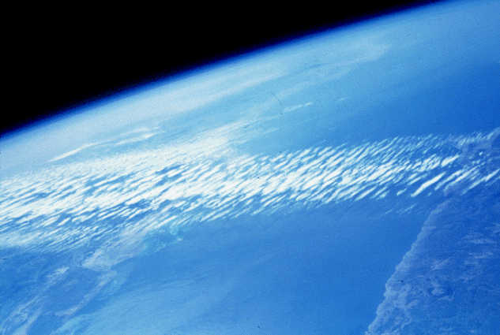
Atmosphere and the Weather
The jet stream: belt of wind found in the upper troposphere

Slide 15
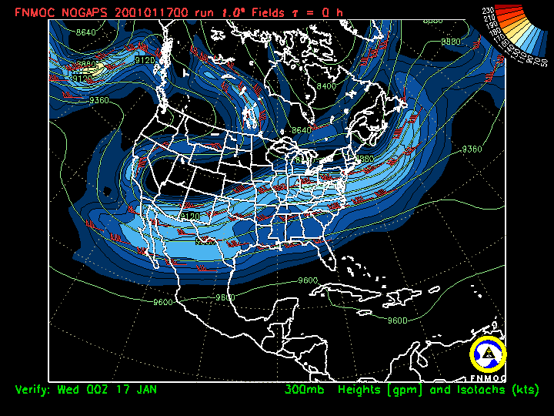

Slide 16
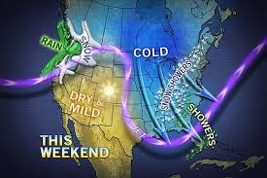
Atmosphere and the Weather
Our severe cold is due to the Jet Stream pulling cold arctic air down from the North.

Slide 17
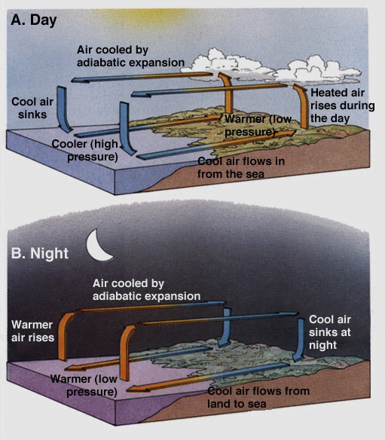
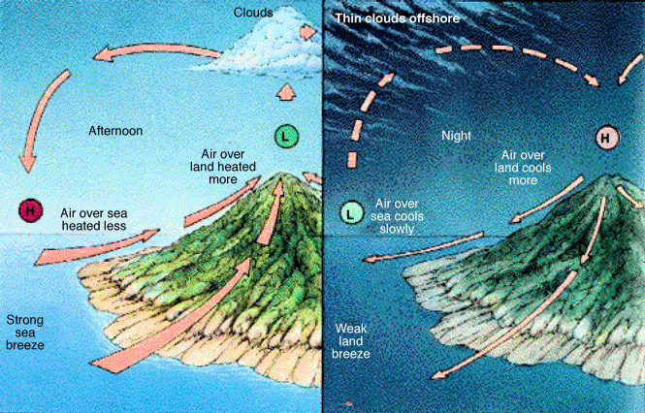
Atmosphere and the Weather
Land and Sea Breezes: changing temperature changes density → creates wind

Slide 18
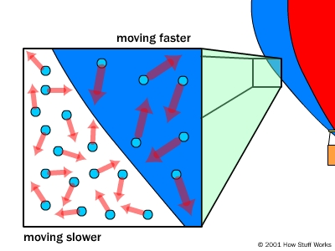
Atmosphere and the Weather
Air temperature – high temps = fast moving air molecules, molecules are farther apart (air is less dense).

Slide 19
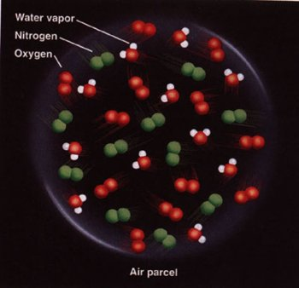
Atmosphere and the Weather
Humidity – amount of water vapor in the air
Warm air can hold more vapor
When humid air cools vapor condenses into water (condensation)

Slide 20
Atmosphere and the Weather
Relative humidity – the measure of the amount of water vapor present in the air compared with the amount needed for condensation to take place at a given temperature
50 % humidity = air contains 50% of water vapor needed for it to rain.
Dew point – temperature at which condensation forms

Slide 21
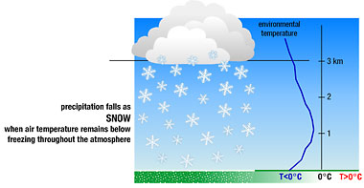
Atmosphere and the Weather
Precipitation
Rain – forms from condensing water vapor in warm air
Snow – forms from condensing water vapor at low temperature

Slide 22
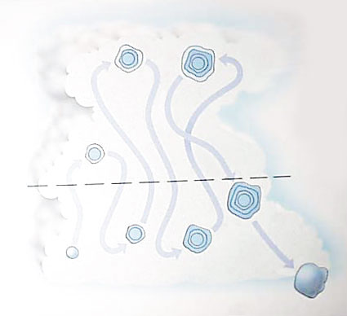
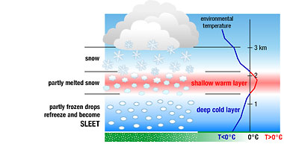
Atmosphere and the Weather
Precipitation (cont.)
Sleet – forms from rain freezing as it reaches the ground.
Hail – pellets of ice formed in clouds, warm updrafts send partially melted ice back into the cloud were they refreeze.

Slide 23
Assessment
Can I…
Explain the relationship between atmosphere and weather.
Explain how wind is formed.
Describe the factors that affect the weather.
pressure, precipitation, humidity, etc.

