Slide 1
Earth Science Notes
Mass Movements

Slide 2
Mass Movement
Main Idea: Mass movements alter Earth’s surface over time due to gravity moving sediments and rocks downslope.
Definition: the movement of a large portion of Earth downslope under the influence of gravity.

Slide 3
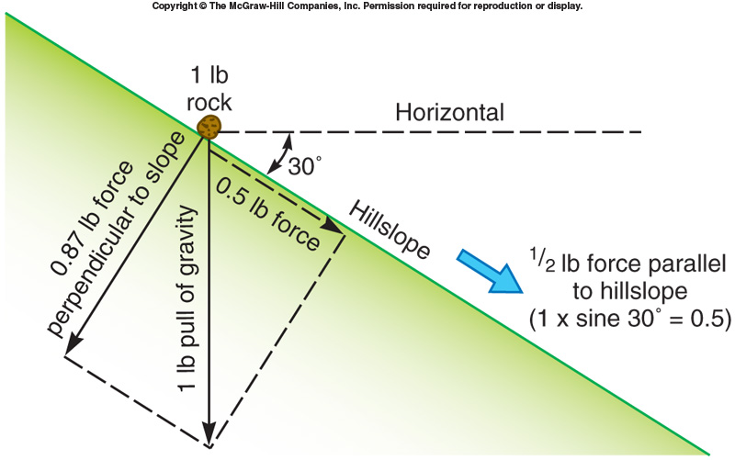
Mass Movement
Role of Gravity
Gravity causes the downward and outward movement of landslides and the collapse of subsiding ground.
Eventually it will flatten all slopes
The force of gravity is the mass of a body x the sine of the slope.
If can remove the initial resistance to motion the body will move.
Earthquake, heavy rain could give initial energy

Slide 4
Types of Mass Movement
Avalanches – form of landslide where large amounts of snow move down slope.
Caused when a layer of snow melts and then freezes. More snow accumulates on this surface. Finally a vibration, usually a sound, triggers the avalanche.
Tend to occur in early winter while ground is still warm.

Slide 5
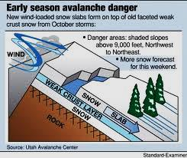
Types of Mass Movement

Slide 6
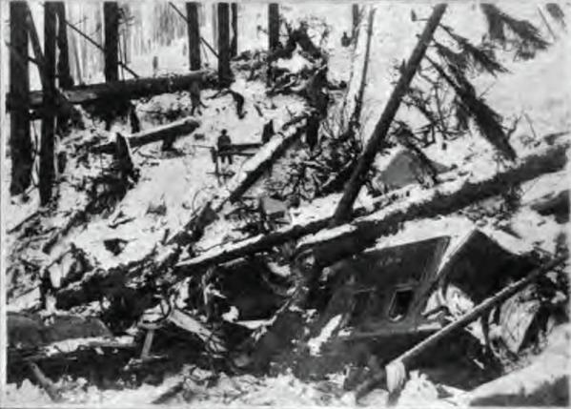
Damage Done By Avalanche

Slide 7
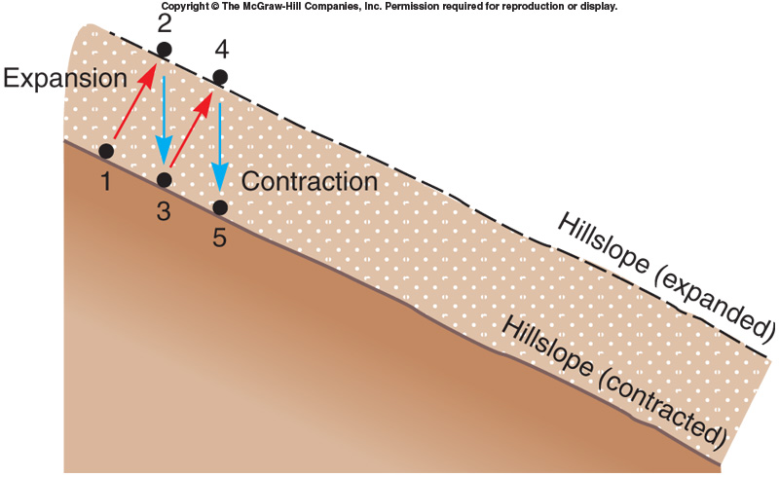
Types of Mass Movement
Creep – slow, steady downhill flow of loose soil or weathered rock.
Caused as a result of rising and falling water levels. Rising water levels lift soil at a right angle to the slope. When water levels drop the soil drops straight down in line with gravity.

Slide 8
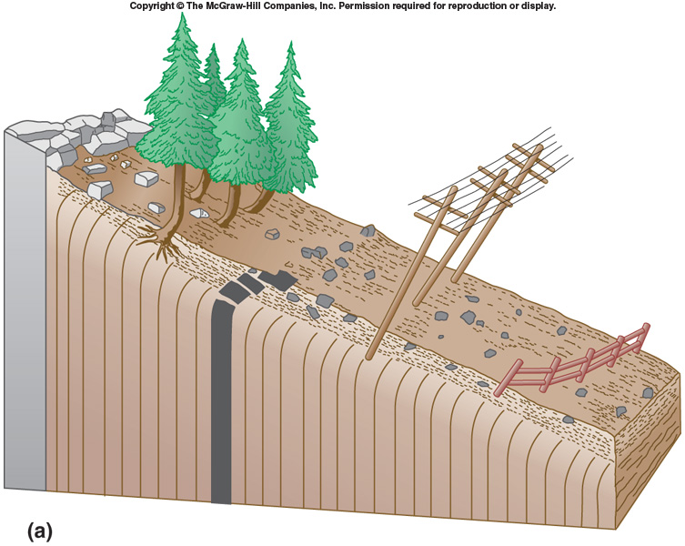
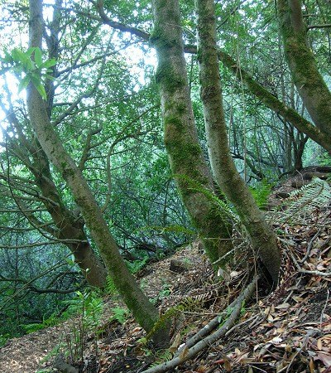
Creep

Slide 9
Types of Mass Movement
Landslide – a rapid, downslope movement of Earth materials that occurs when the soil or rock separates from the bedrock.
Common on steep slopes where the soil has become saturated.
Types of Landslide
Avalanches
Rocks slides

Slide 10
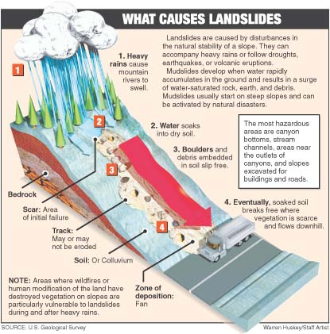
Types of Mass Movement

Slide 11
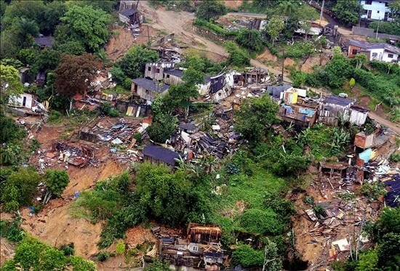
Damage Done by Landslides

Slide 12
Types of Mass Movement
Mudflows - fast moving mixtures of mud and water.
Triggered by seismic activity.
Common to volcanic regions where the soil is fine textured and can retain water well.
Heat from volcano melt snow on mountainside.

Slide 13
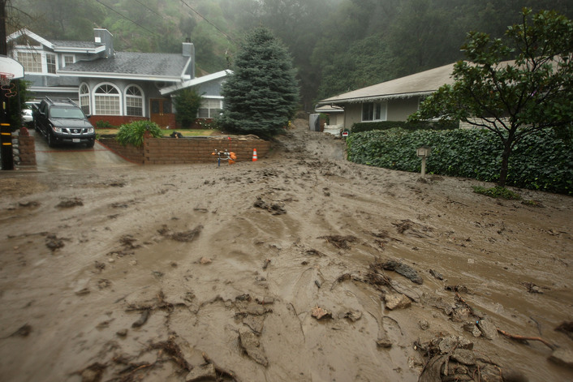
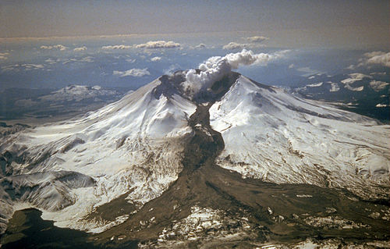
MUDFLOWS

Slide 14
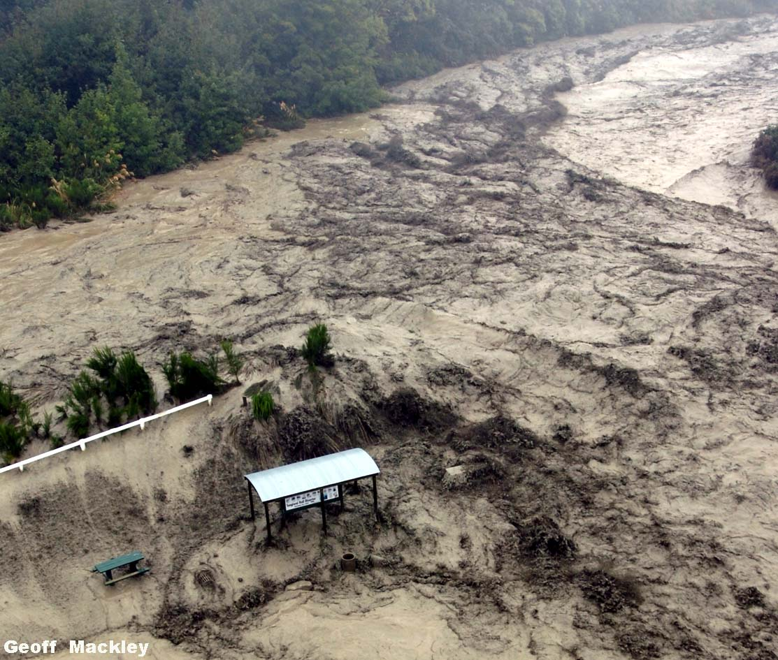
Lahar (Mudflow) Event – New Zealand

Slide 15
Types of Mass Movement
Rockslides – a type of landslide that consists of sheets of rock break loose from the underlying bedrock and move downslope.
During rockslides the rocks are often broken into smaller blocks and deposited at the bottom of a mountain
Often triggered by Earthquakes.

Slide 16
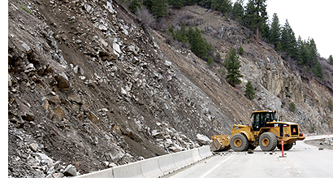
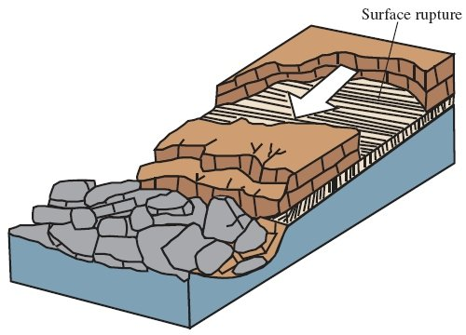
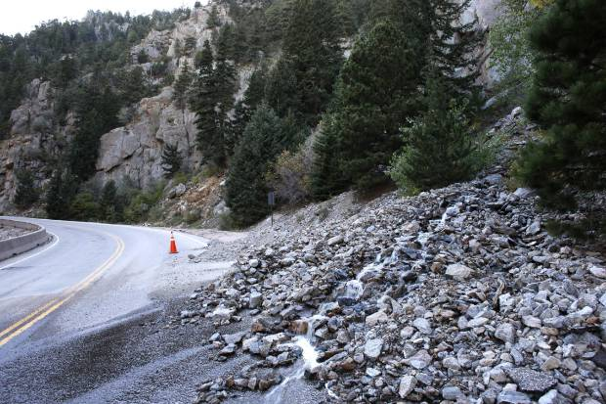
Rockslides

Slide 17
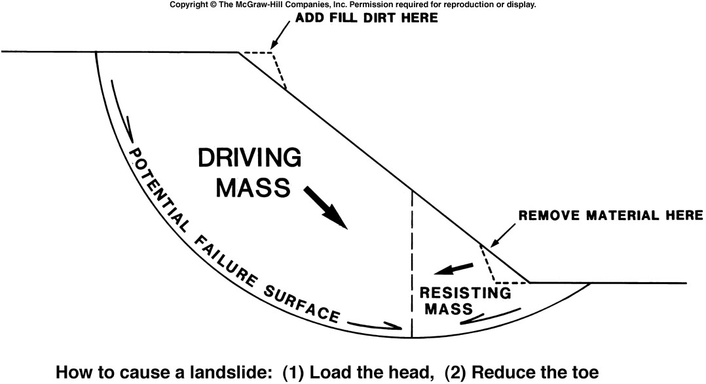
Types of Mass Movement
Slump – mass movement that is the result of soil or weather rocks moving downslope along a curved surface.
The bottom falls out of the land.
Happens where the soil is heavy and the slope is somewhat steep.
Often occurs after
a heavy rain.

Slide 18
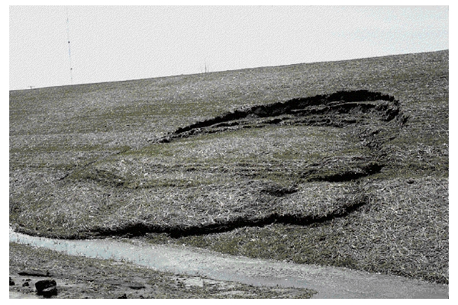
SLUMP

Slide 19
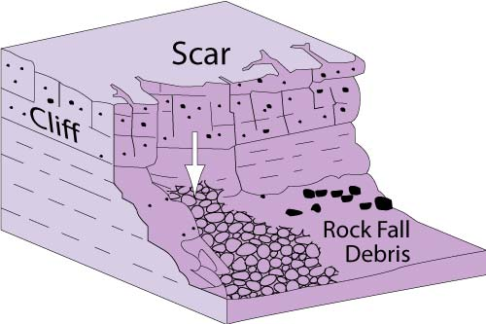
Types of Mass Movement
Rock falls – rocks are loosened by physical weathering and fall in a nearly vertical fashion.
Happens at high elevations
Produces a pile of debris at the foot of a slope called talus.

Slide 20
Rock falls

Slide 21
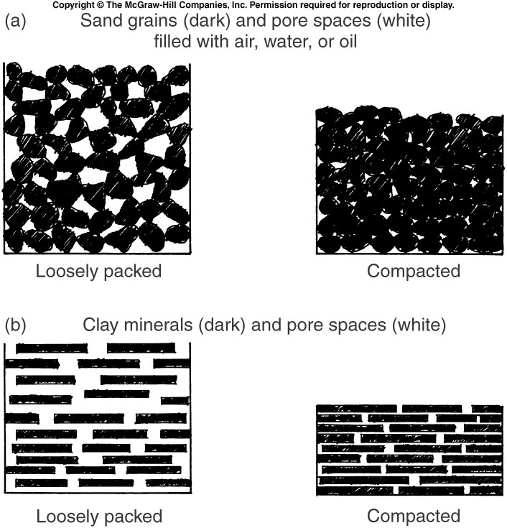
Types of Mass Movement
Subsidence - the contraction of land due to the loss of underlying soil, water, or even oil.
Occurs where soil is loosely packed or where there is limestone has been dissolved underground.

Slide 22
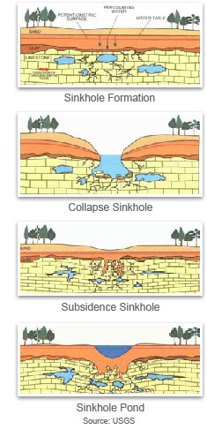
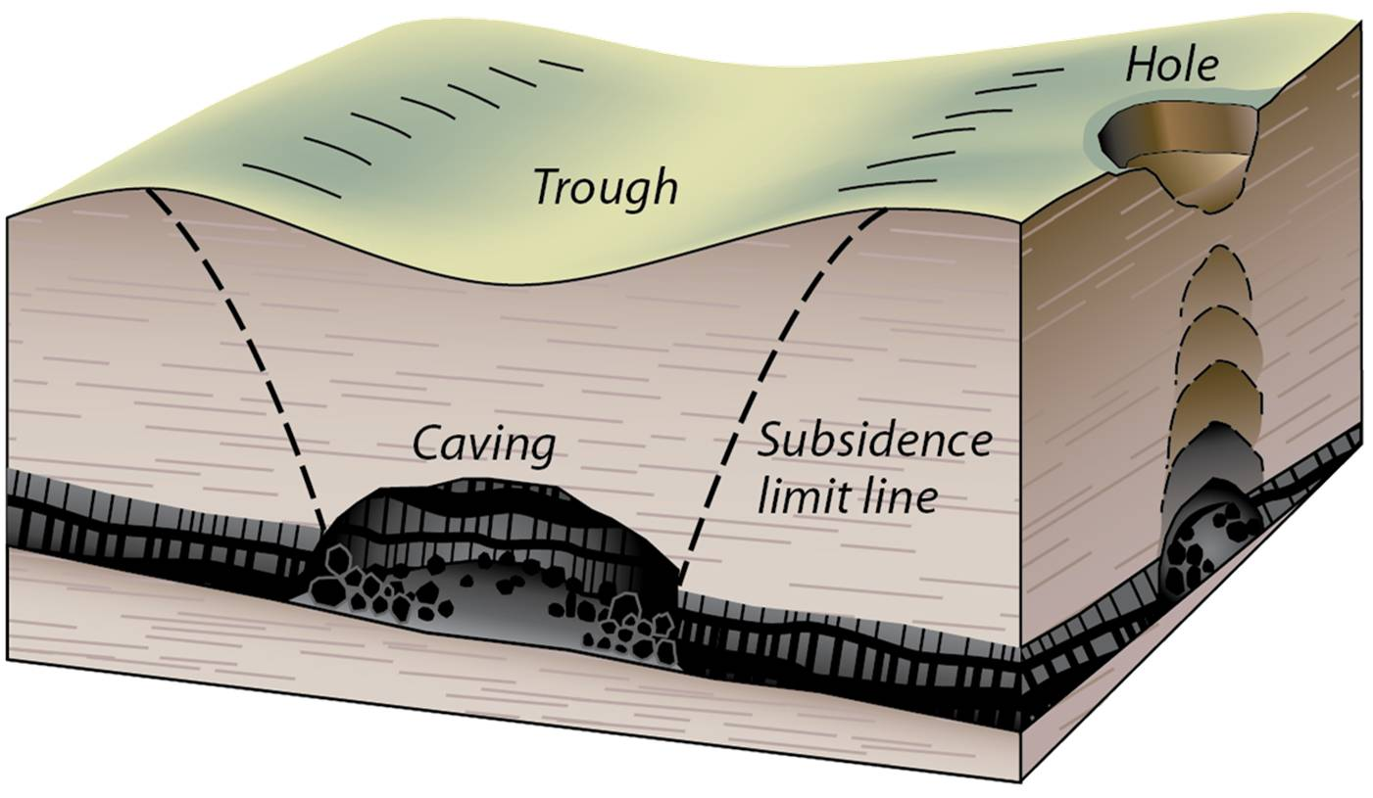
SINKHOLES
Subsidence in the extreme form are called sink holes.

Slide 23
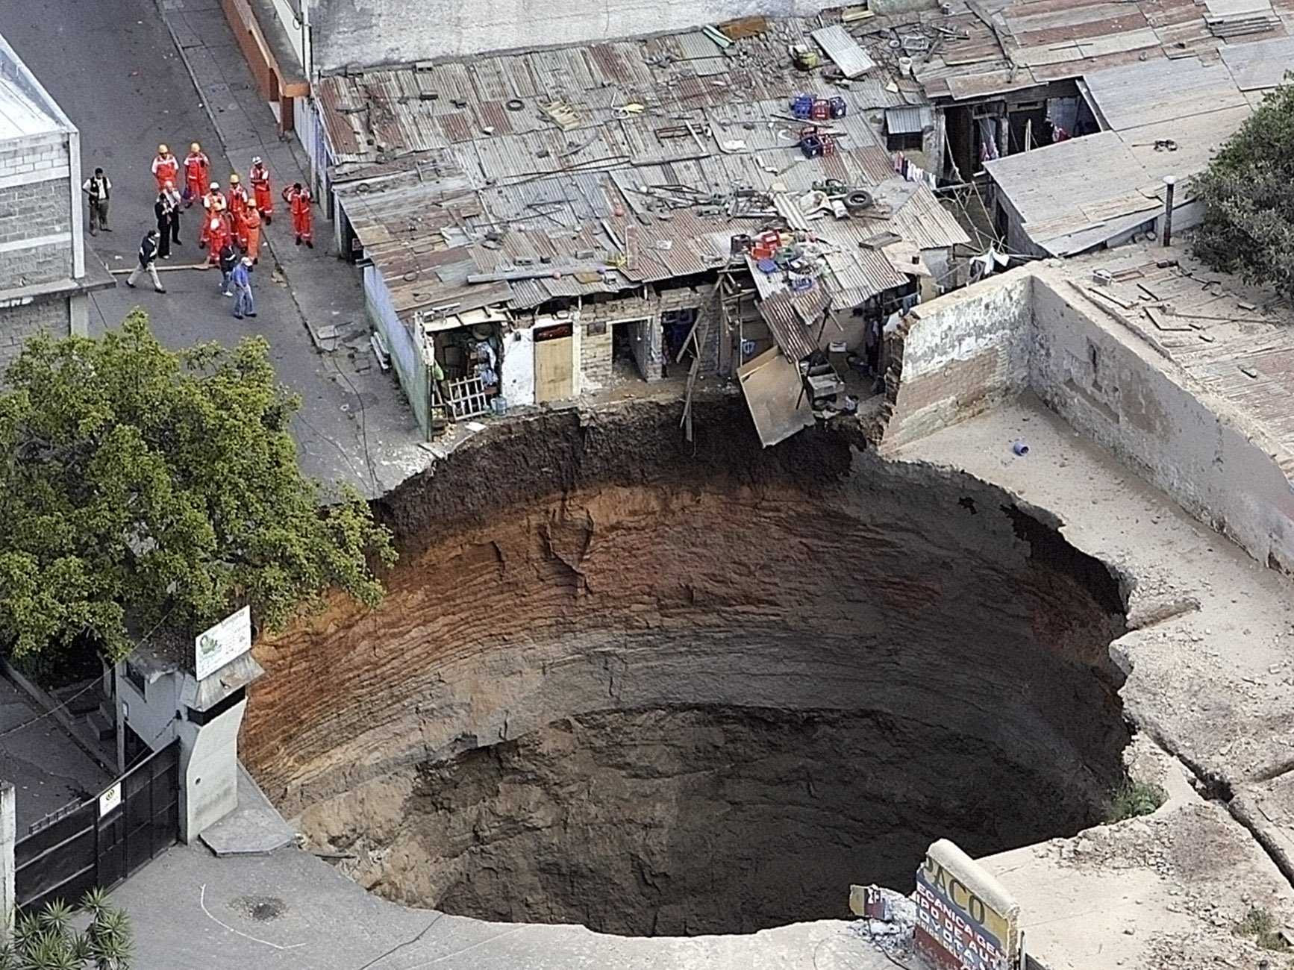
SINKHOLES

Slide 24
Summary
Can I…
Define mass movement and the give examples of different types.
Identify each form of mass movement from a diagram or picture.

