Slide 1
Earth Science Notes
Metamorphic Rocks

Slide 2
Objective
I can…
Define Metamorphic Rock.
Classify Metamorphic Rock.
Explain types of Metamorphism.
Describe grades of Metamorphism

Slide 3
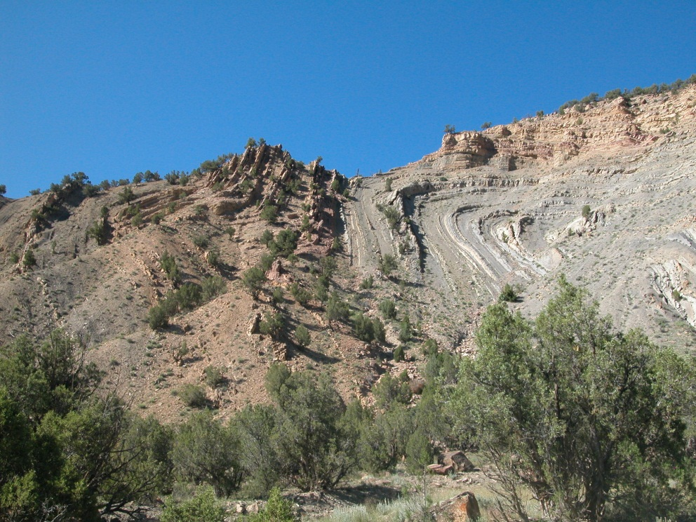
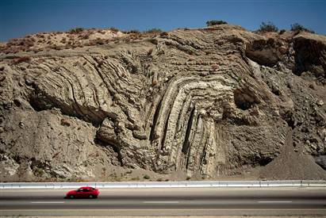
Metamorphic Rocks

Slide 4
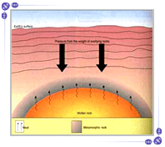
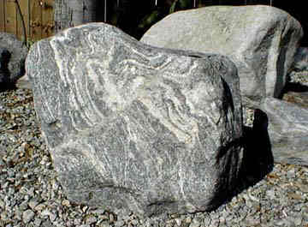
Metamorphic Rocks
Rocks that are created because of a change in pressure and temperature.

Slide 5
Metamorphic Rock Formation
Metamorphic rocks can form igneous, sedimentary, or other metamorphic rocks.
Pressure on these rocks can be due to the immense amount of force applied from the rock above it.
Temperature can come from a rock being in close proximately of magma.

Slide 6
Classification of Metamorphic Rock
Rocks are classified according to composition and texture.
Foliated rocks – formed when mineral grains line up in parallel layers.
Ex: Slate – used for blackboards, roofs, sidewalks

Slide 7
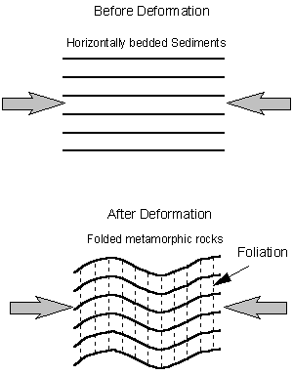
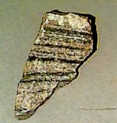
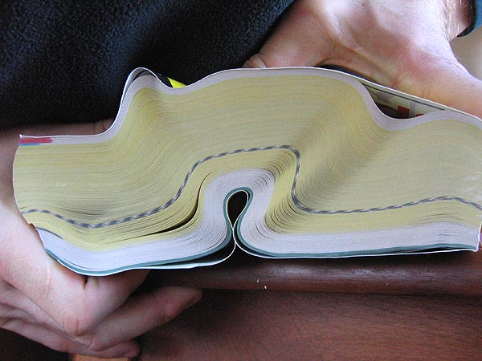
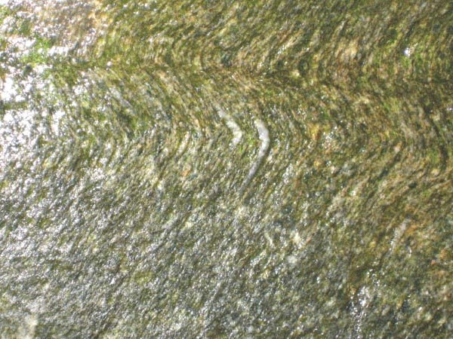
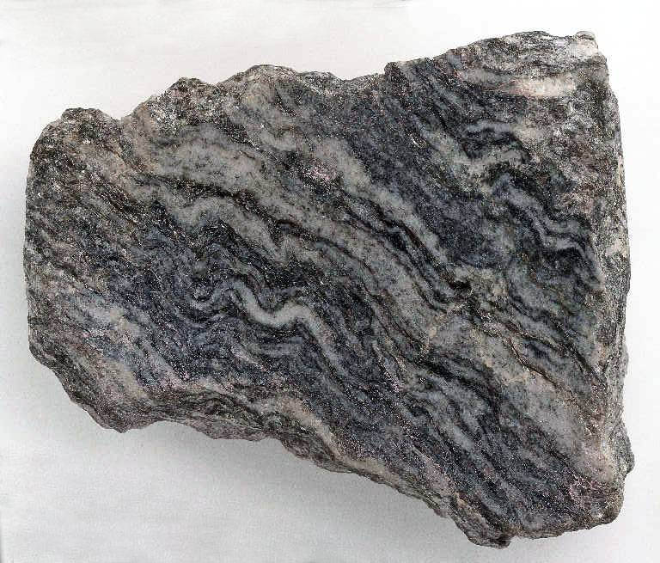
Foliated rocks

Slide 8
Classification of Metamorphic Rock
Rocks are classified according to composition and texture.
Nonfoliated rocks – metamorphic rocks where mineral grains (crystals) grow and rearrange, but they do not form layers.
Ex: Quartzite – formed from sandstone that was changed by immense heat and pressure. Quartz crystals grow in size and become interlocking.
Ex: Marble – marble forms when limestone is put under extreme pressure and temperature.

Slide 9
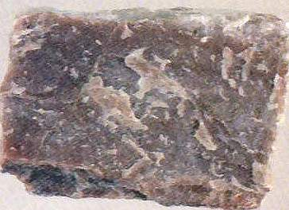
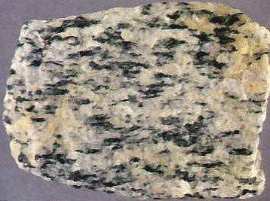
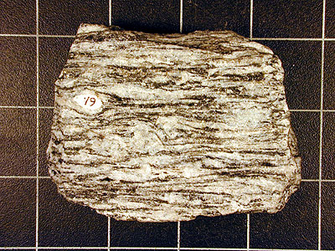
Nonfoliated rocks

Slide 10
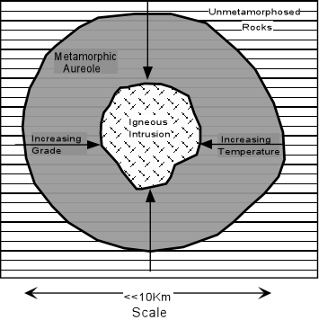
Metamorphic Rocks
Types of Metamorphism
Contact metamorphism – occurs adjacent to igneous intrusions and results from high temperatures associated with the igneous intrusion.

Slide 11
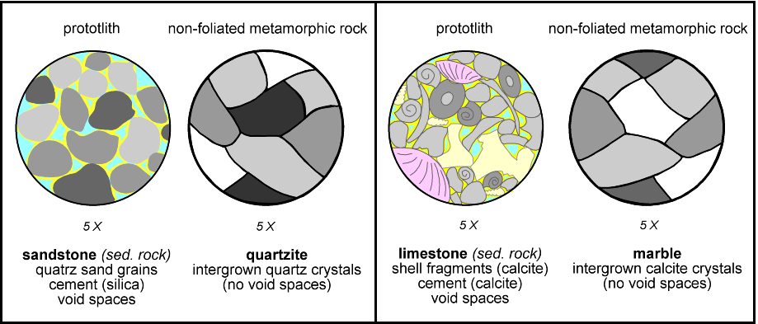
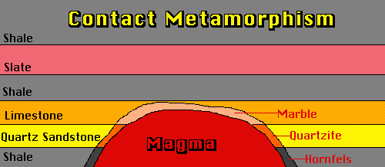
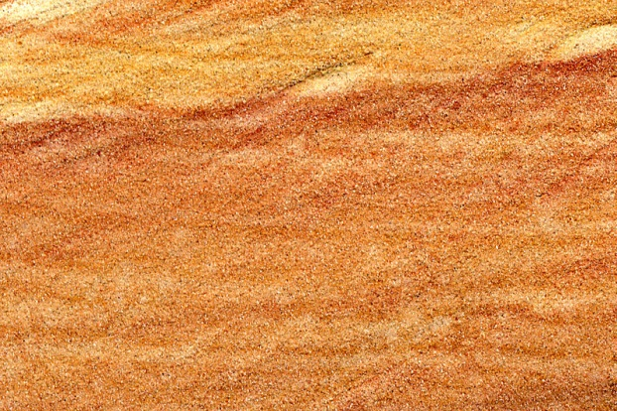
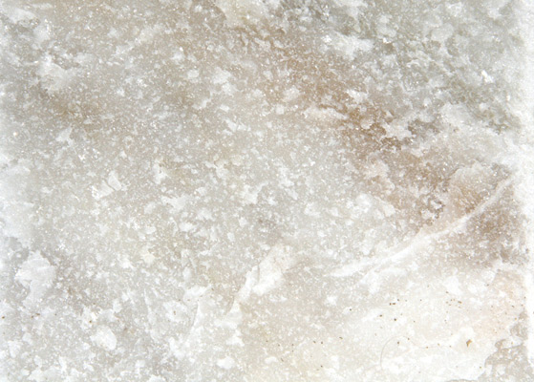
Contact Metamorphism

Slide 12
Metamorphic Rocks
Types of Metamorphism
Regional Metamorphism – occurs under conditions of HIGH temperature and HIGH pressure.
Produced from forces of tectonic plate contact
Same forces that produce mountains, cause Earthquakes create this metamorphism
Occurs over larger areas and generally shows no relationship to igneous bodies.

Slide 13
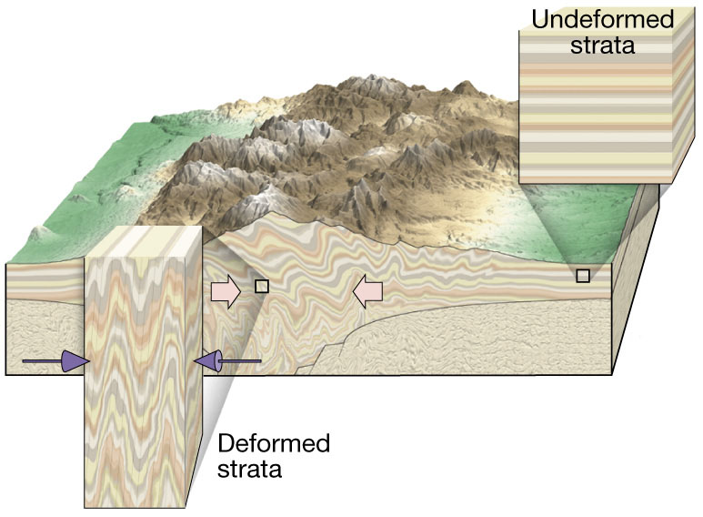
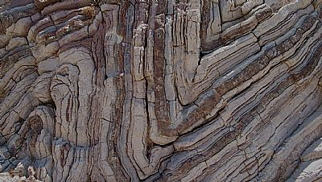
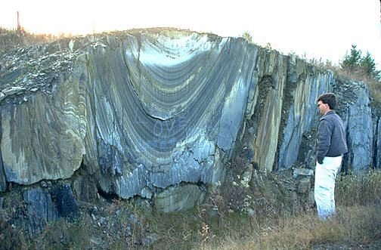
Regional Metamorphism

Slide 14
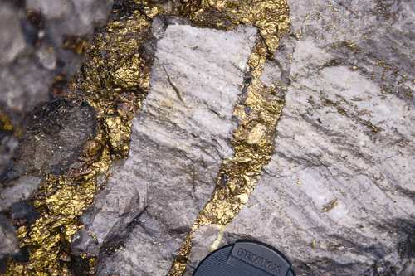
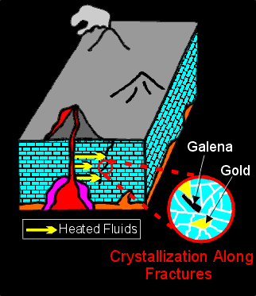
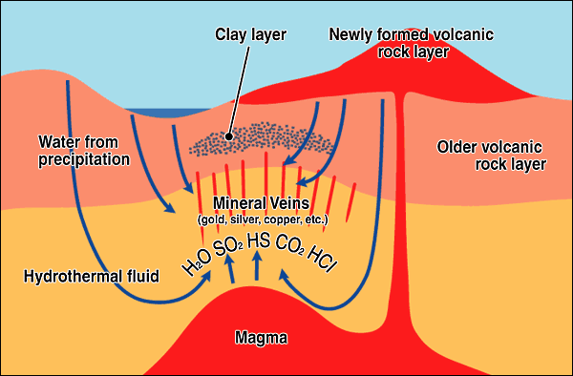
Metamorphic Rocks
Types of Metamorphism
Hydrothermal Metamorphism – occurs when really hot water and dissolved ions react with rocks to alter there chemical composition and mineral content.

Slide 15
Metamorphic Rocks
Other Types of Metamorphism
Burial Metamorphism – sedimentary rocks are buried to several hundred meters, weight and temperature cause metamorphosis
Shock Metamorphism – meteorites impact Earth causing ultrahigh pressures in the impacted rock.
Cataclastic Metamorphism – occurs along fault lines, rocks deform under pressure and heat due to friction of the “rubbing” rocks.

Slide 16
Other Types of Metamorphism

Slide 17
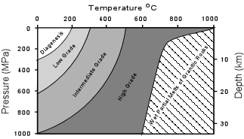
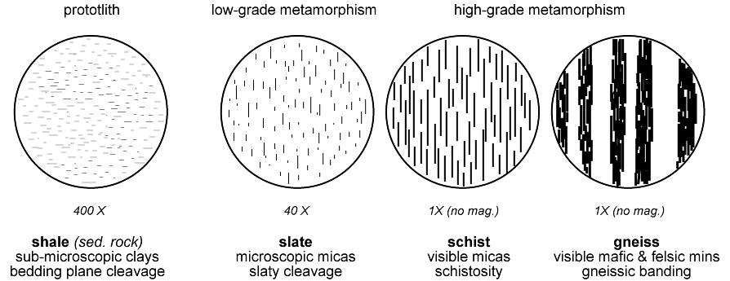
Metamorphic Rocks
Different combinations of temperature and pressure resulting in different degrees or GRADES of metamorphism.

Slide 18
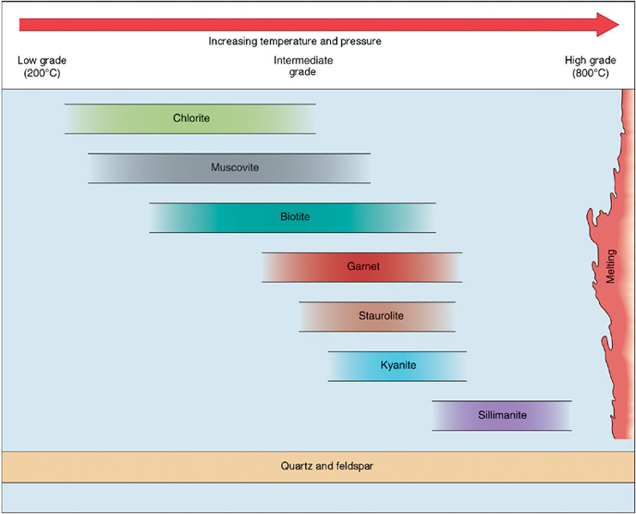
Metamorphic Rocks

Slide 19
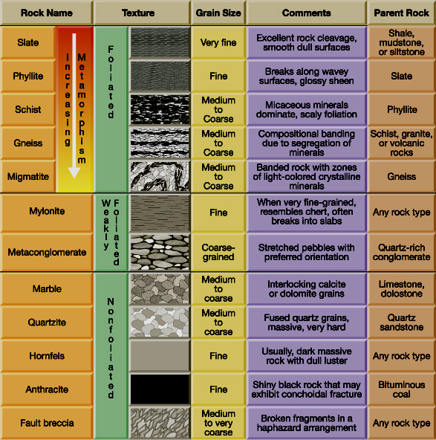

Slide 20
Metamorphic Rocks
Summary
Metamorphic Rock Formation
Heat and pressure
Any rock type can become metamorphic
Classification
Foliated / Non-foliated
Types of Metamorphism
Contact / Regional / Hydrothermal / Etc.
Grades of Metamorphism
Low → High

