Slide 1
Oceanography
The Ocean’s Composition and Structure

Slide 2
Objectives
I can…
Describe the composition of Oceans.
Explain what Salinity is.
Identify the factors that affect the salinity of oceans.
Explain where the solutes in the ocean come from.

Slide 3
What is Ocean Water Made of?
Recall: in Unit 3 we discussed homogenous mixtures or solutions.
Solutions contained a solute and a solvent
Solute – stuff being dissolved
Solvent – stuff doing the dissolving

Slide 4
What is Ocean Water Made of?
Ocean Water is a Solution!
Water is the solvent and the solutes are many
Major Solutes found in water
Ions made from salts (ionic compounds)
Sodium, Chloride, Magnesium, Potassium, Sulfates, Calcium, Bromides, Fluorides, and others
Gases exchanged with the atmosphere
Oxygen, carbon dioxide, others

Slide 5
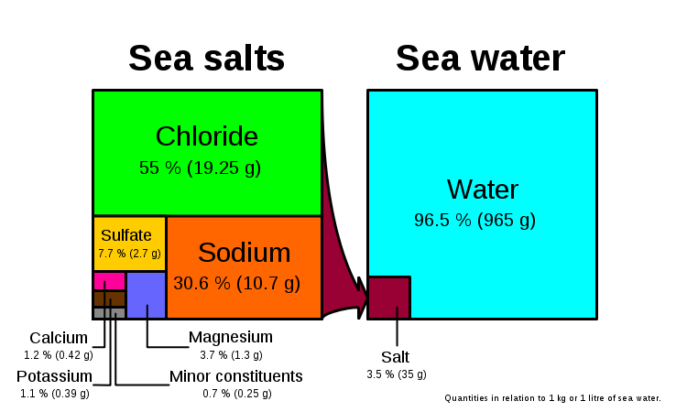
Major Solutes in Ocean Water
Ocean Salts
Ocean Water

Slide 6
What is Ocean Water Made of?
These solutes contribute to the SALINITY of the ocean.
Salinity is a term that refers to how much salt is dissolved in the ocean water.
The Salinity in the Ocean varies but the average amount is measured at 35 g / 1 kg H₂0
This is also called 35 ppt (parts per thousand)

Slide 7
What is Ocean Water Made of?
Factors affecting Ocean Water Salinity
Most importantly, the difference in evaporation and precipitation experienced by the oceans.
More E than P ➔ oceans more salty
The solvent (i.e. water) evaporates leaving behind salt.
More P than E ➔ oceans less salty
More solvent (i.e. water) is added to the solution and the ocean is less salty.

Slide 8
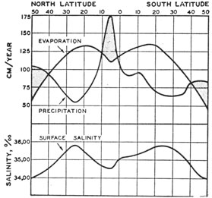
What is Ocean Water Made of?
How does this data from the US Navy support the information on the previous slide?

Slide 9
What is Ocean Water Made of?
Factors affecting Ocean Water Salinity
River Emptying – river systems contribute much fresh water to the oceans. Where the river water and ocean water mix is called an estuary.
Rivers like the Amazon are empty so much freshwater into the ocean, that the water is doesn’t get salty for almost a mile out into the ocean.

Slide 10
What is Ocean Water Made of?
Factors affecting Ocean Water Salinity
Freezing of ocean water and thawing of ice.
Freezing ➔ “removes” water from the ocean
This makes ocean water more salty.
Thawing➔ adds freshwater back to the ocean
This makes the ocean water less salty.
Differences in salinity affect the movements of ocean water
We will discuss this more in the future.

Slide 11
What is Ocean Water Made of?
Variations in Salinity
Due to which process is dominant in a specific region of the Earth.
Ex: in the tropical regions there is a lot more precipitation than evaporation. What affect does this have on Salinity?
Tropical Region have less salinity.

Slide 12
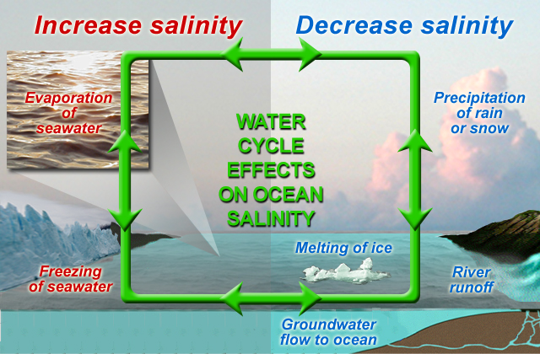

Slide 13
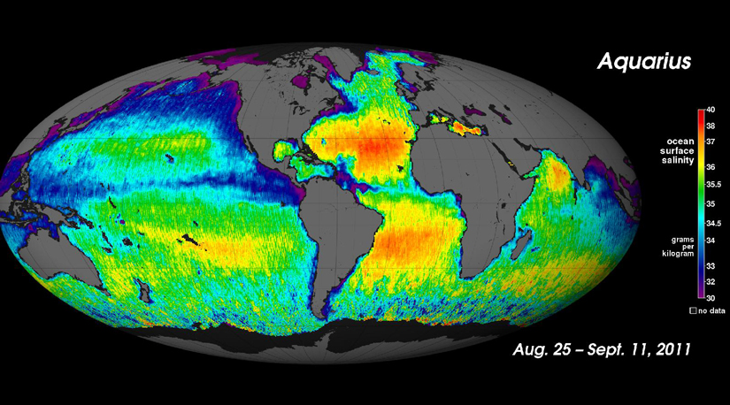

Slide 14
Why are Oceans Salty?
Were the Salt comes from…
Weathering and Erosion of Rock
Rain water is slightly acidic (from CO₂). It will breakdown the rock and carry the dissolved minerals and sediments to the river.
Recall sources of minerals were their rocks
Sodium and Chloride from Halite (NaCl)
Potassium from Feldspar (in Granite)
Fluoride from Fluorite (CaF₂)

Slide 15
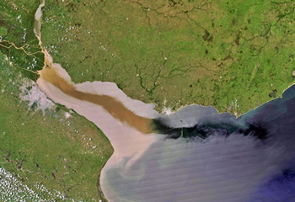
Why are Oceans Salty?
Were the Salt comes from…
Weathering and Erosion of Rock (cont.)
Rivers carry both dissolved load and suspended load to the ocean resulting in a build up of minerals.
Satellite view of La Plata River discharge to the Atlantic Ocean. One way minerals and salts are deposited into the oceans is from outflow from rivers, which drain the landscape, thus causing the oceans to be salty.

Slide 16
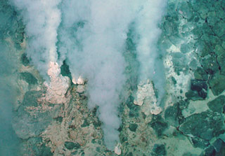
Why are Oceans Salty?
Were the Salt comes from…
Volcanic Eruptions
Gases from volcanoes include sulfur and sulfur compounds, chlorides, and other salt forming ions.
Hydrothermal Vents
Hydrothermal vents, such as these, are present, and they release large amounts of carbon dioxide and minerals.

Slide 17
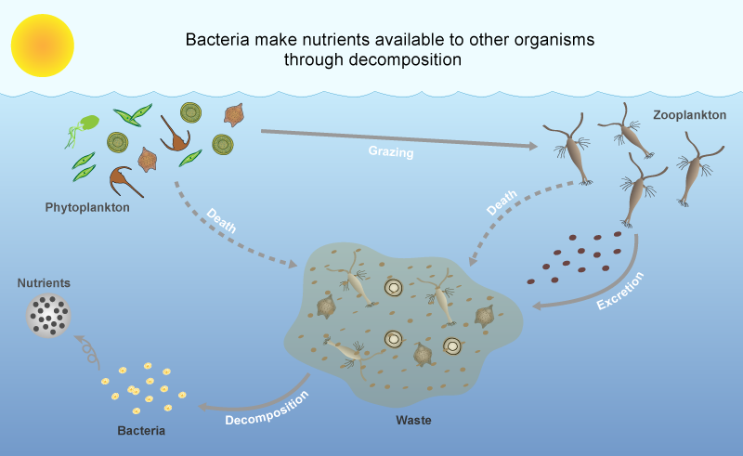
Why are Oceans Salty?
Were the Salt comes from…
Decomposition of Organisms – when marine organisms die the shells that were made from the salts in the ocean water are then returned to the ocean water as the remains decompose.

Slide 18
Assessment
Can I …
Describe the composition of Oceans.
Explain what Salinity is.
Identify the factors that affect the salinity of oceans.
Explain where the solutes in the ocean come from.

