Slide 1
EARTH SCIENCE NOTES
Ocean Structure

Slide 2
Objectives
I can…
Recall shoreline features
Describe the features of the ocean floor.
Describe the layers of the ocean itself.

Slide 3
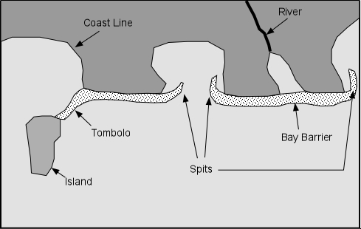
Ocean Structure (Shorelines)

Slide 4
Ocean Structure
These Shoreline features are apart of the Continent itself (obviously).
Working out from the shoreline you have the continental shelf.
This is the edge of the continent that lies beneath the ocean.
Most continental shelves are broad, gently sloping plains covered by relatively shallow water.
Water depth over the continental shelves averages about 60 meters (200 feet).
Sunlight penetrates the shallow waters, and many kinds of organisms flourish.

Slide 5
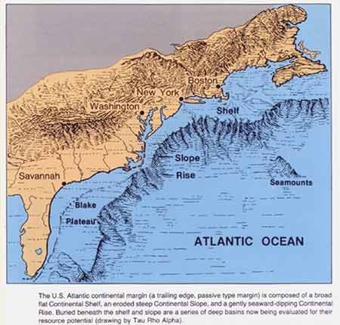
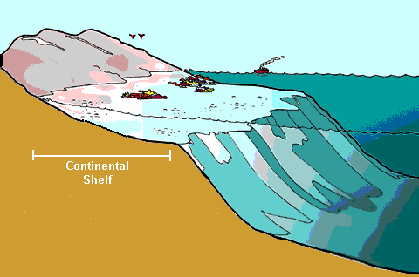
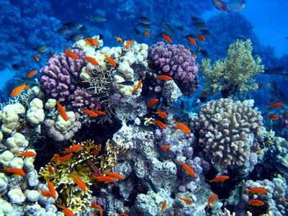
Ocean Structure
The Continental Shelf

Slide 6
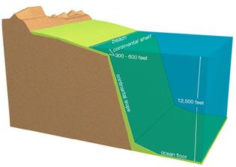
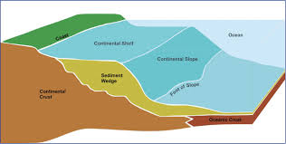
Ocean Structure
The next feature moving out away from shore, past the continental shelf is the continental slope.
The continental slope is considered the true edge of the continent and is characterized by a sudden drop in elevation.

Slide 7
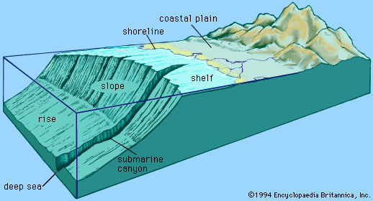
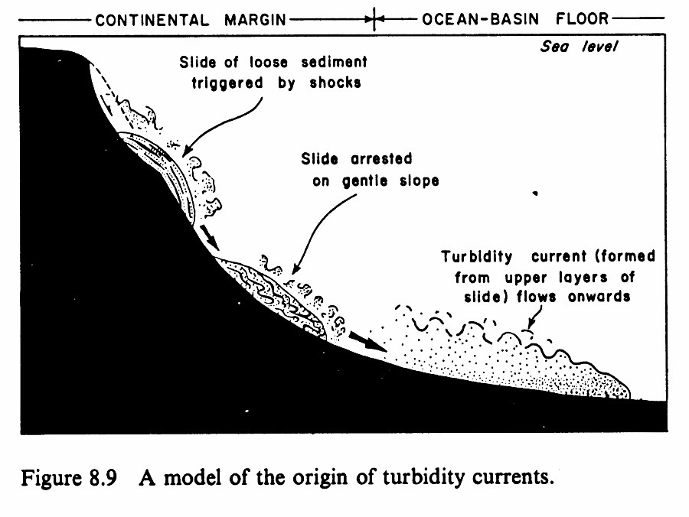
Ocean Structure
From the continental slope you transition to the the continental rise.
The continental rise consists of sediments that have collected from the currents that move along the seafloor.

Slide 8
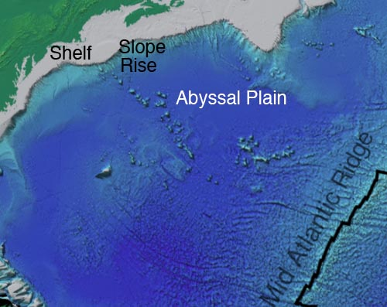
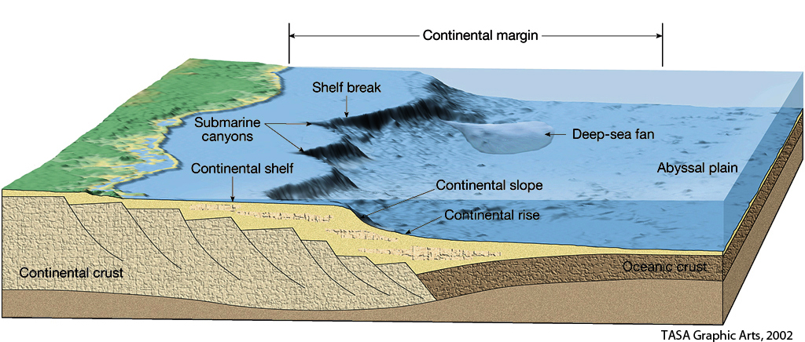
Ocean Structure
At the bottom of the continental rise is the abyssal plains.
Abyssal plains are sediment-covered portions of the deep ocean floor.
With surface slopes of less than one foot of elevation difference for each thousand feet of horizontal distance, they are the flattest areas on Earth.

Slide 9
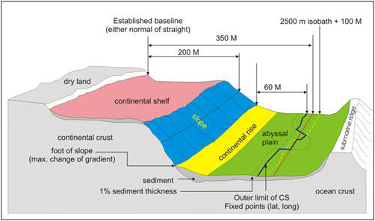

Slide 10
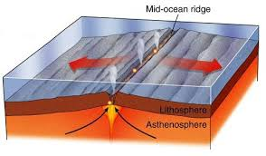
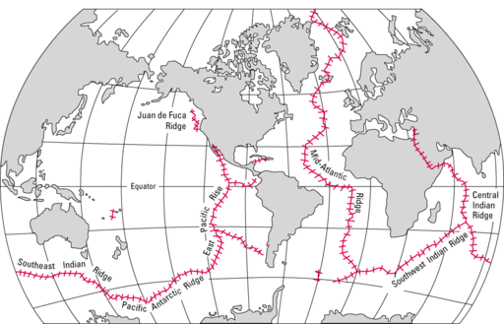
Ocean Structure
Features of the Ocean Floor
Mid-ocean ridges – underwater mountain range that separates tectonic plates
These are sites of seafloor spreading.
Run around the Earth

Slide 11
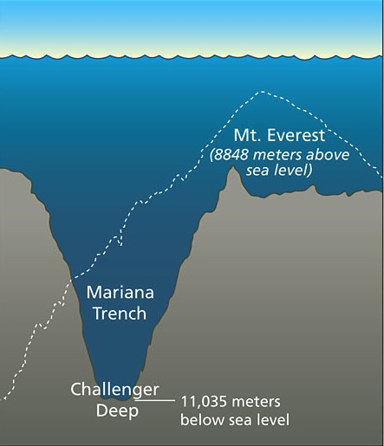
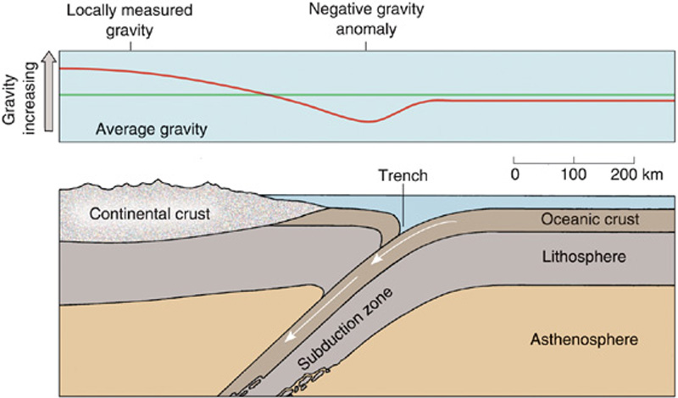
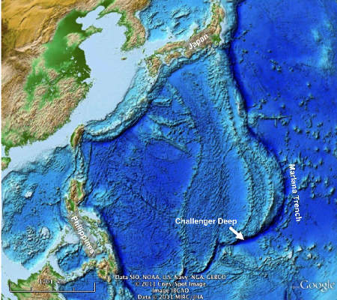
Ocean Structure
Features of the Ocean Floor
Deep Ocean Trenches – long, narrow, arc-shaped depressions in the ocean floor.
Created when the tectonic plate is being dragged under another by tectonic forces.

Slide 12
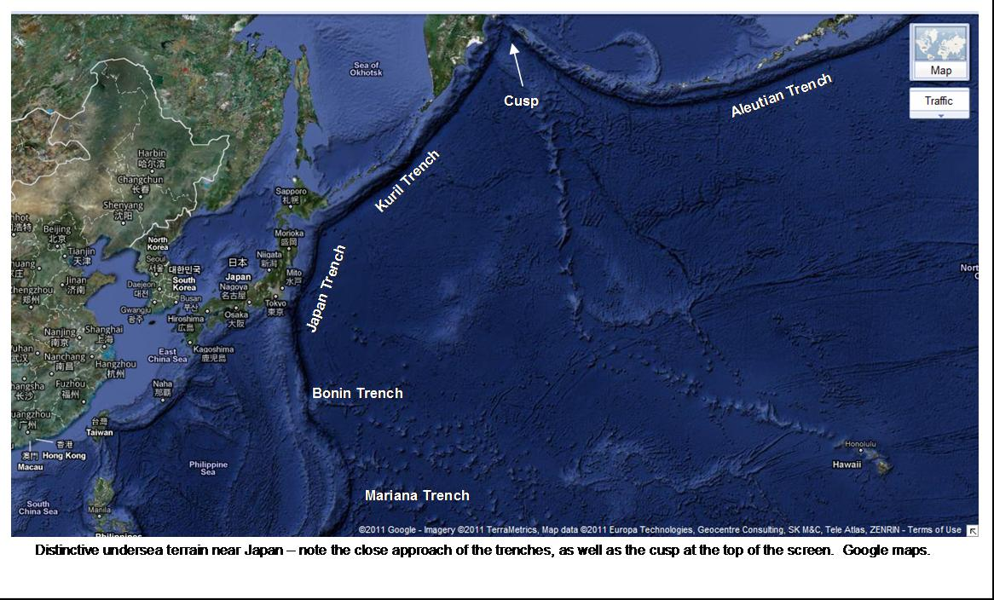

Slide 13
Ocean Structure
We have talked about ocean structures moving outward from the shoreline.
Now we will look at the ocean from top to bottom.
You will see even the ocean water itself has a structure to it.

Slide 14
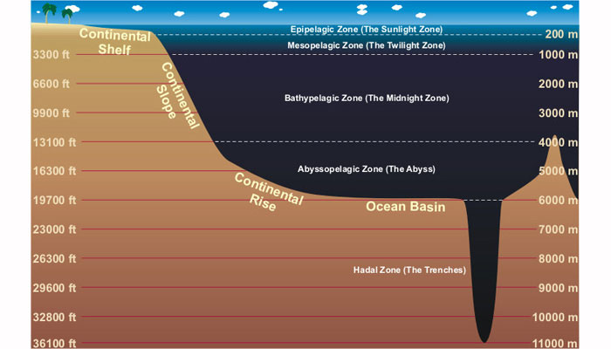
Ocean Structure
Layers of the Ocean
the oceans are not uniformly mixed but are structured in layers with distinct properties

Slide 15
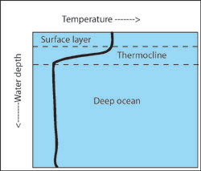
Ocean Structure
Layers of the Ocean
Epipelagic (sunlight zone)
From 0 to -200 m, warmer water, wave action
Mesopelagic (twilight zone)
Here water temperature falls rapidly with depth to less than 5°C at 1,000 meters.
This sharp transition, which is called the thermocline, inhibits vertical mixing between denser, colder water at depths and warmer water nearer the surface.

Slide 16
Ocean Structure
Layers of the Ocean
Bathypelagic (the midnight zone)
From 1000 to 4000 m, water is almost uniformly cold, around 4°C. No sunlight penetrates to this level, and pressure at the bottom of the zone is about 5,880 pounds per square inch.
Abyssopelagic
Little life exists, reaches to the ocean floor at a depth of about 6,000 meters.
Hadal Zone
Deepest points in the ocean, narrow trenches that occur at convergence zones—points where two oceanic plates collide and one is driven beneath the other.
Highly specialized life forms, including fish, shrimps, sea cucumbers, and microbes, survive even at these depths.

Slide 17
Assessment
Can I …
Recall shoreline features
Describe the features of the ocean floor.
Describe the layers of the ocean itself.

