Slide 1
Chemistry Notes
The Modern Periodic Table

Slide 2
The Modern Periodic Table
Objectives:
See how electron configurations are related to the layout of the periodic table
Explain the discrepancies in the predicted EC and the actual EC on the PT
Write the most stable electron configuration for a given element
Explain why one elements is more stable over another.

Slide 3
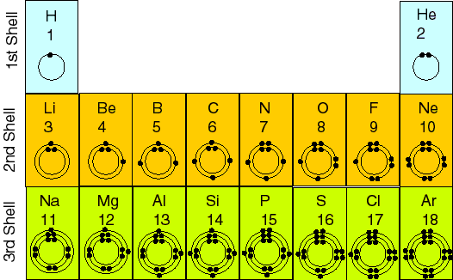
The Modern Periodic Table
The PT is arrange in such a way that:
Energy levels increase by one as you move down the PT from period to period.

Slide 4
The Modern Periodic Table
The PT is arrange in such a way that:
# of valance electrons increases by one as you move across the PT from group to group.

Slide 5
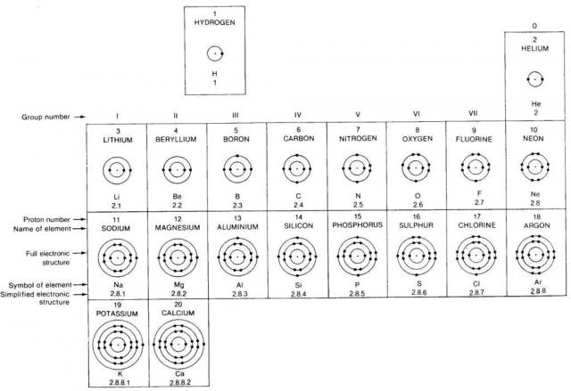

Slide 6
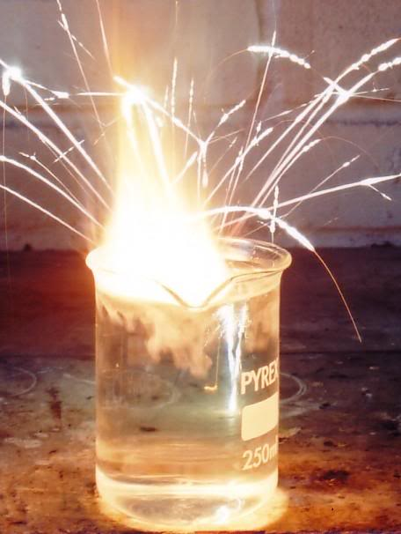
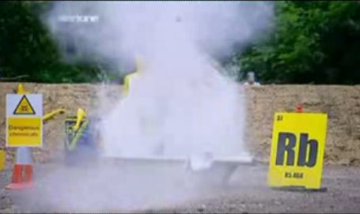
The Modern Periodic Table
Certain electron arrangements are repeated periodically as atoms increase in atomic number.
Elements in the same group (column) have similar electron configurations.
This gives these elements similar chemical properties.
Recall yesterdays activity with Group 1 elements

Slide 7
The Modern Periodic Table
All group 1 elements have the “s” sublevel that only has 1 electron in it.
All the elements in group 1 have 1 valance shell electron.
All elements in group 1 react violently with water.

Slide 8
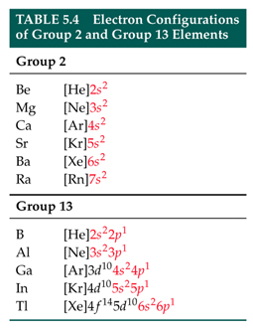
The Modern Periodic Table
Group 2 elements all have electron configurations that end with a full “s” sublevel (2 electrons)
Group 3 has electron configurations the end with
…__ s²__p¹

Slide 9
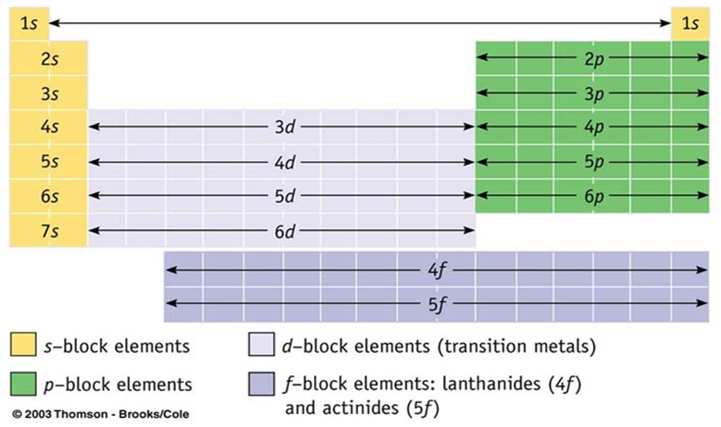
The Modern Periodic Table
Elements on the periodic table are arranged in blocks.
Blocks represent the orbitals atoms are trying to fill

Slide 10
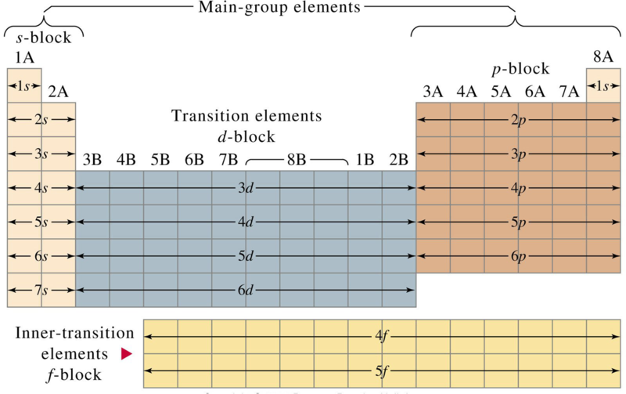
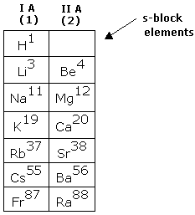
“Blocks” of the Periodic Table
Alkali metals and alkali earth metals as well as helium end their electron configuration with the “s” sublevel
These are s-block elements

Slide 11
“Blocks” of the Periodic Table
Nonmetals, metalloids, and post-transition metals end their electron configuration with the “p” sublevel
These are p-block elements

Slide 12
“Blocks” of the Periodic Table
Transition metals end their electron configuration with the “d” sub level
These are d-block elements

Slide 13
“Blocks” of the Periodic Table
Actinide and Lanthanide series end their electron configuration with the “f” sublevel
These are f-block elements

Slide 14
The Modern Periodic Table
The table we use (next slide) has some apparent inconsistencies when it comes to EC.
Ex: 3d¹⁰ 4s² p¹ instead of 4s² 3d¹⁰ 4p¹
Shown this way to save space and is simply different way of writing the EC – according to PEL
We will always write and EC according to the Auf Bau Principle

Slide 15
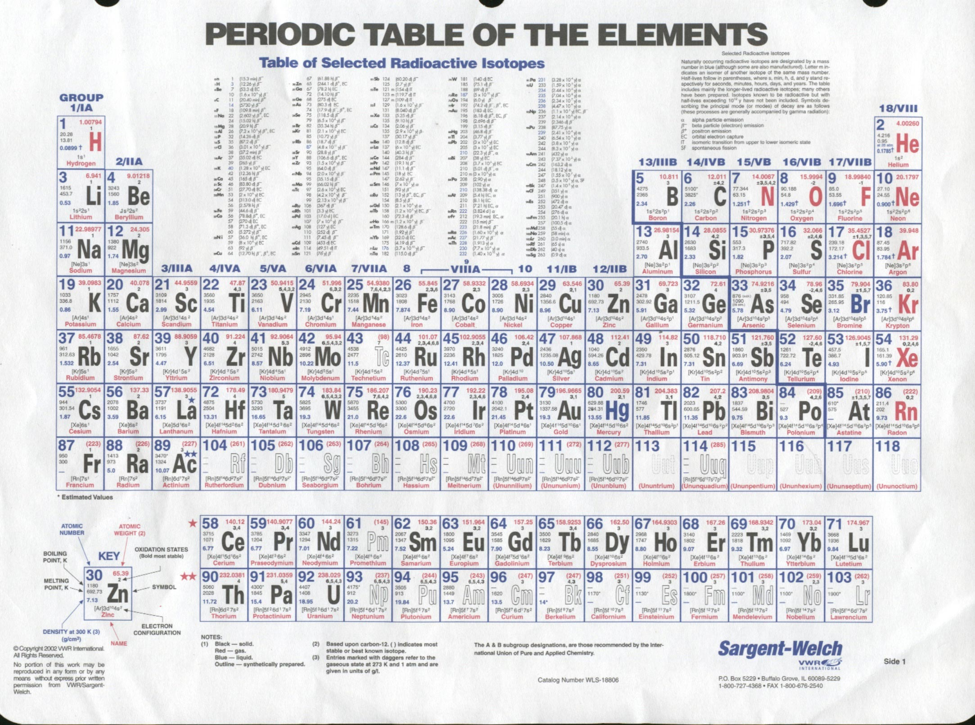
The Modern Periodic Table
Notice how the elements in the first row of the transition elements are filling the 3d sublevel.
Does it always follow a consistent pattern (d¹, d², d³, …) ?
Why not? What's the deal?

Slide 16
The Modern Periodic Table
Here’s the Deal
EC follow the predicted pattern (the way we originally learned how to write EC)
However, if the atom can become more stable by moving an electron to another orbital, it will.

Slide 17
Relative Stability of Electron Configurations
Recall how atoms achieve stability
Main group (A-group) elements become stable when the have an octet
Recall the Octet Rule: eight electrons in the outer energy level make an atom stable.
A-group elements want to have filled s and p orbitals
This adds up to 8 e⁻.

Slide 18
Relative Stability of Electron Configurations
How atoms achieve stability
Octet Rule does not hold true for B-group elements
B-group elements become stable when they have achieved full or half-filled sublevels.
These elements are filling d and f orbitals
This adds up to 10 and 14
Stability for B-group elements can be determined using the stability pyramid (next slide)

Slide 19
Relative Stability of Electron Configurations
Less Stability
No Special Arrangement
Half full sublevel
Greater Stability
Full Sub level
Full Outer level

Slide 20
Relative Stability of Electron Configurations
Below is Chromium’s predicted electron configuration:
1s² 2s² 2p⁶ 3s² 3p⁶ 4s² 3d⁴

Slide 21
Relative Stability of Electron Configurations
Chromium’s actual electron configuration:
1s² 2s² 2p⁶ 3s² 3p⁶ 4s¹ 3d⁵
Notice with chromium’s electron configuration
One electron has shifted from the 4s sublevel to the 3d sublevel.
This allows the atom to have a more stable configuration
Chromium is more stable with two half sublevels opposed to 1 full sublevel and one sublevel with no special arrangement.

Slide 22
Summary
Be able to…
Explain the patterns seen on the periodic table
Know how the electron configurations change as you move through the period table
Describe the s, p, d, and f block
Explain how atoms achieve a stable electron configurations
Octet rule
Stability pyramid
Predict the most stable electron configuration

