Slide 1
Earth Science Notes
Relative Age of Rocks

Slide 2
Objectives
I can…
Distinguish relative and absolute dating.
Describe the 6 laws of relative dating.
Use the 6 laws of relative dating to establish a chronology (timeline) for a given column of rock layers.

Slide 3
Age of Rocks
What we discussed last time
Geologist generally date rocks by …
Using identifiable patterns of fossils found in rock layers (called faunal succession).
RECALL: Index fossils allowed us to make correlations between rock layers found in different locations
Using principles of geology
Ex: Superposition Principle
Using Radiometric Dating
Not just C-14
What we will discuss today
What we will discuss next time.

Slide 4
Age of Rocks
Development of the geologic time scale and dating of formations and rocks relies upon two fundamentally different ways of telling time:
Relative Age – means how old rocks are in relation to other rock formations
places events or rocks in their order of occurrence.
Absolute Age – age of rock based on the radioactive decay of isotopes
Absolute dating places events or rocks at a specific time.

Slide 5
Relative Age of Rocks
Six Laws used to determine the relative ages of Rock
Law of original horizontality:
Law of lateral continuity:
Law of superposition:
Law of inclusions:
Law of cross-cutting
Law of unconformities

Slide 6
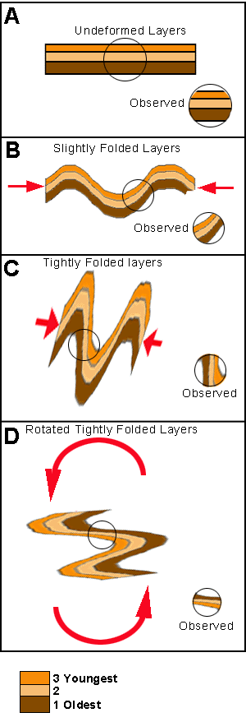
Relative Age of Rocks
Law of original horizontality: sedimentary layers and lava flows are originally deposited as relatively horizontal sheets.
If they are no longer horizontal or flat it is because they have been displaced by movements in the Earth’s Crust.

Slide 7
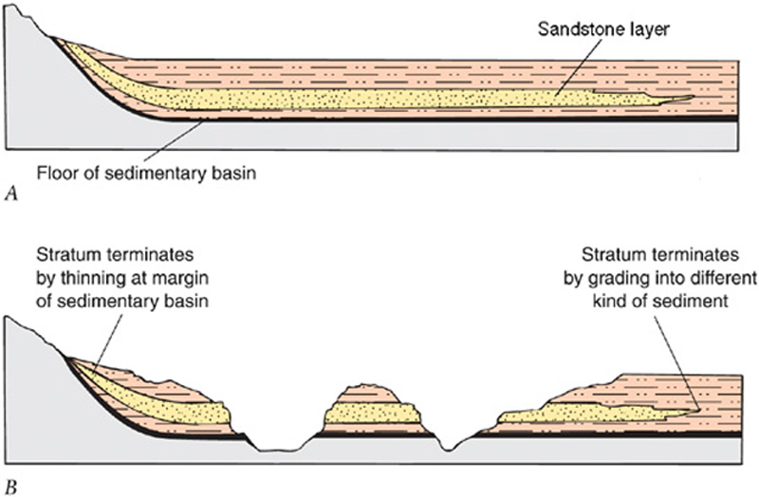
Relative Age of Rocks
Law of lateral continuity: lava flows and sedimentary layers extend laterally in all directions until they thin to nothing or reach the edge of the basin of deposition.

Slide 8
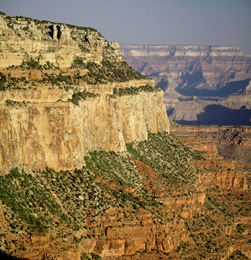
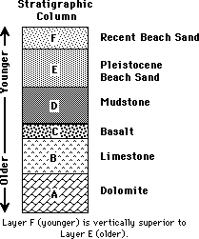
Relative Age of Rocks
Law of superposition: In an undisturbed sequence of strata or lava flows, the oldest layer is at the bottom of the sequence and the youngest is at the top.

Slide 9
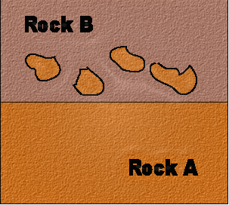
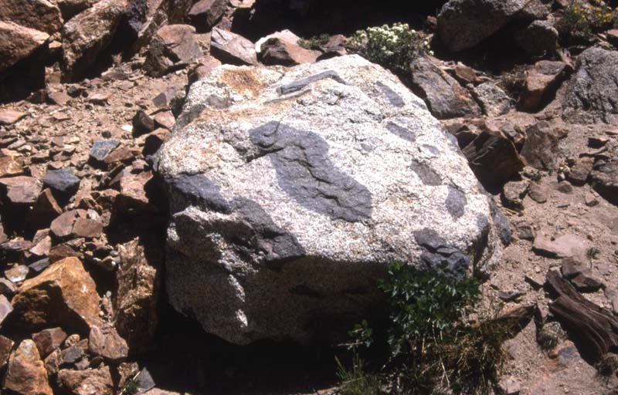
Relative Age of Rocks
Law of inclusions: any piece of rock that has become included in another rock or body of sediment must be older than the rock or sediment in which it has been incorporated.

Slide 10
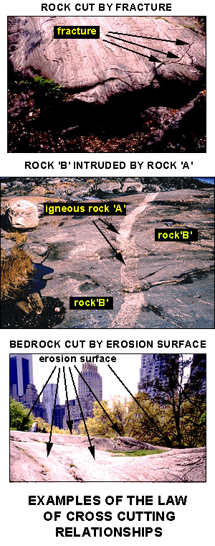
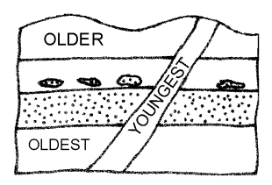
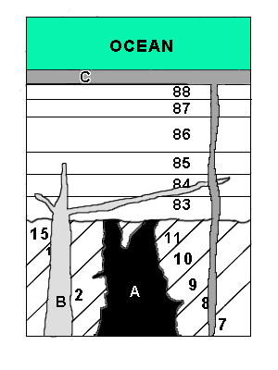
Relative Age of Rocks
Law of cross-cutting: any feature that cuts across a rock or body of sediment must be younger than the rock or sediment that it cuts.

Slide 11
Relative Age of Rocks
Law of unconformities: surfaces called unconformities represent gaps in geologic time where layers were not deposited for a time or else layers have been removed by erosion.

Slide 12
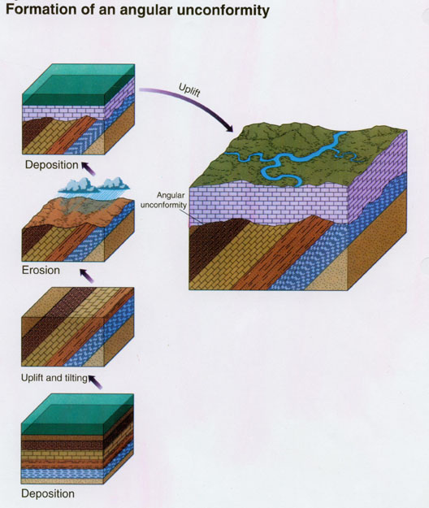
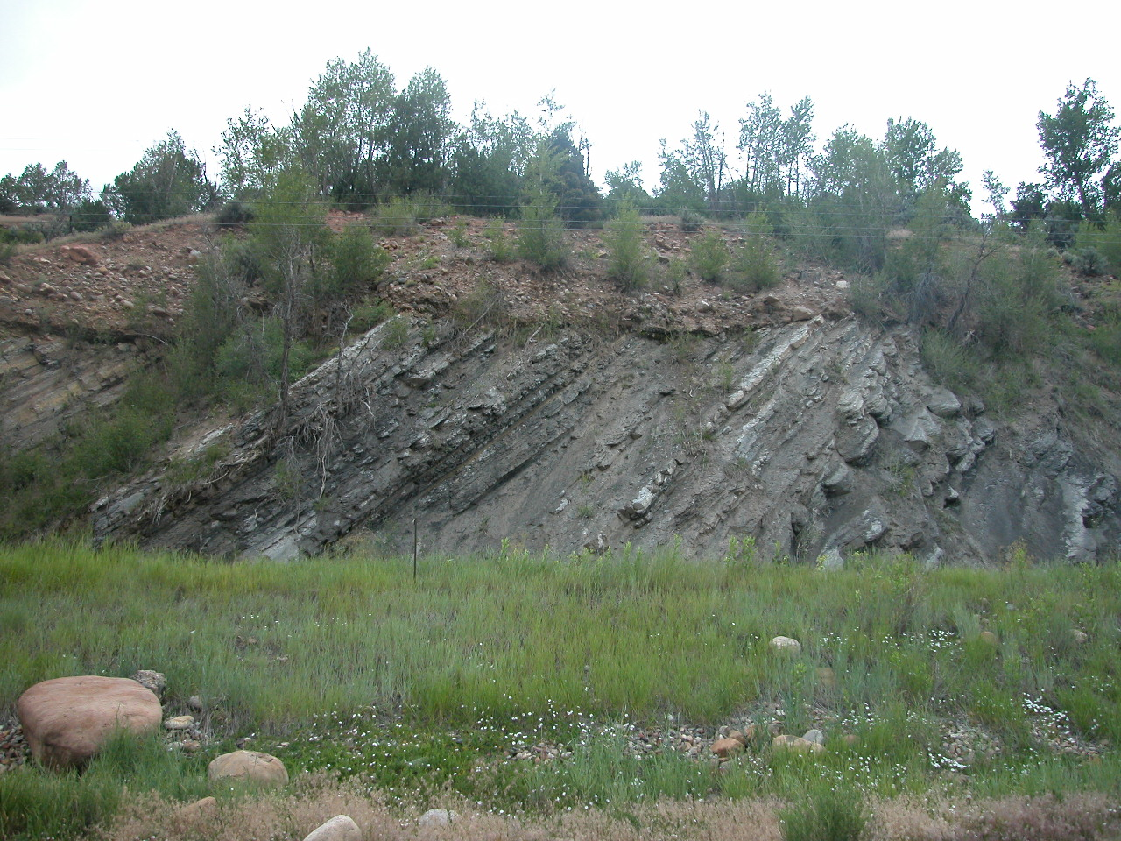
Unconformities
ANGULAR UNCONFORMITIES
Angular unconformities are characterized by an erosional surface which truncates folded or tilted strata. Overlying strata are deposited basically parallel with the erosion surface.

Slide 13
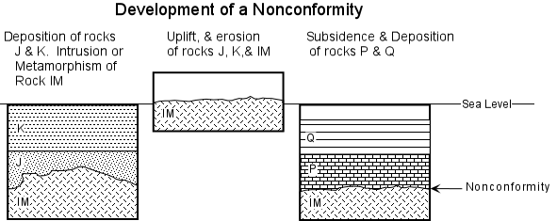
Unconformities
NONCONFORMITIES
Nonconformities are characterized by an erosional surface which truncates igneous or metamorphic rocks.

Slide 14
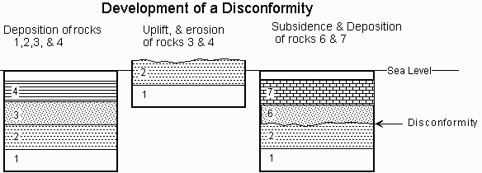
Unconformities
DISCONFORMITIES
Disconformities are characterized by an irregular erosional surface which truncates flat-lying sedimentary rocks.

Slide 15
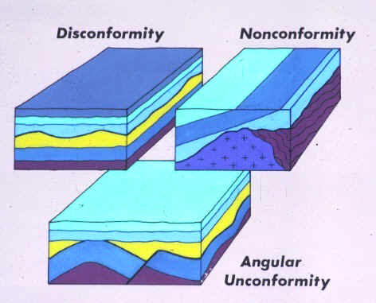

Slide 16
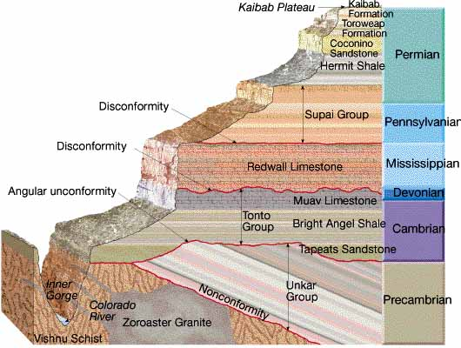
Unconformities

Slide 17
