Slide 1
Earth Science Notes
Scientific Thinking

Slide 2
Objectives
I can…
Explain what scientific thinking is
Describe types of Evidence
State the end goal of science
Explain how the Scientific Method relates to Scientific thinking

Slide 3
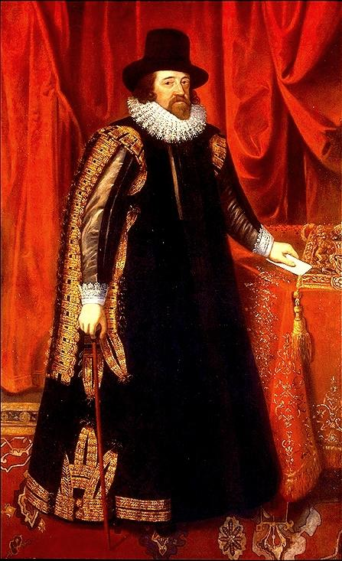
WHO IS THIS GUY?
"If a man will begin with certainties, he shall end in doubts; but if he will be content to begin with doubts, he shall end in certainties."
What do you think this means?

Slide 4
WHO IS THIS GUY?
Bacon (pictured) and Descartes formalized Science into a Methodology.
However, many people have contributed to the SM over time.
Karl Gauss David Hume John Locke Ernst Mach John Dewey Humphry Davy Isaac Newton Robert Boyle Abraham Wolf Morris Cohen Karl Pearson William James | Gregor Mendel John Herschel Immanuel Kant William Wells Charles Darwin Claude Bernard William Jevons Charles Pierce William Jevons William Harvey Michael Faraday William Whewell | Johannes Kepler Albert Einstein Henry Armstrong John Stuart Mill Joseph Priestley Bertrand Russell Benjamin Franklin Antoine Lavoisier Joseph Gay-Lussac Ernest Rutherford James Clerk Maxwell Albert North Whitehead

Slide 5
Scientific Thinking
Reflect on the Essay we read. And finish the sentence.
Scientific thinking is …
_______________________________________
_______________________________________
_______________________________________
_______________________________________

Slide 6
Scientific Thinking:
Begins with the use of evidence:
Types of Evidence
Empirical – evidence that can be experienced
Authoritarian – evidence from an expert
Testimonial – eye-witness accounts
Circumstantial – evidence that depends on the circumstance (means, motive, opportunity)

Slide 7
Scientific Thinking:
Types of Evidence (cont.)
Emotional – evidence derived from feeling
Hearsay – evidence based on secondhand accounts
Spectral – evidence revealed by a ghost or angel

Slide 8
The Scientific Method
Problem or Scientific Question
Developing a hypothesis
Make initial observations
Do background research

Slide 9
The Scientific Method
Testing
Develop a method of testing each hypothesis
Identify the variables in your experiment
Independent variable – the variable changed by the researcher
Dependent variable – the measured variable. The thing you are looking at to see if it has been affected when the IV is changed
With an experimental Research Method there are two groups
Control: the group that is “untreated.” The group that is treated like “normal.”
Experimental: the group receiving the treatment
Obtain needed materials
Perform Tests

Slide 10
The Scientific Method
Results
Describe observations made during your test
Analyze Data collected during test
Conclusion
Interpret data
Critique experiment
Suggest improvements

Slide 11
The Scientific Method
Outline for Lab Reports
Problem or question
Hypothesis – what hypotheses did you develop from your observations
Procedure
Materials – tell what was used
Methods – explain how you performed experiment
Results – organizing data
Observations – what happened during experiment
Analyzation – breakdown data – graphs and charts
Conclusion – what does the data mean
Interpret data
Does the data support each hypothesis
What things could of influence the data
What are some ways the experiment could be improved

Slide 12
Scientific Thinking and the Scientific Method
Your Homework:
Write a paragraph explaining the relationship between the Scientific Method and Scientific Thinking.
Have this ready when you come to class

Slide 13
Assess Yourself
Can I perform the given objectives (slide 2)
Can I…
Explain what scientific thinking is
Describe types of Evidence
State the end goal of science
Explain how the Scientific Method relates to Scientific thinking

Slide 14
REMEMBER

Slide 15
