Slide 1
Earth Science Notes
Interesting Stuff in Space

Slide 2
What is out there beyond our solar system?
What does stuff look like out there?

Slide 3
Gravity
To have an upstanding of space, you must have some understanding of gravity.
Gravity:
Is a force (measured in Newtons) F = ma
Is everywhere (even in space)
Depends of mass (anything that has mass exerts a gravitational force).
Isaac Newton developed a law that that described the force of attraction between two masses.
F_{g} = G m₁m₂
d²

Slide 4
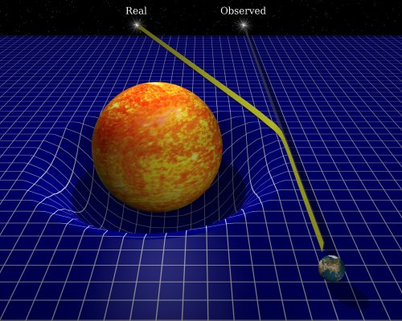
Gravity
Newton described gravity (with his Laws), Einstein explained gravity (with his theory).
Einstein did not view gravity as a force but as a curvature of space.
Large masses literally warp space.
Changes in the path of light due to the presence of a large mass (like out sun) supports this theory.

Slide 5
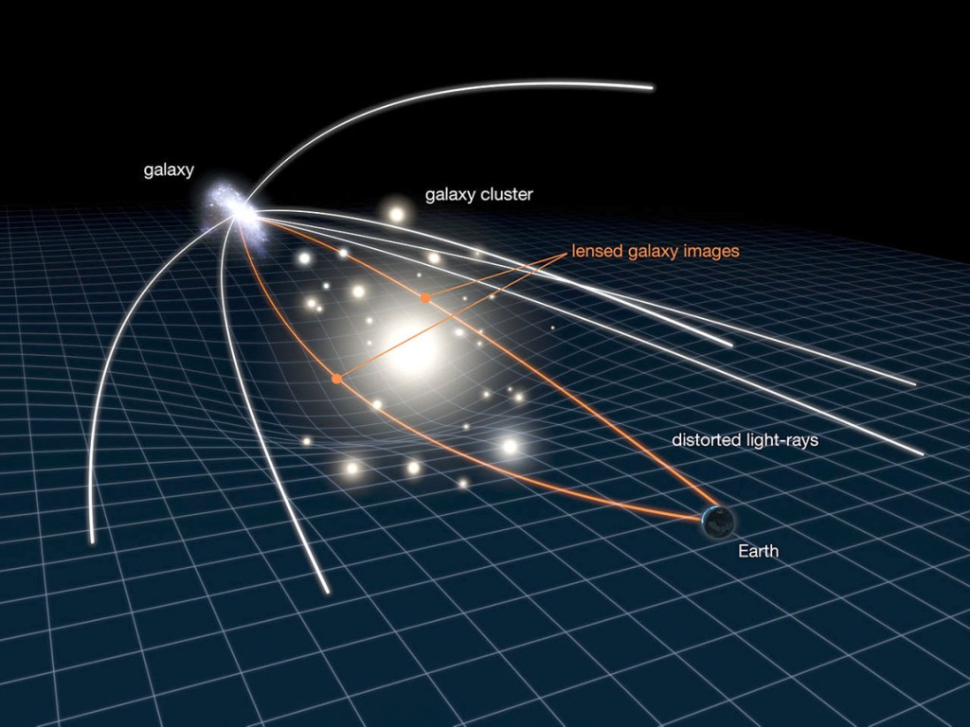
Large masses in space cause the bending of light from distant space and make stars and galaxies appear warped or stretched.
Image to the right is take from Hubble.

Slide 6
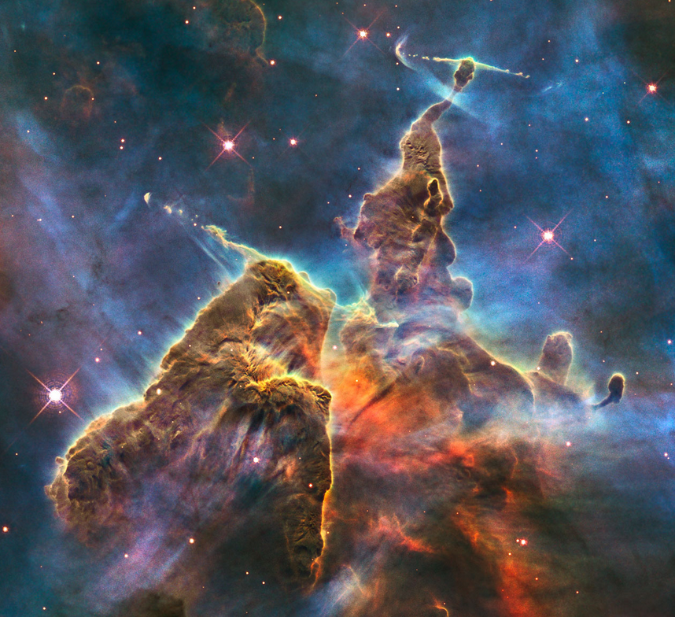
Nebulas
Giant collections of interstellar dust and ionized gases.
May be light years across
Some parts of the nebula may clump together more than others.
There are several types of nebulas
Planetary, emission, reflection, dark, etc.

Slide 7
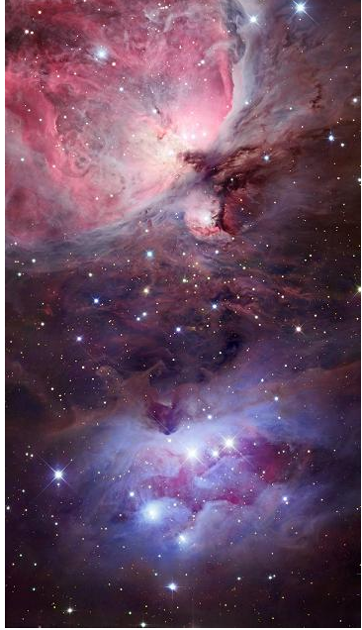
Nebulas
Stars form out of nebulas.
Irregularities in the density of the gas causes a net gravitational force that pulls the gas molecules closer together (it collapses).
As the collapse continues the pressure on the gases increases and the temperature intensifies.
This creates an emission nebula
When it gets hot enough it starts to emit intense radiation (i.e. light), and a star is born.

Slide 8
Nebulas
Nebulas also are created as stars die
Planetary nebulas are the result of a dying star.
When a star has burned through so much material that it can no longer sustain its own fusion reactions, the star's gravity causes it to collapse.
As the star collapses, its interior heats up. The heating of the interior produces a stellar wind that lasts for a few thousand years and blows away the outer layers of the star.
When the outer layers have blown away, the remaining core remnant heats the gases, which are now far from the star, and causes them to glow.

Slide 9
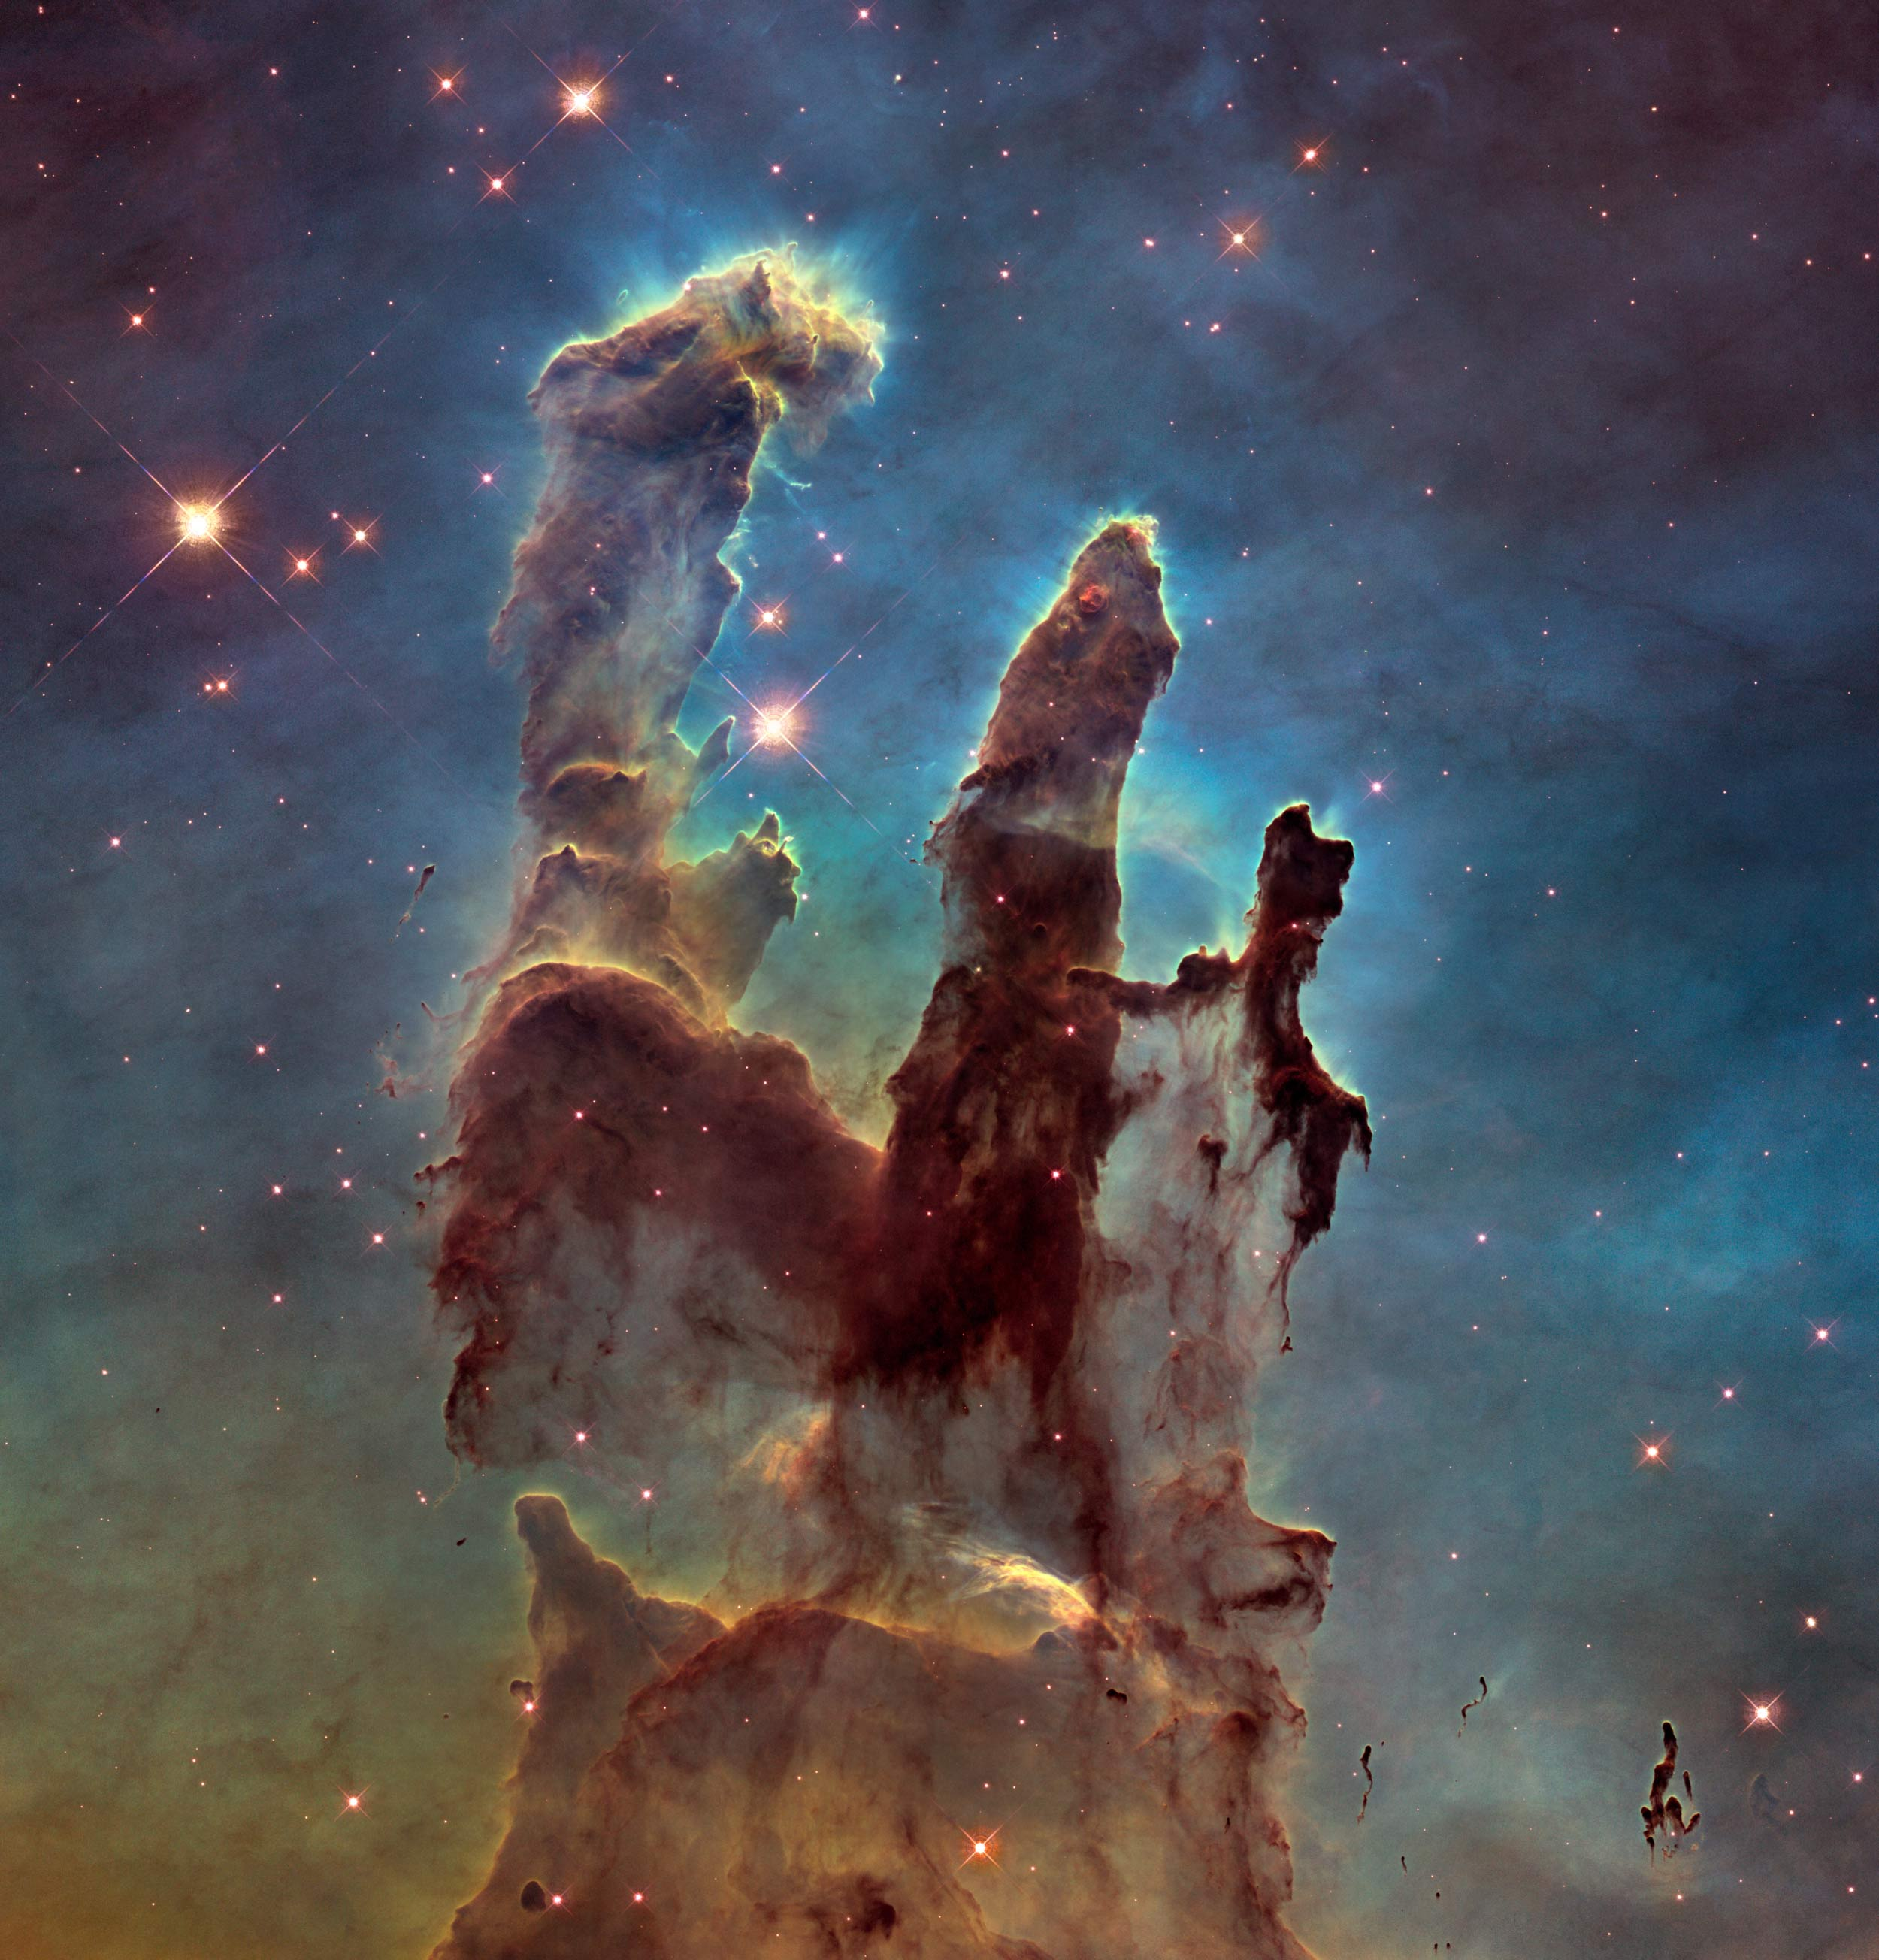
Nebulas seen from HUBBLE
The “Pillars of Creation” seen in the Eagle Nebula.
This is an emission nebula.
A young star nursery

Slide 10
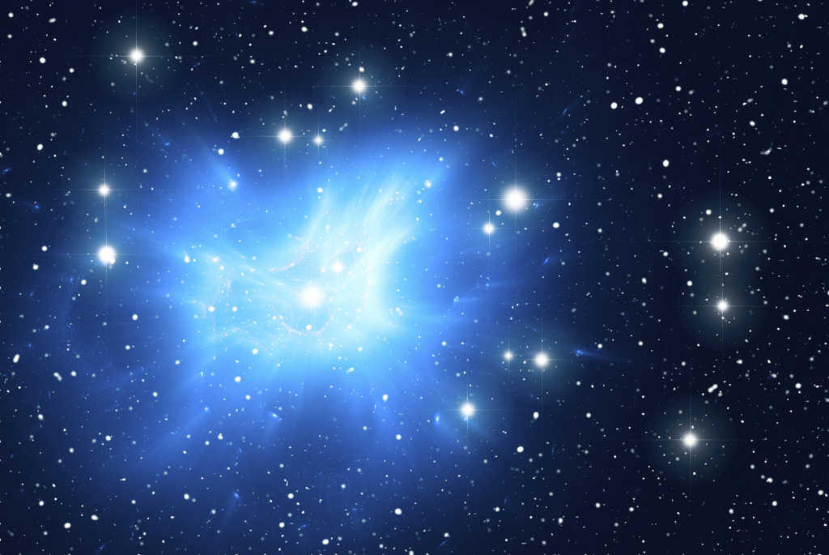
Nebulas seen from HUBBLE
Here is the Pleiades Nebula
This is a reflection nebula
Gas and debris actually reflect starlight

Slide 11
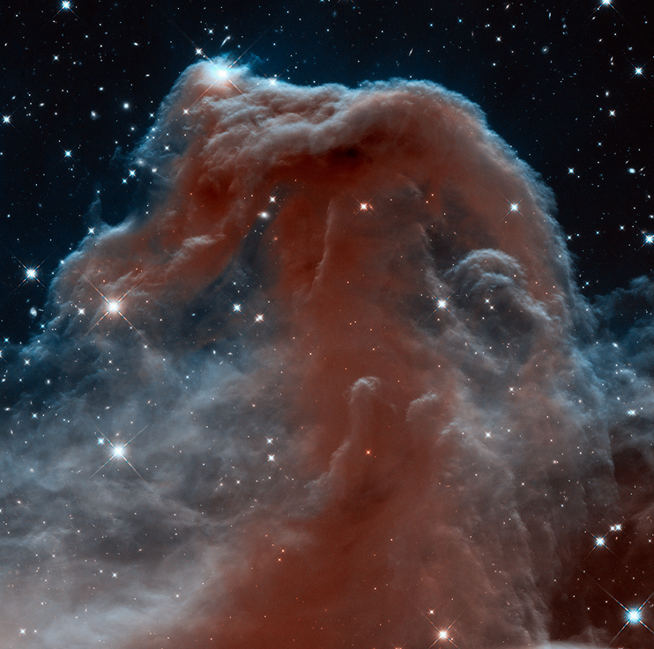
Nebulas seen from HUBBLE
This is the horse head nebula.
It is a “dark nebula”
No light is emitted from the nebula, it actually blocks light from stars.

Slide 12
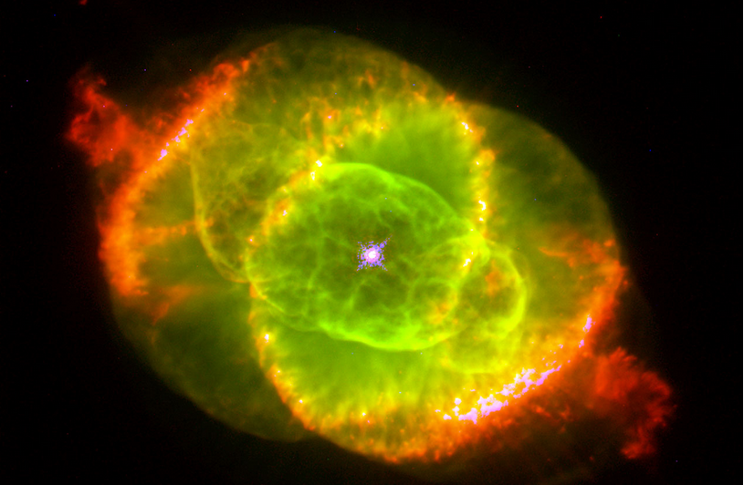
Nebulas seen from HUBBLE
This is the “Cat’s Eye Nebula”
This is an example of a planetary nebula.
There are no planets in a planetary nebula.
This was misnamed

Slide 13
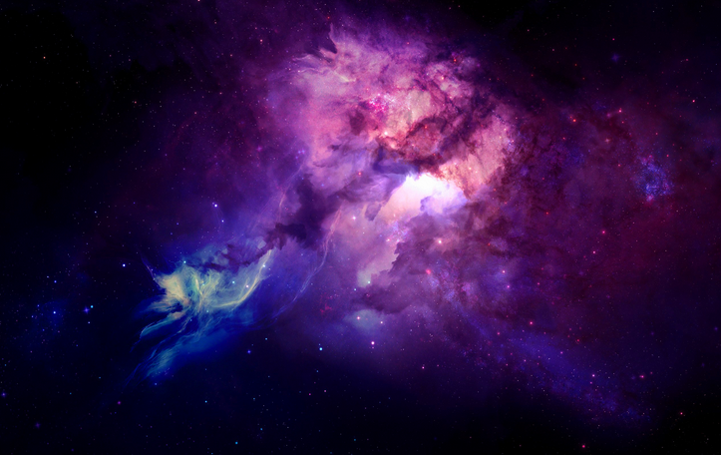
Nebulas seen from HUBBLE
Supernova Remnants – created from massive explosions of super large stars

Slide 14
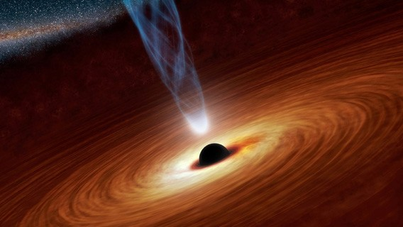
Black Holes
Black holes are NOT holes but large concentrations of matter. Remember the mass creates the gravity.
Black holes form as a result of star death. Black holes are collapsed stars. Massive stars, many times larger than our Sun, collapse into the size of a large city (e.g. NYC).
The result is a gravitational pull so intense that light cannot even escape from it.

Slide 15
Black Holes
Scientists can't directly observe black holes with telescopes that detect x-rays, light, or other forms of electromagnetic radiation.
We can, however, infer the presence of black holes and study them by detecting their effect on other matter nearby.
If a black hole passes through a cloud of interstellar matter, for example, it will draw matter into it.
If a star gets to close to a back hole it will tear the star apart.
http://www.space.com/12719-black-hole-swallows-star-nasa-swift.html

Slide 16
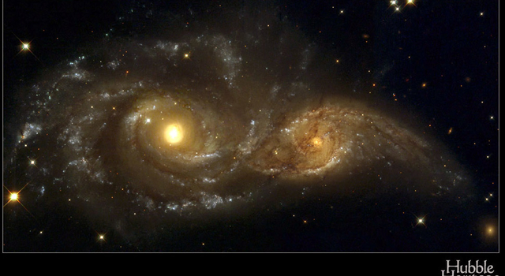
Black Holes
Illustration of two spiral galaxies with black holes at their center, about to collide.

Slide 17
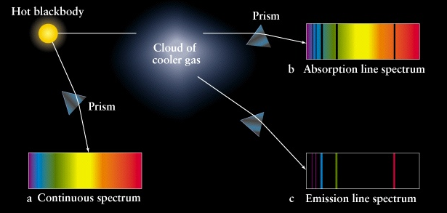
Universe Expansion
Erwin Hubble measured the light given off from distant galaxies and was able to calculate their velocities from their period-luminosity relationship.
Brighter stars have larger periods of brightness before dimming.
Calculating a star’s mag brightness allowed for determining its distance based on the fact that lights brightness decreases at a predictable rate.
Hubble then observed spectrum lines (lines of colored light emitted from charged gas) from the stars as well.

Slide 18
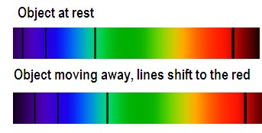
Universe Expansion
Hubble found that these spectrum lines were shifting toward the red end of the spectrum (this is called Red Shift)
This told him that these galaxies were moving away from Earth at a very fast rate.
Mostly red-shifted light from galaxies tells us that the universe is expanding.

Slide 20
Dark Matter / Dark Energy

Slide 21
Space Travel at the Speed of Light

Slide 22
Cosmic Background

