Slide 1
Matter and Energy
Matter
Is Investigated Systematically
(Unit 1)
Can be converted to Energy
(E = mc²)
Can be Classified
Can be Measured
(Unit 2)
Can Possess Energy

Slide 2
Matter and Energy
Matter Can Posses Energy
Matter
Changes in Temperature and Pressure create phase changes
Entropy of Matter is Influence by Energy
Energy Affects the States of Matter
Matter transfers energy in different ways
Changes in Energy can be measured

Slide 3
Objectives
What you are expected to do.
Describe the states of matter in terms of the relative amounts of KE and AF
Describe the molecular motion of each state of matter
Explain how temperature and pressure affect the phases of matter
Define entropy and use it to describe states of matter.

Slide 4
Matter Possess Energy
States of Matter
Determined by the relative amount of KE and attractive forces between the particles of matter.
Solids ➔ AF > KE
Liquids ➔ AF ≈ KE
Gases ➔ AF < KE
Matter Posses Energy
This affects its state

Slide 5
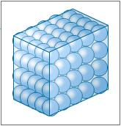
States of Matter
Solids
Particles vibrate in fixed positions
Ordered chemical structure

Slide 6
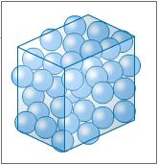
States of Matter
Liquids
Particles are close but move past each other
Molecules lack order

Slide 7
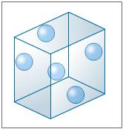
States of Matter
Gasses
Particles move with different speeds and directions
Easily compressed

Slide 8
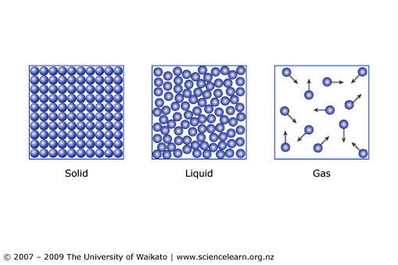
States of Matter

Slide 9
States of Matter
Changes in Temperature and Pressure determine the State of Matter as well as the changes in phase they experience.
Phase Changes
Melting / Freezing
Vaporization / Condensation
Sublimation / Deposition

Slide 10
Matter and Energy
Matter Can Posses Energy
Matter
Changes in Temperature and Pressure create phase changes
Entropy of Matter is Influence by Energy
Energy Affects the States of Matter
Matter transfers energy in different ways
Changes in Energy can be measured

Slide 11
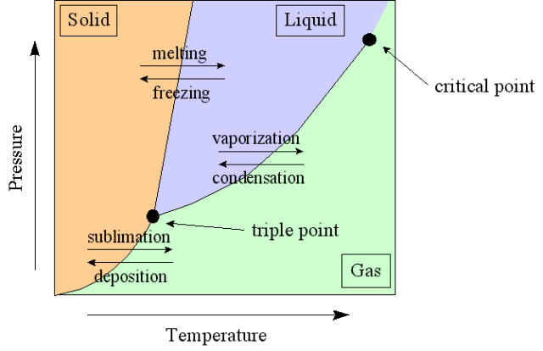
States of Matter
States of matter can be described with phase diagrams
A phase diagram is a graphical way to depict the effects of pressure and temperature on the phase of a substance.

Slide 12
Phase Diagrams
Regions not on a line represent conditions of temperature and pressure where only one particular phase is present
Gases are most likely under conditions of high temperature
Solids are most likely under conditions of high pressure

Slide 13
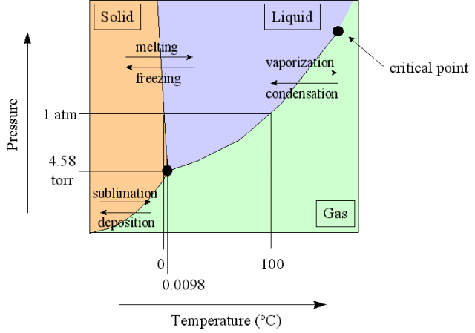
Phase Diagrams
The frozen state of water (ice) is actually less dense than the liquid state, thus, the liquid state is more compact than the solid state
Increasing pressure, which will favor compactness of the molecules, will thus favor the liquid state
Increasing pressure will thus lower the temperature at which the solid will melt

Slide 14
Phase Diagrams
Triple Point – all three states of matter can exist in equilibrium
Critical Point – point where gases cannot be liquefied

Slide 15
Matter and Energy
Matter Can Posses Energy
Matter
Changes in Temperature and Pressure create phase changes
Entropy of Matter is Influence by Energy
Energy Affects the States of Matter
Matter transfers energy in different ways
Changes in Energy can be measured

Slide 16
States of Matter
States can be described in terms of Entropy
Entropy = measure of molecular disorder
What increases entropy of matter?
Heating
Melting
Evaporation
Dissolving

Slide 17
States of Matter and Entropy
Relative Entropies: Solid < Liquid < Gas

Slide 18
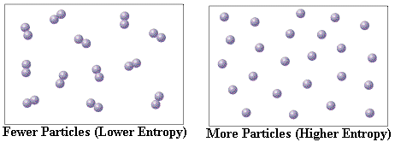
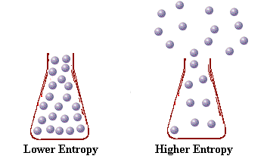
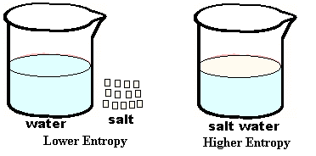
States of Matter and Entropy
Entropy increases with increasing temperature (kinetic energy).

Slide 19
Summary
What you are expected to do.
Describe the states of matter in terms of the relative amounts of KE and AF
Describe the molecular motion of each state of matter
Explain how temperature and pressure affect the phases of matter
Define entropy and use it to describe states of matter.

