Slide 1
Earth Science Notes
Air Masses and Weather Fronts

Slide 2
Objectives
I can…
Explain what an air mass
Describe different weather fronts.
Explain how weather is created by passing fronts.

Slide 3
Air Masses
Air Masses are bodies of air that possess the same characteristics like temperature and humidity.
You have read about these air masses in your book.
Can cover hundred of thousands of square miles
Can have some variation within
Air masses originate in an area called a source region.
The longer the air mass stays over its source region, the more likely it will acquire the properties of the surface below.

Slide 4
Air Masses
There are four general air mass classifications categorized according to the source region.
polar latitudes P - located poleward of 60° north and south
tropical latitudes T - located within about 25° of the equator
continental c - located over large land masses--dry
marine m - located over the oceans----moist

Slide 5
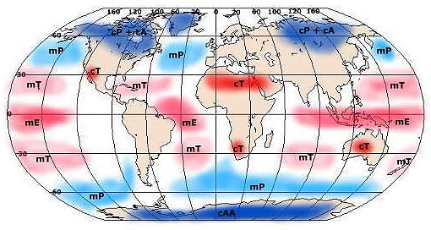
Air Masses

Slide 6
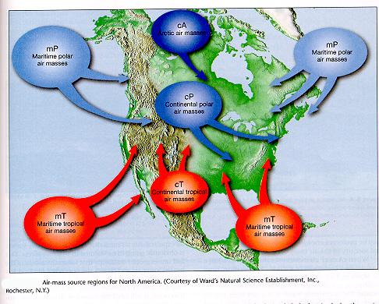
Air Masses

Slide 7
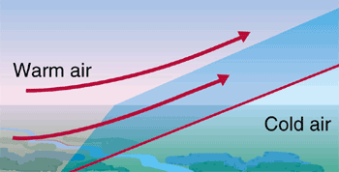
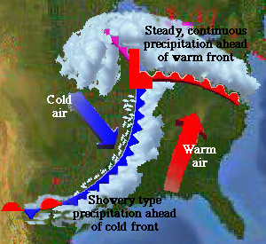
Factors that affect weather
Weather Fronts – the boundary between two air masses with different temperatures, densities, and amounts of moisture.

Slide 8
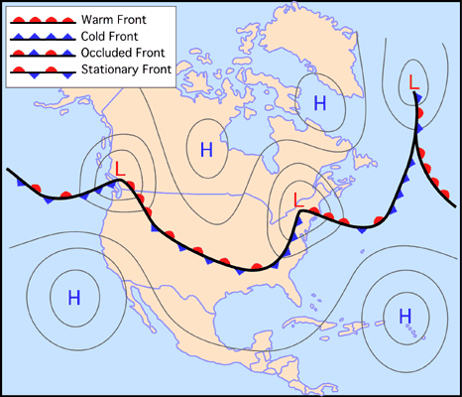
Fronts

Slide 9
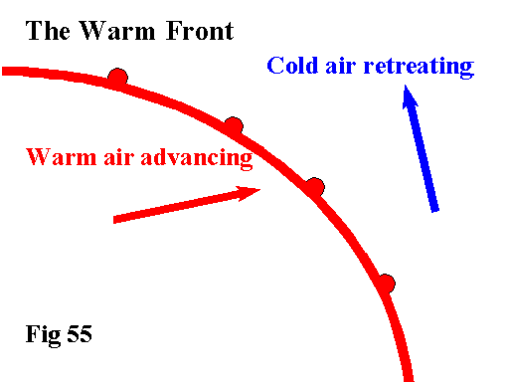
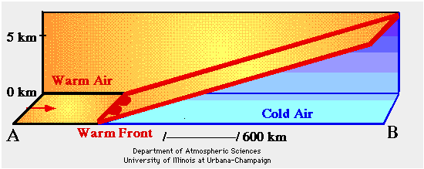
Fronts
Warm front – lighter warmer air advances toward colder denser air masses
Because of their slow rate of advance and very low slope, warm fronts usually produce light to moderate precipitation over a large area for an extended period.

Slide 10
Fronts
Cold front – colder air advances toward warm air mass
When cold fronts advanced warm air is pushed up into the troposphere at a faster rate. This creates cumulonimbus clouds and thunderstorms result.

Slide 11
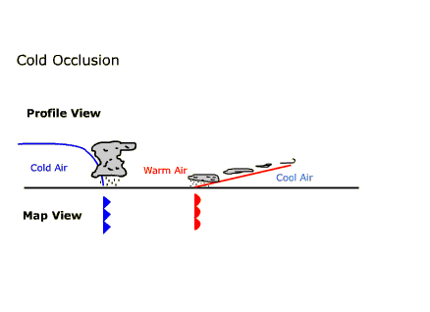
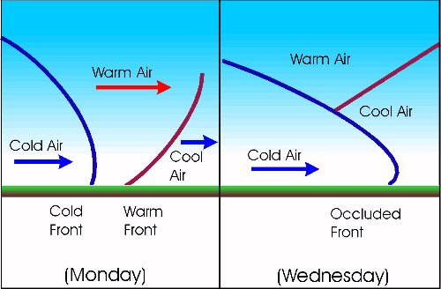
Fronts
Occluded front – cold air and cool air collide with warm air in the middle. Warm air moves up.

Slide 12
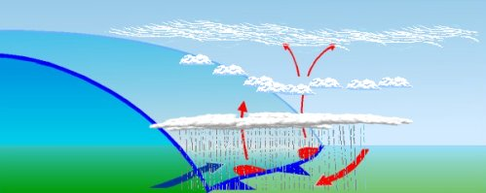
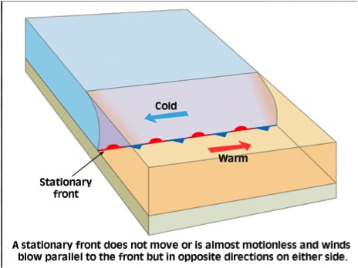
Fronts
Stationary front – warm and cold fronts collide and neither advances

Slide 13
Fronts

Slide 14
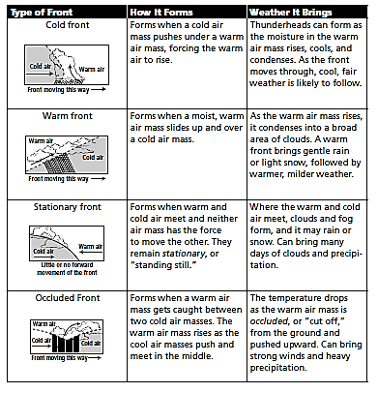
Weather Associated with Each Front

Slide 15
Severe Weather
Produced by collision of different air masses (i.e. FRONTS) or rapid change in conditions.
Example: T-Storms, tornadoes, hurricanes, blizzards, etc.
Be able to explain each example

Slide 16
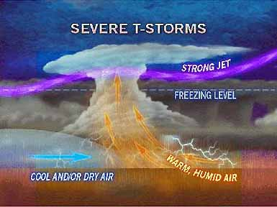
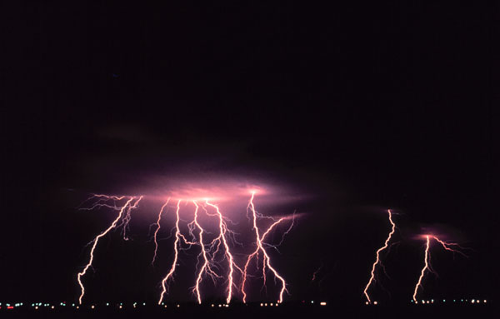
Thunderstorms
Facts About Thunderstorms
They may occur singly, in clusters, or in lines.
Some of the most severe occur when a single thunderstorm affects one location for an extended time.
Thunderstorms typically produce heavy rain for a brief period, anywhere from 3 0 minutes to an hour.
Warm, humid conditions are highly favorable for thunderstorm development.

Slide 17
Tornadoes
A violently rotating column of air…
in contact with the ground
hanging from a cumulonimbus cloud
often (but not always) visible as a funnel cloud.

Slide 18
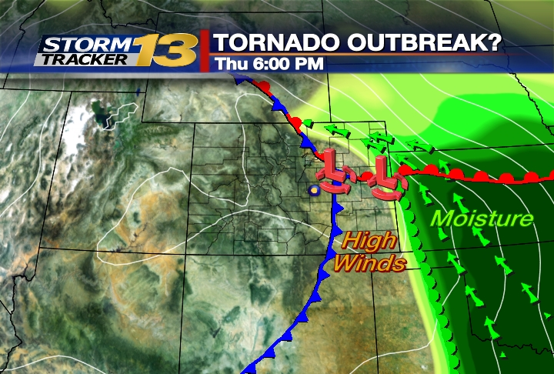

Slide 19
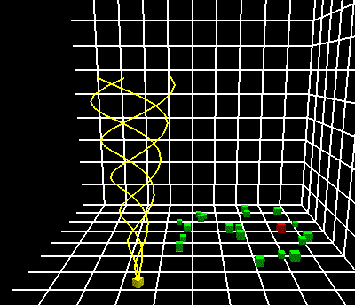
Tornadoes

Slide 20
Hurricanes
A hurricane is an intense, rotating oceanic weather system that circles around a region of low pressure.
possesses maximum sustained winds exceeding 119 km/hr (74 mph).
It forms and intensifies over tropical oceanic regions.

Slide 21
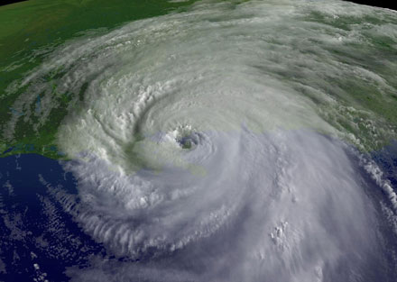
Hurricanes

Slide 22
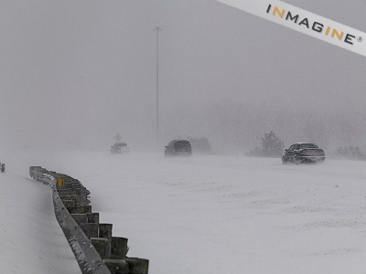
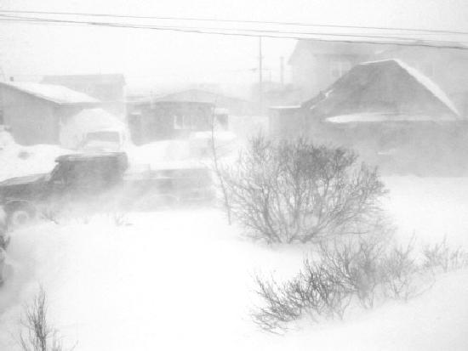
Blizzards
The U.S. Weather Bureau definition:
A snowstorm with winds of at least 35 mph, temperatures 20 degrees F or lower over the period of the storm is a plain "blizzard."
A severe blizzard has 45 mph or greater winds, blowing snow and temperatures at 10 degrees F or below.

Slide 23
Assessment
Can I…
Explain what an air mass
Describe different weather fronts.
Explain how weather is created by passing fronts.
Describe different types of severe weather.

