Slide 1
Earth Science Notes
Wind Erosion

Slide 2
Objectives
I can…
Explain how wind changes the Earths surface
Describe the different types of Wind Erosion
Describe the process of dune formation and identify the dune types.

Slide 3
Erosion
Recall: Types of Erosion we have discussed
Mass movement
Glaciers
Water Erosion
Rill, Gully, & Sheet Erosion
Stream Erosion
Cave Formation

Slide 4
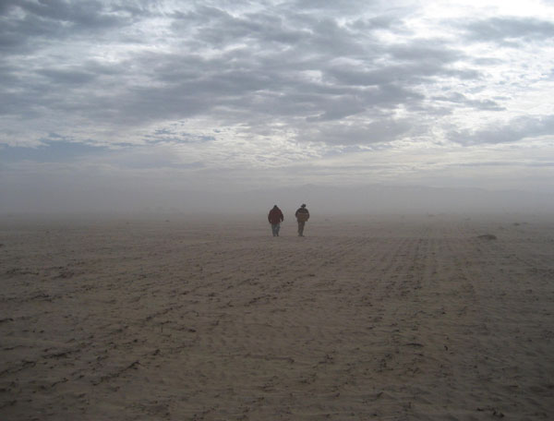
Wind Erosion
Wind Erosion is another form of erosion.
Wind Erosion is a common phenomenon occurring mostly in flat, bare areas; dry, sandy soils; or anywhere the soil is loose, dry, and finely granulated.

Slide 5
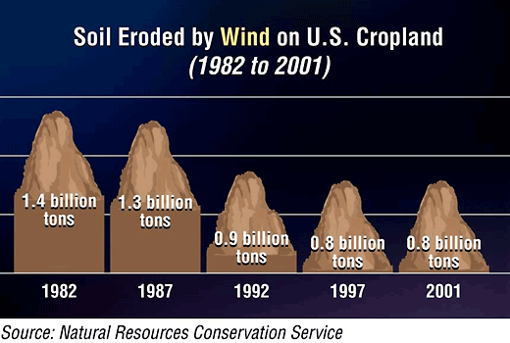
Wind Erosion
Wind erosion damages land and natural vegetation by removing soil from one place and depositing it in another.
It causes soil loss, dryness and deterioration of soil structure, nutrient and productivity losses and air pollution.

Slide 6
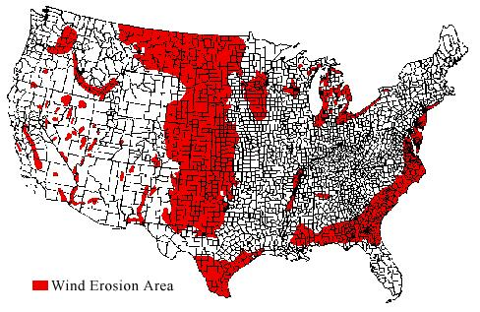
Wind Erosion
Areas of Wind Erosion – Nationally

Slide 7
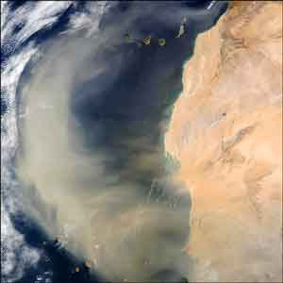
Types of Wind Erosion
Suspension: Fine particles move parallel to the surface and upward into the atmosphere by strong winds.
Suspended particles can travel hundreds of miles.
NASA satellite image of a dust storm carrying particles off the coast of west Africa.

Slide 8
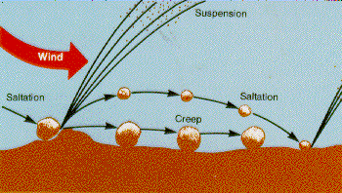
Types of Wind Erosion
SALTATION: Movement of particles by a series of short bounces along the surface of the ground, and dislodging additional particles with each impact.
Depending on conditions, this process accounts for 50 to 90% of the total movement of soil by wind.

Slide 9
Types of Wind Erosion
SOIL CREEP: The rolling and sliding of larger soil particles along the ground surface.
Accounts for 5 to 25% of total soil movement by wind.
Different from the mass movement creep

Slide 10
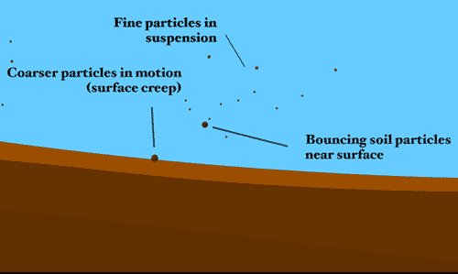
SUSPENSION
SOIL CREEP
SALTATION

Slide 11
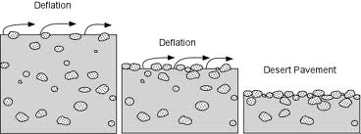
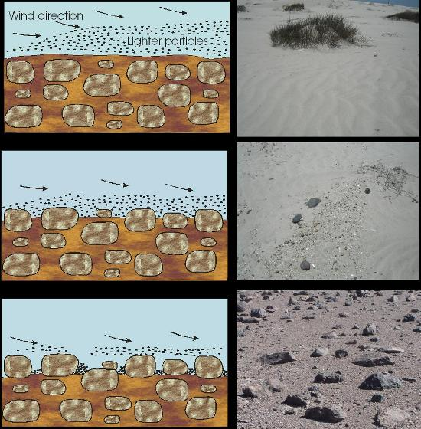
Wind Erosion
Wind can lower the level of land. This process is called deflation.
Wind causes the lifting and transport of lighter particles from a dry soil, leaving behind a surface of coarse grained sand and rocks.

Slide 12
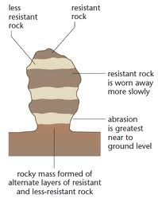
Wind Erosion Affects
When wind picks up sediments and causes it to contact surfaces creating damage. This process is called abrasion.
Wind carrying quartz is effective at wearing down surfaces. Quartz is a 7 on Mohs Hardness Scale

Slide 13
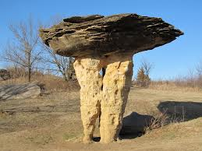
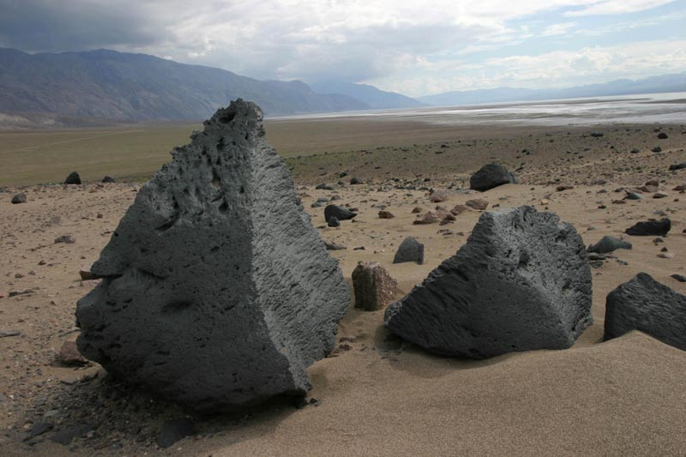
Wind Erosion Affects
Abrasion is the cause for a lot of unique rock formation.
Rocks shaped by wind blown sediments are called ventifcats.

Slide 14
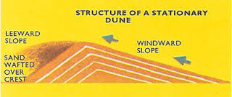
Wind Erosion Affects
Wind eventually deposits sediments leaving dunes.
Terms to know about Dunes
Windward side – side facing wind, less of a slope
Leeward side – side facing away from wind, steeper slope.

Slide 15
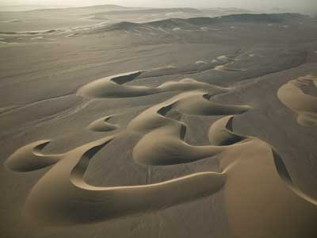
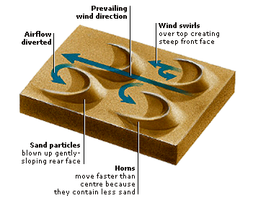
Wind Erosion Affects
Type of Dune: Barchan
The Barchan dune are crescent shaped.
These are the fastest moving dunes and are formed by the wind continuously coming from one direction.

Slide 16
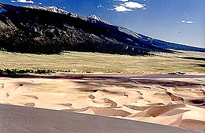
Wind Erosion Affects
Type of Dune: Transverse
Barchan dunes can become aligned together along a plane perpendicular to become transverse dunes.

Slide 17
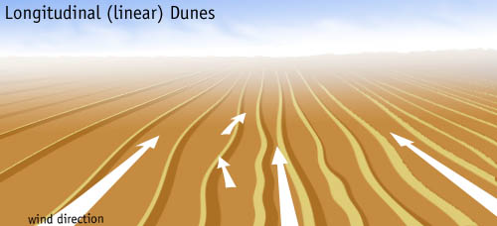
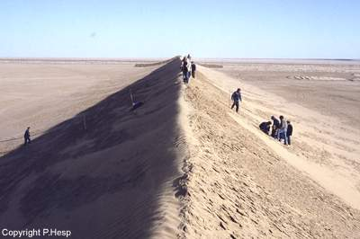
Wind Erosion Affects
Type of Dune: Longitudinal
When barchan dunes become highly elongated, they may form into longitudinal dunes.
In other parts of the world, such as in Africa, great fields of longitudinal dunes can dominate the landscape for hundreds of miles.

Slide 18
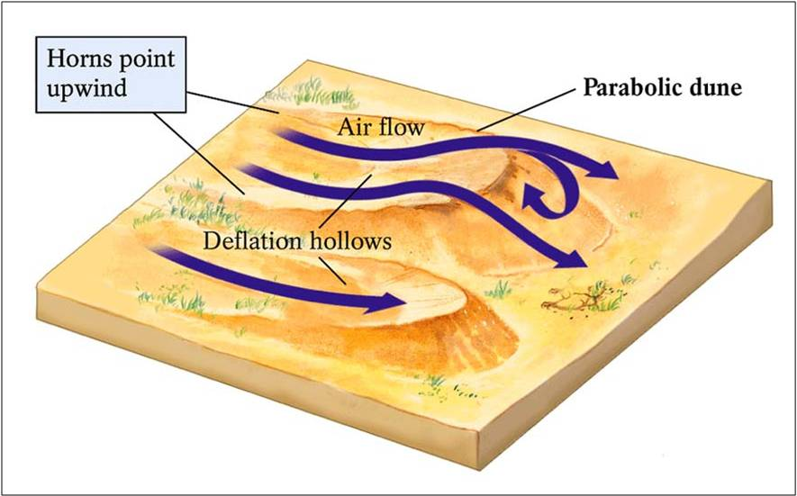
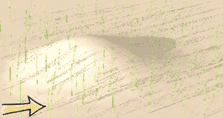
Wind Erosion Affects
Type of Dune: Parabolic
If strong winds erode a section of the vegetated sand a parabolic dune may form.
Vegetation holds the "arms" of the dune in place as the leeward "nose" of the dune migrates forward.

Slide 19
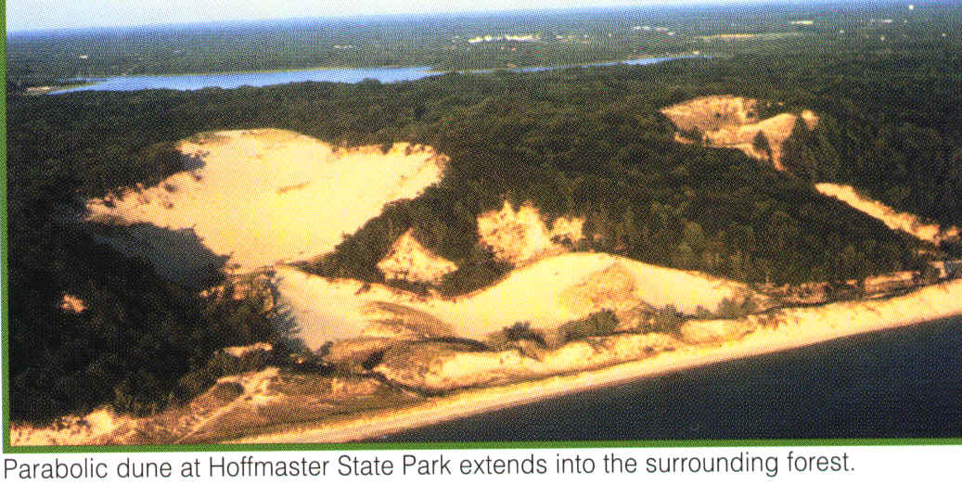

Slide 20
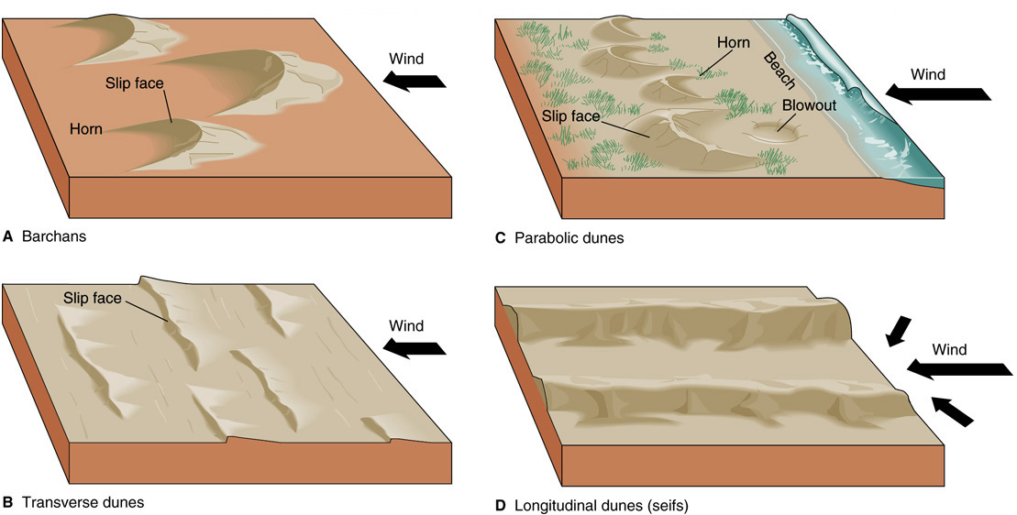
Wind Erosion Affects

Slide 21
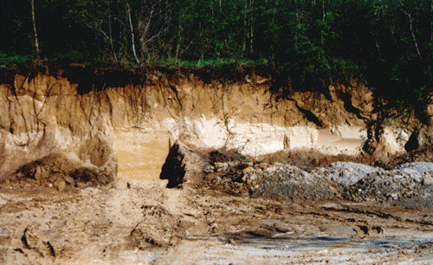
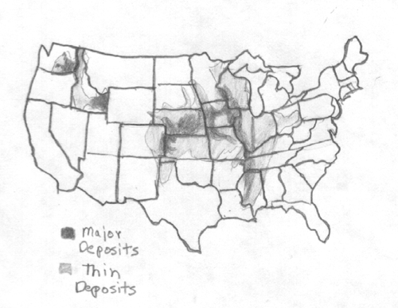
Wind Erosion Affects
Besides sand deposits (dunes) smaller sediments like silt and clay can also be deposited. These deposits are called Loess.
Loess deposits provide for nutrient rich soils.

Slide 22
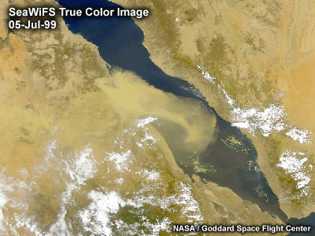
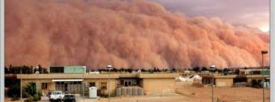
Wind Erosion Affects
Sandstorms – provide for a massive redistribution of sediments.

Slide 23
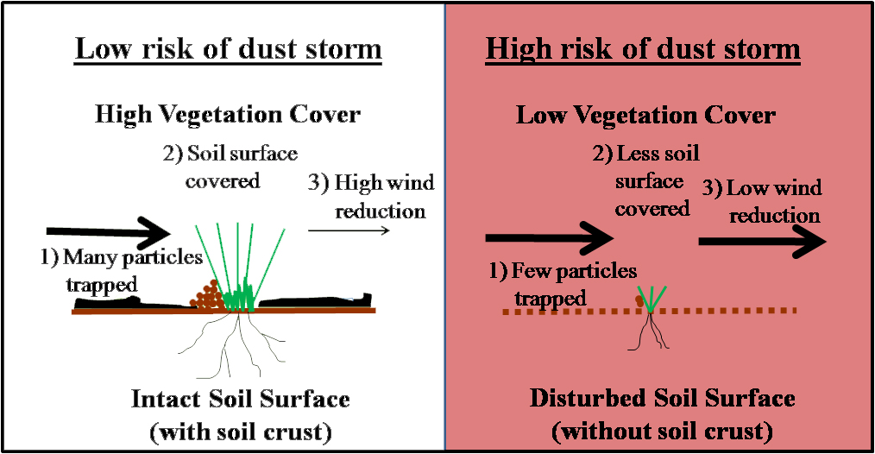

Slide 24
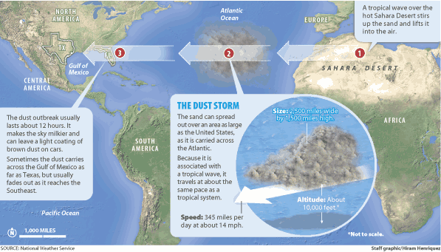

Slide 25
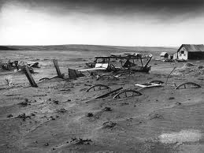
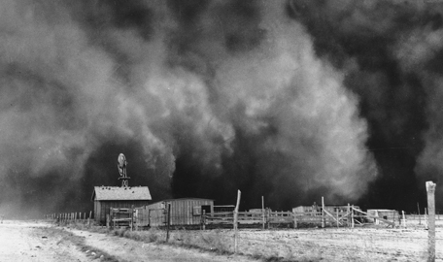
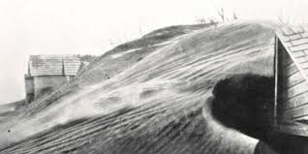
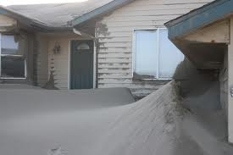
Sandstorm Aftermath

Slide 26
Assessment
Can I…
Explain how wind changes the Earths surface
Describe the different types of Wind Erosion
Describe the process of dune formation and identify the dune types.
Describe the affects of soil erosion

