Slide 1
Earth Science Notes
Fuels and Other Energy Resources

Slide 2
Objectives
I can…

Slide 3
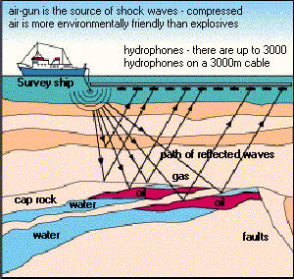
Obtaining Natural Resources: Drilling
Before oil can be removed it has to be located.
A sound wave is generated and the return waves will be reflected differently is there is a change in the medium.
Sound will be reflected differently off oil than it is off stone and even water.
Speed and intensity of the wave are altered.

Slide 4
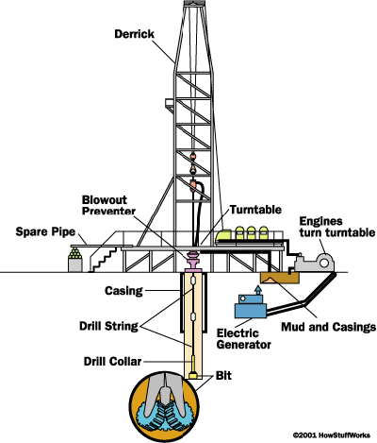
Obtaining Natural Resources: Drilling
Once oil is located, drilling begins. A derrick is set up, which holds the drilling apparatus.
A drill bit burrows through layers of rock until it gets to the oil reservoir.
New sections of drill pipe are added as the hole gets deeper.

Slide 5
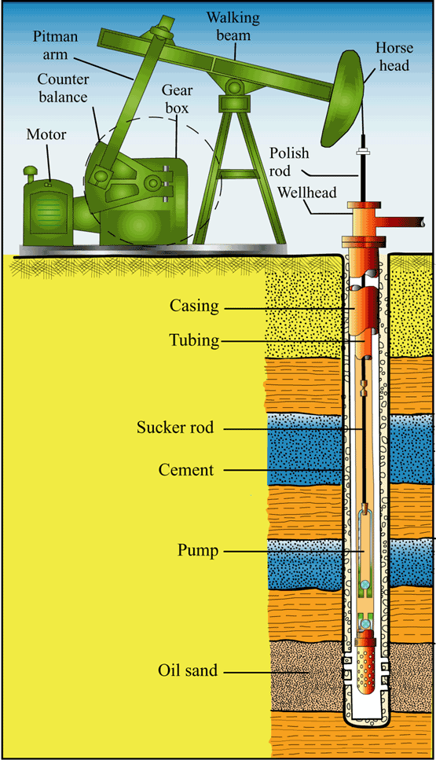
Obtaining Natural Resources: Drilling
After the rig is removed, the crew puts a pump on the well head.
A motor drives a gear box that moves a lever.
The lever pushes and pulls a rod up and down. The rod is attached to a sucker rod, which is attached to a pump.
This system forces the pump up and down, creating a suction that draws oil up through the well.

Slide 6
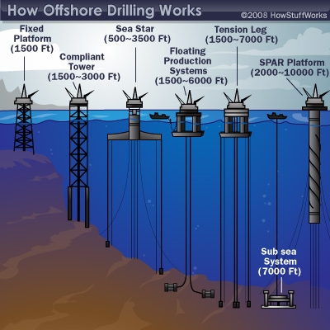
Obtaining Natural Resources: Drilling
Offshore drill is achieved differently at different depths.
The fixed platform is simply a tower that rests on concrete.

Slide 7
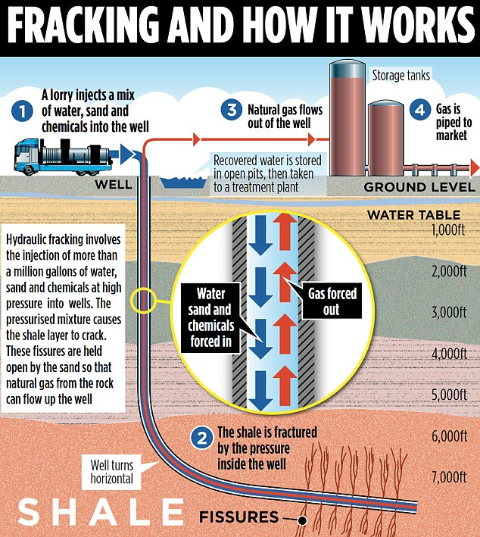
Obtaining Natural Resources

Slide 8
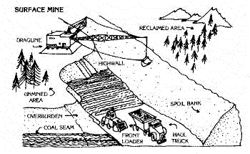
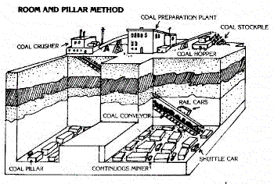
Obtaining Natural Resources: Mining
Mining is the extraction of valuable minerals form the Earth.
Coal is mined in two ways:
Surface Mine
Underground Mine

Slide 9
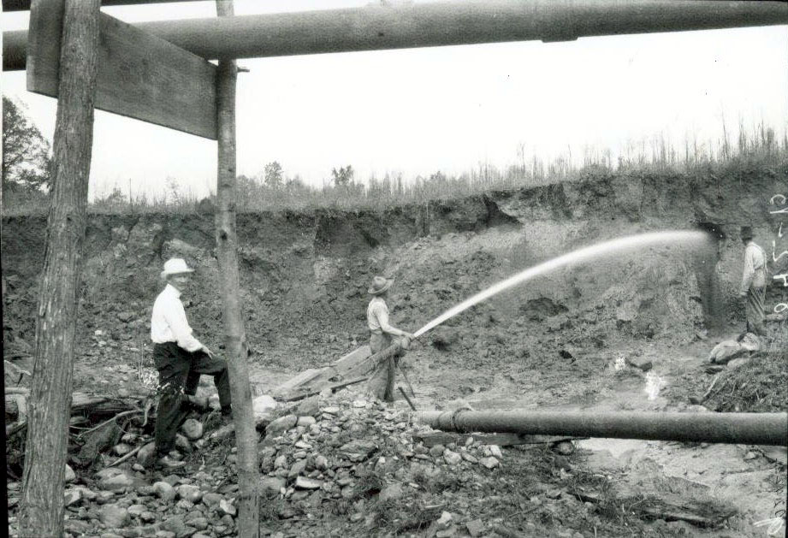
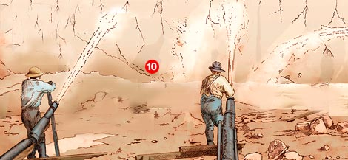
Obtaining Natural Resources: Mining
Hydraulic mining is another form of mining. It involves removing earth with high pressure water.
This method is used to obtain valuable sediments from the soil.

Slide 10
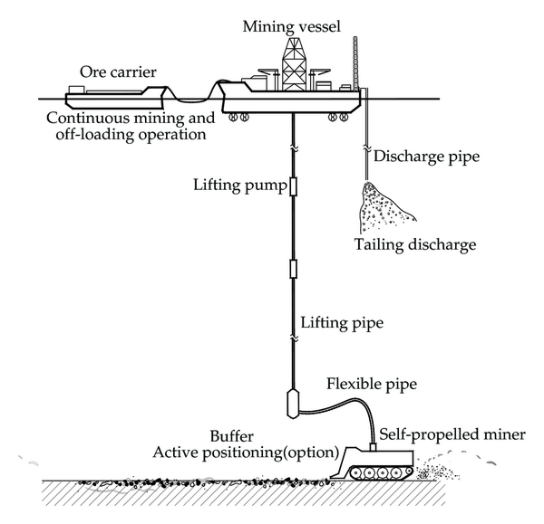
Obtaining Natural Resources: Mining
Deep Sea Mining is a relatively new method.
This method entails breaking and then sucking up the seafloor. The sediments are sorted on the ship and the unwanted materials are put back in the water.
This is often done near hydrothermal vents.

Slide 11
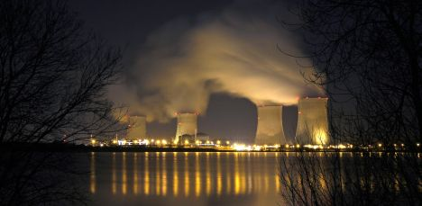
Producing Energy from Natural Resources
Producing Energy
Heating
Doing work (car engines)
Producing power (power plants).

Slide 12
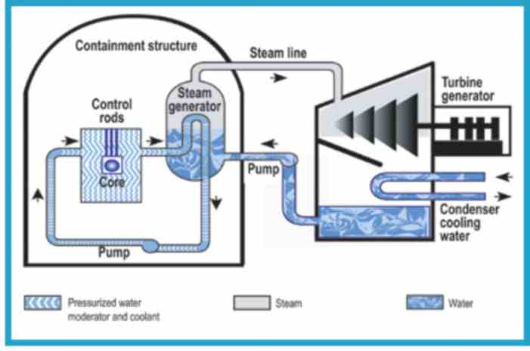
Producing Energy from Natural Resources
Any fuel could be used to power a power plant,
All power plants work the same basic way.
Something causes a turbine to spin (usually steam).
The turbine generator converts mechanical energy to electrical energy by inducing a current in metal wires. This process is called induction.
Electrons flow through the metal wires to homes and businesses.

Slide 13
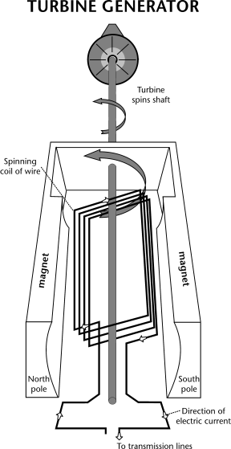
Producing Energy from Natural Resources
How induction works:
The process of converting mechanical energy to electricity is based on the relationship between magnetism and electricity.
In 1831, Faraday discovered that when a magnet is moved inside a coil of wire, electrical current flows in the wire.
The generator has a series of insulated coils of wire that form a stationary cylinder. This cylinder surrounds a rotary electromagnetic shaft.
When the electromagnetic shaft rotates, it induces a small electric current in each section of the wire coil.
Each section of the wire becomes a small, separate electric conductor. The small currents of individual sections are added together to form one large current.
This current is the electric power that is transmitted from the power company to the consumer.

Slide 14
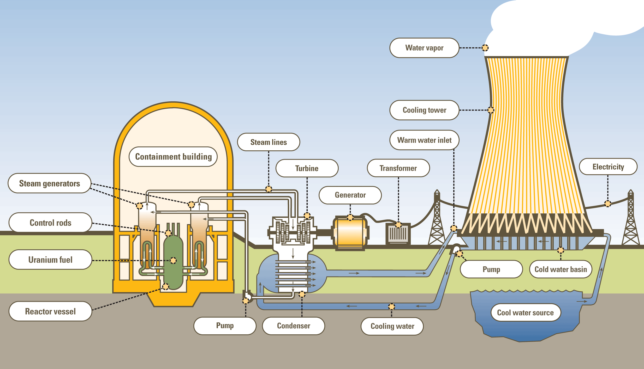
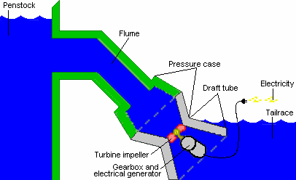
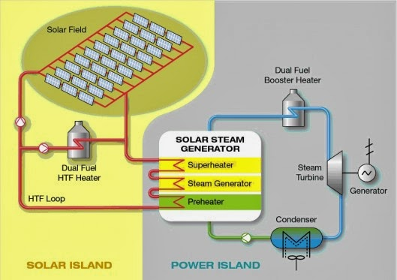
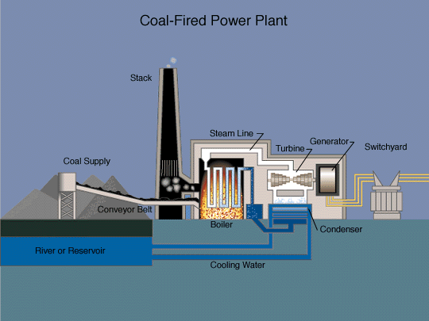
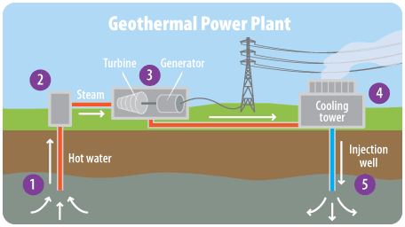
Any fuel could be used to power a power plant

Slide 15
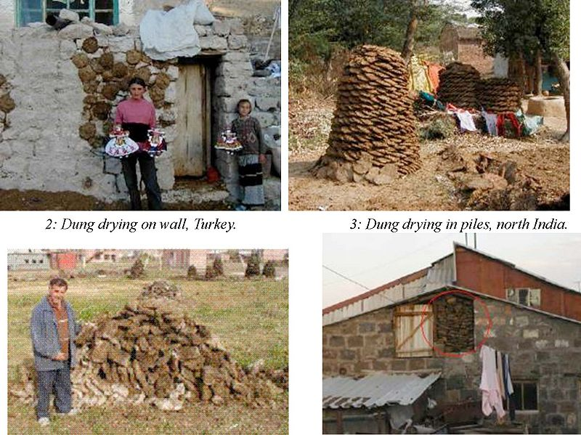
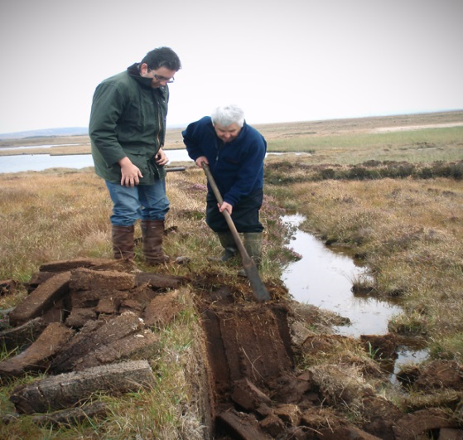
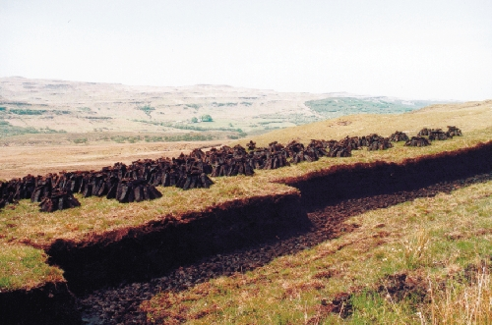
Types of Conventional Resources
Biomass Fuels – fuels derived from living things. Energy is derived from the presence of hydrocarbons made by photosynthesis
Examples: Wood / Plants / Fecal Matter / Peat

Slide 16
Biomass Fuel
Pros of Biomass Fuel
Cons of Biomass Fuel

Slide 17
Types of Conventional Resources
Fossil Fuels – fuel formed from the compression and decomposition of organic matter over a long period of time.
These fuels consist primarily of hydrocarbons.
Ex: Coal / Oil and Natural Gas /Oil Shale
Oil Shale – is a fine-grained rock that contains hydrocarbons called kerogen. The oil shale is crushed and then heated. The vapor produced is condensed and refined and Shale Oil is produced.

Slide 18
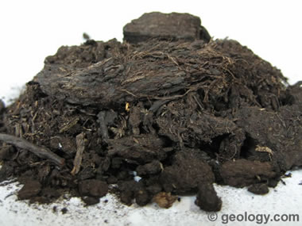
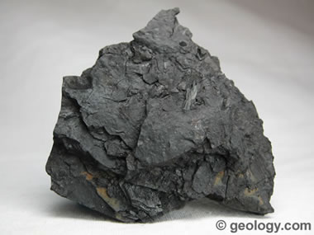
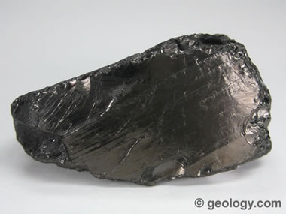
Coal
Peat: A mass of recently accumulated to partially carbonized plant debris. This material is on its way to becoming coal but its plant debris source is still easily recognizable.
Lignite: The lowest rank of coal is "lignite". It is peat that has been compressed, dewatered and lithified into a rock. It often contains recognizable plant structures.
Anthracite Coal: Anthracite is the highest rank of coal. It has a bright luster and breaks with a semi-conchoidal fracture.

Slide 19
Fossil Fuel
Pros of Fossil Fuels
Cons of Fossil Fuel

Slide 20
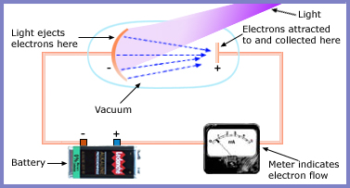
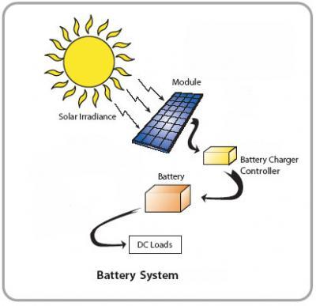
Alternative Energy Resources
Solar Energy – energy obtained from the sun.
Solar cells are used to make electricity using sunlight.
The photoelectric effect → when higher frequency light hits certain metals, electrons are ejected. This can produce a current.

Slide 21
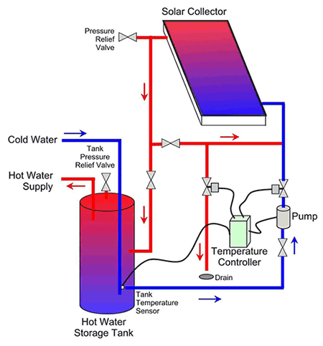
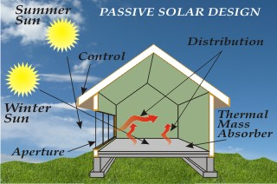
Alternative Energy Resources
Types of Solar heating
Passive – the sun simply warms the material directly
Active - uses devices like solar panels to capture heat.

Slide 22
Solar Energy
Pros of Solar Energy
Cons of Solar Energy

Slide 23
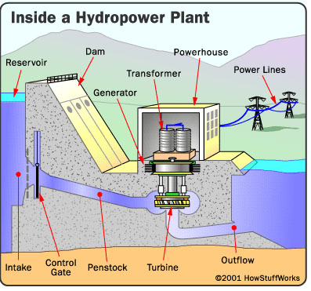
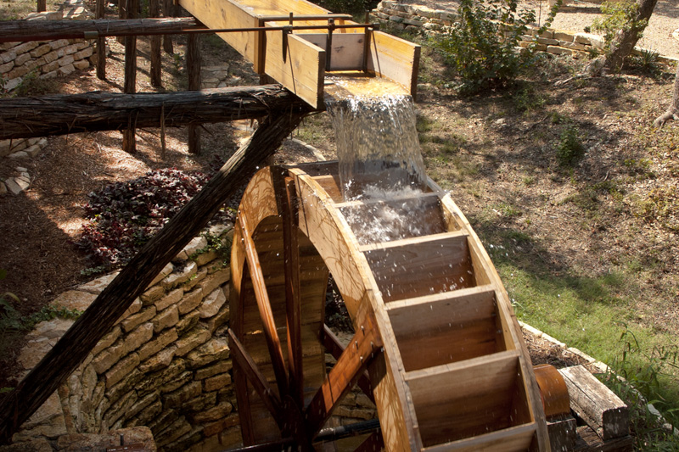
Types of Conventional Resources
Hydroelectric Power – using the energy of falling water to create electricity.
Recall PE to KE? KE is converted to electrical energy.

Slide 24
Hydroelectric Energy
Pros of Hydroelectric Energy
Cons of Hydroelectric Energy

Slide 25
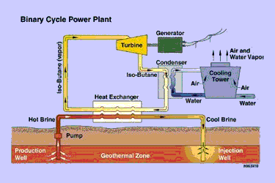
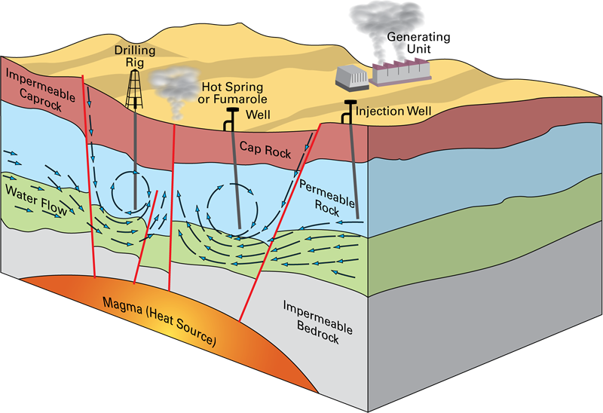
Types of Conventional Resources
Geothermal Power – energy produced when water heated by magma is pressurized and blows over a turbine to generate electricity.

Slide 26
Geothermal Energy
Pros of Geothermal Energy
Cons of Geothermal Energy

Slide 27
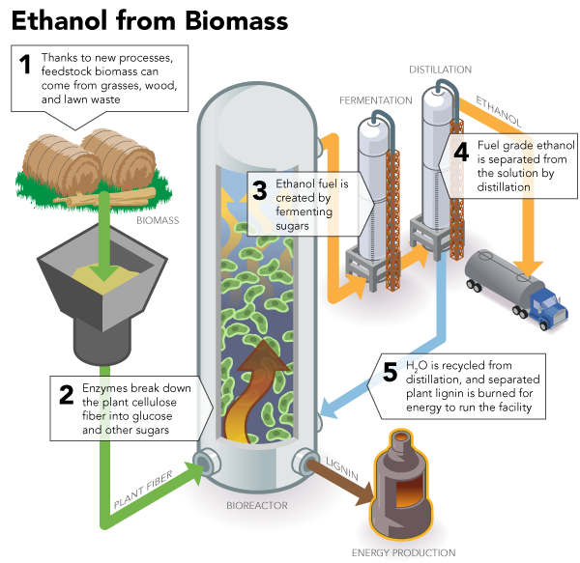
Types of Conventional Resources
Biofuels – like biomass fuels, these come from crops, eood, etc. But biofuels are further refined to become more like gasoline.
Ex: Ethanol

Slide 28
Biofuels
Pros of Biofuels
Cons of Biofuels

Slide 29
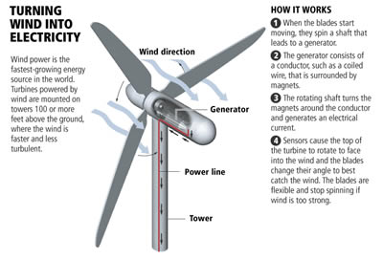
Obtaining Natural Resources
Wind Energy – using the kinetic energy (moving mass of air) to generate electricity.

Slide 30
Wind Energy
Pros of Wind Energy
Cons of Wind Energy

Slide 31
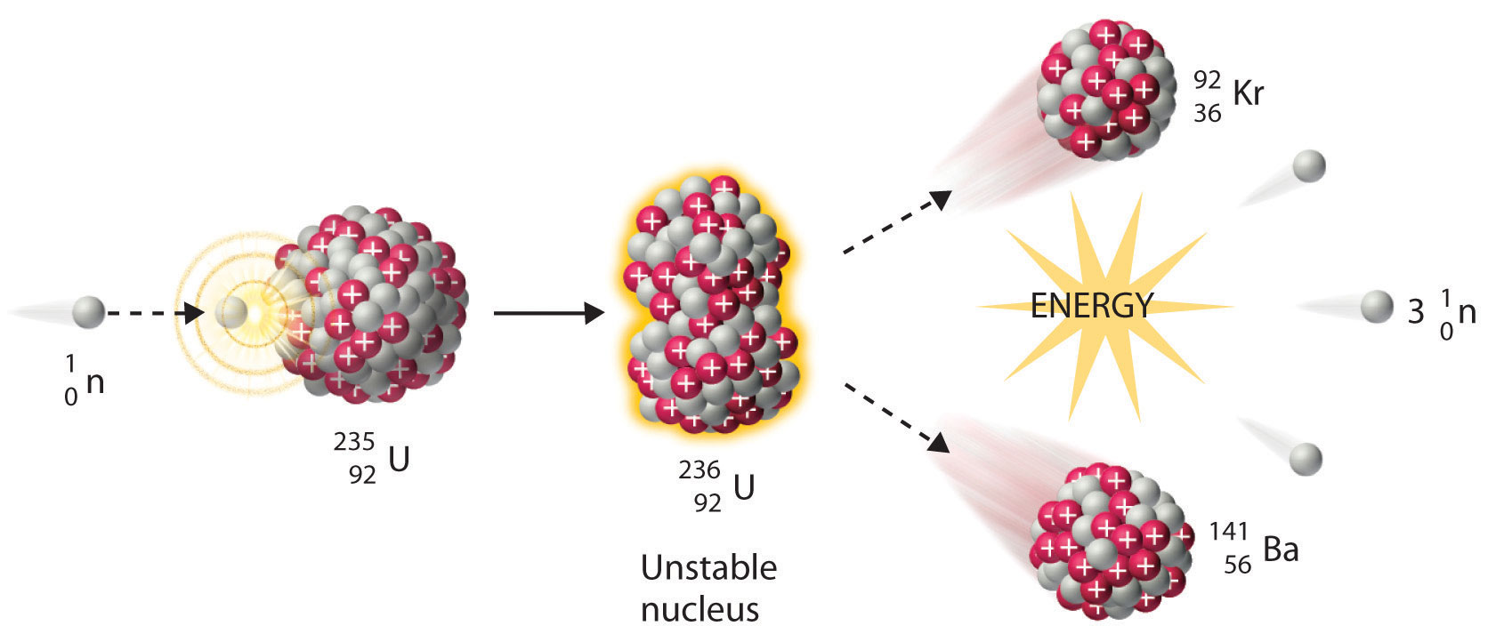
Obtaining Natural Resources
Nuclear Power – energy is produced by the splitting of atoms. This process is called nuclear fission.

Slide 32
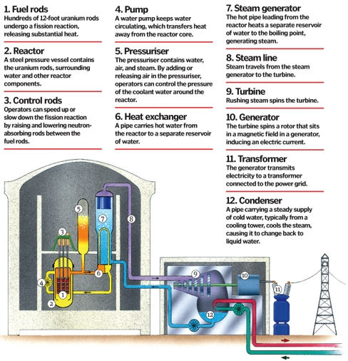
A Nuclear Reactor

Slide 33
Nuclear Energy
Pros of Nuclear Energy
Cons of Nuclear Energy

Slide 34
Read the sections in the textbook related to these notes (25.1 and 25.2).
Begin thinking about what way the US should go in terms of energy.
Be ready for discussion.

