Slide 1
Earth Science Notes
Igneous Rocks

Slide 2
Objectives
I can…
Define and describe Igneous Rocks
Explain how different Igneous Rocks are formed
Explain the process of Partial Melting and Fractional Crystallization
Classify and Identify Igneous Rocks

Slide 3
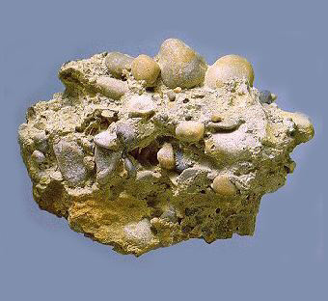
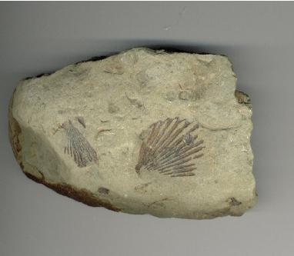
Definition of Rock
Mixture of minerals, volcanic glass, organic matters, other rock fragments and other natural materials.

Slide 4
Definition of Rock
Rocks differ from minerals in that they do not have definite compositions.
A mineral is a pure substance whereas a rock is a mixture
There are basically three groups of rocks
Igneous, metamorphic and sedimentary.

Slide 5
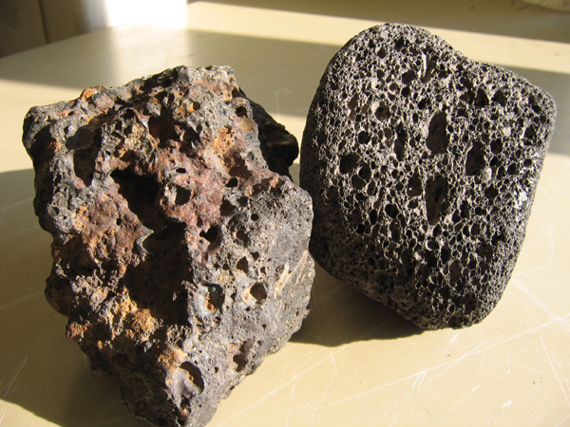
Igneous Rocks
Igneous Rocks that form from magma or lava

Slide 6
Formation of Igneous Rocks
(Rock → Magma)
Partial Melting
When rocks begin to melt the minerals in them melt at different temperatures
Some minerals melt at low temperatures while others melt at higher temperatures .
As each type of mineral melts, the resulting magma’s composition is changed
This is how you get different types of Igneous Rocks

Slide 7
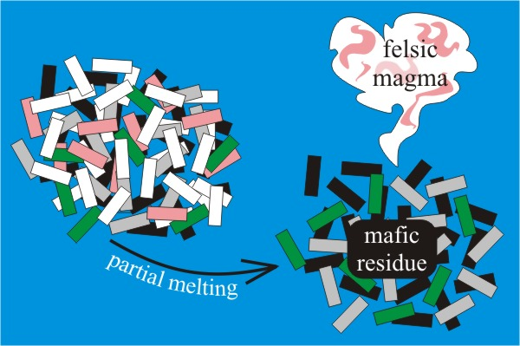
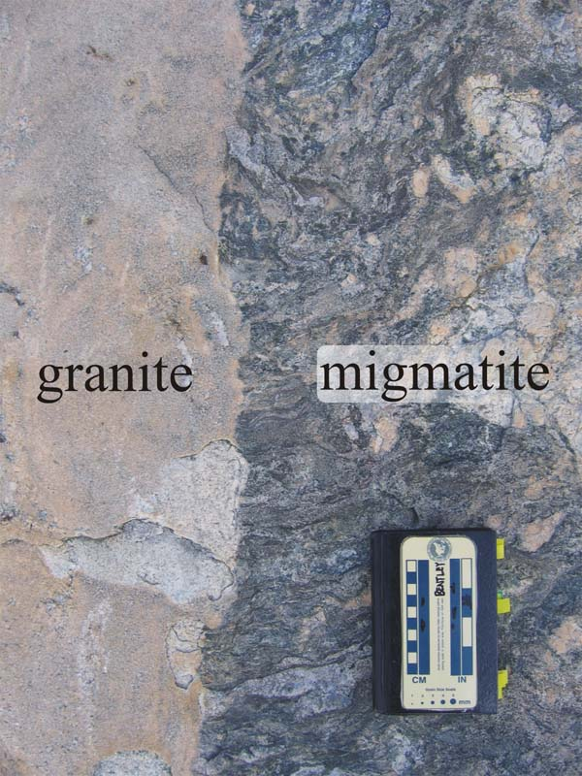

Slide 8
Formation of Igneous Rocks
Making Igneous Rocks (Magma→ Rock)
Fractional Crystallization
As magma cools, the minerals with the higher MP’s crystallize first. These minerals settle to the bottom of the magma.
This is followed by the mineral with the next highest BP, and so on until eventually all minerals are crystallized and you have your rock.

Slide 9
Fractional Crystallization

Slide 10
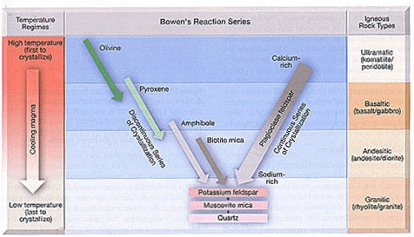
Formation of Igneous Rocks
Making Igneous Rocks (Magma→ Rock)
The Bowen’s Reaction Series
This model shows how minerals crystalize as magma cools to form igneous rocks.
Minerals crystallize in a specific order (according to MP)
Shows us how igneous rocks can vary in their composition

Slide 12
The Bowen’s Reaction Series
The Discontinuous Branch of the series
Different minerals crystallize at definite temperatures
These minerals are said to be mafic, meaning high in Mg and Fe.

Slide 13
The Bowen’s Reaction Series
The Continuous Branch of the series
Minerals composition changes gradually with the Ca-rich minerals crystallizing first, as cooling progresses the minerals become more Na-rich.
These minerals are said to be Felsic, meaning high in silica.

Slide 14
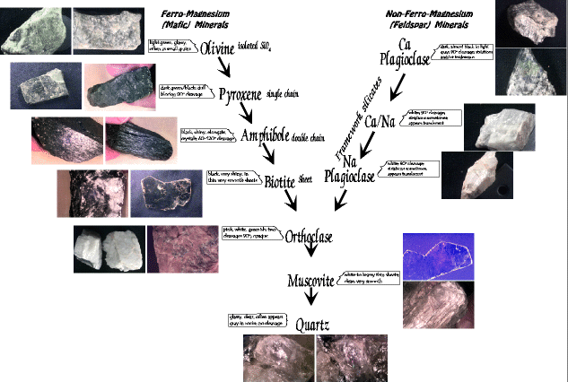

Slide 15
STOP – lets group up and do WS 11 – Bowens reaction series

Slide 16
Classification of Igneous Rock
Classification of Igneous Rock is based on mineral composition, texture, and grain (crystal) size.
Composition is determined by the Bowen Reaction Series
The first minerals to form are Basaltic
The last minerals to form are Granitic
Intermediates are called Andesitic

Slide 17
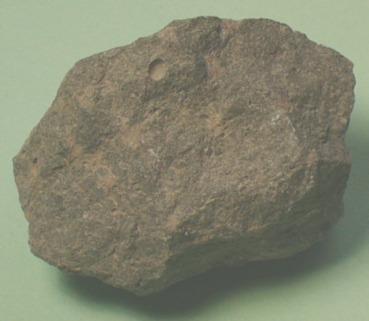
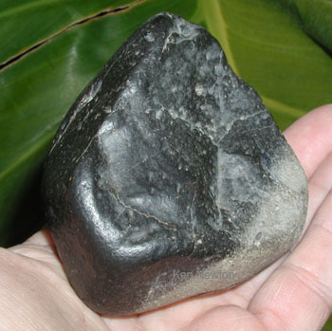
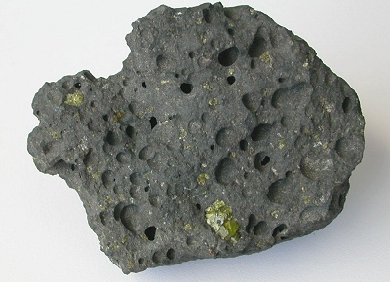
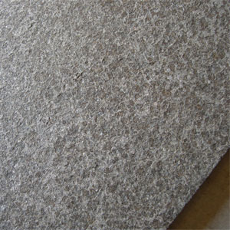
Classification of Igneous Rock
Basaltic Rocks
High Density, Dark Colored,
Very Fluid
Chemical Composition: Iron, Magnesium, low silica (SiO₂)

Slide 18
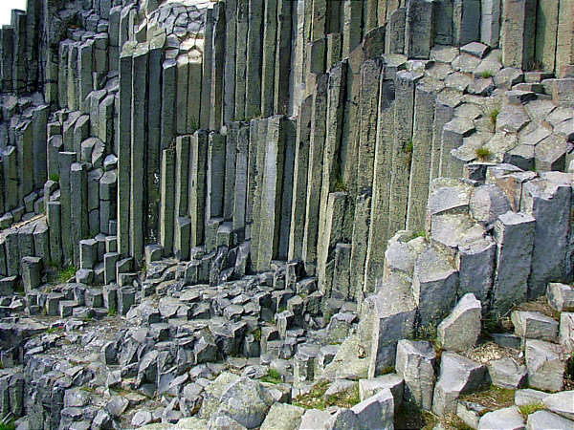
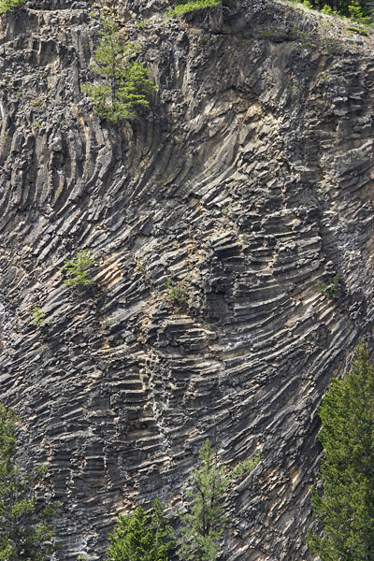
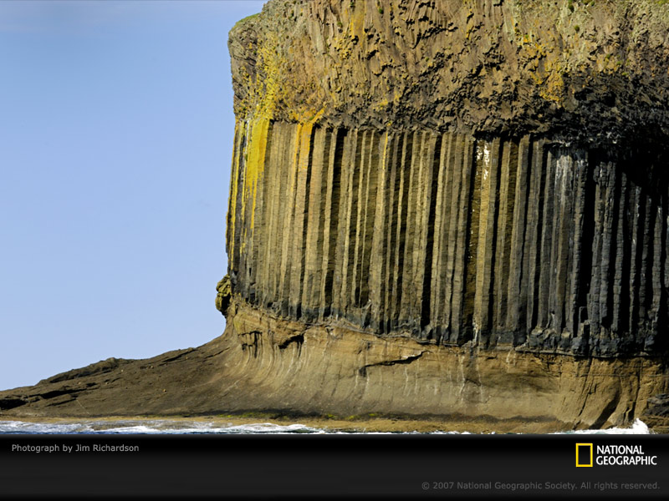
Basalt Rock Formations

Slide 19
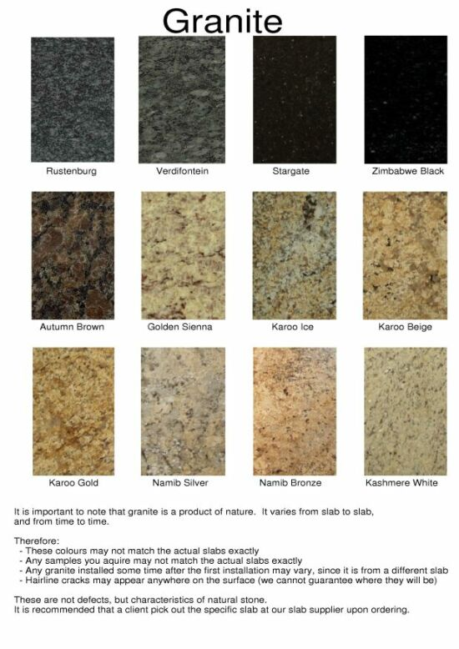
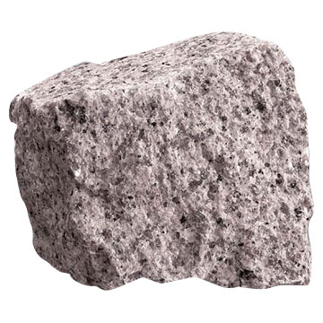
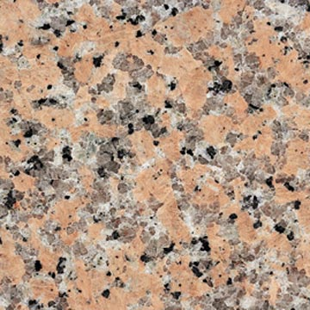
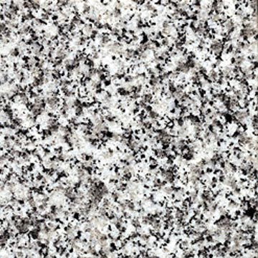
Classification of Igneous Rock
Granitic Rocks
Light Colored, Low Density, Very rigid
Chemical Composition: low magnesium and Iron, high silica (SiO₂)

Slide 20
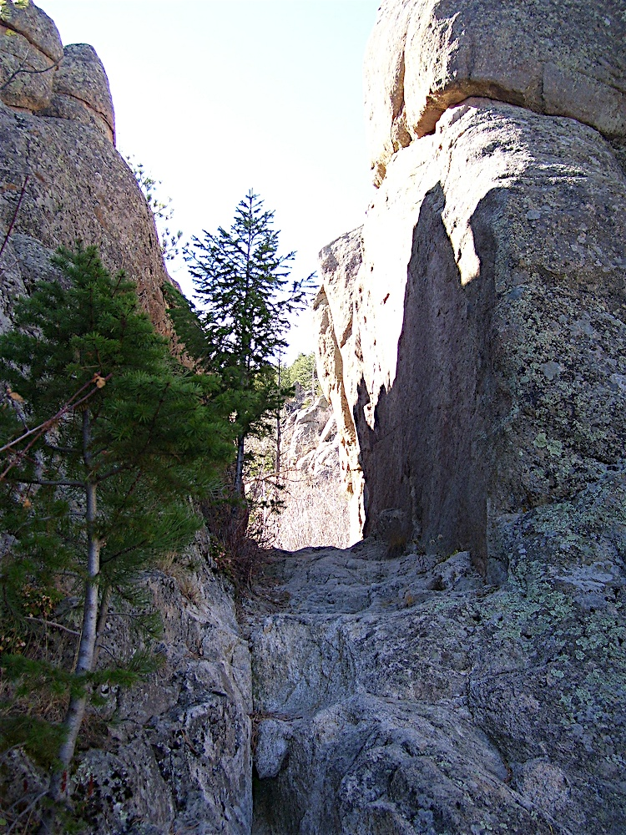
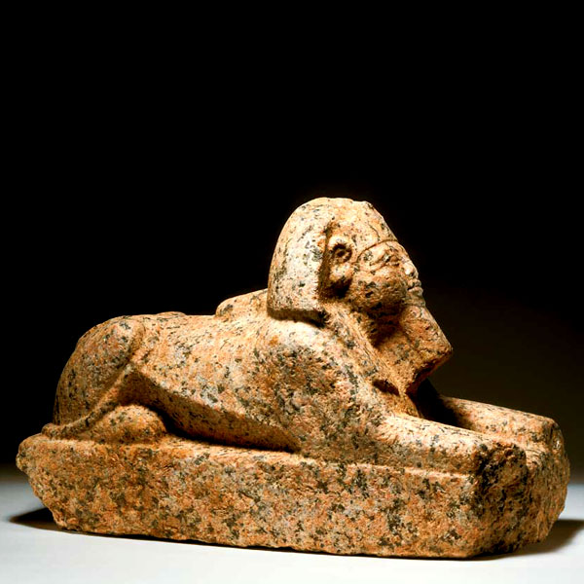
Granitic Rock Formations

Slide 21
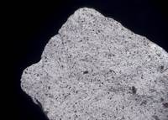
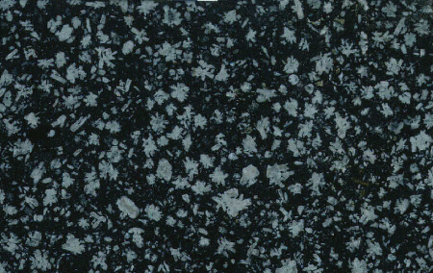
Classification of Igneous Rock
Andesitic Rocks
Intermediate between Basaltic and Granitic

Slide 22
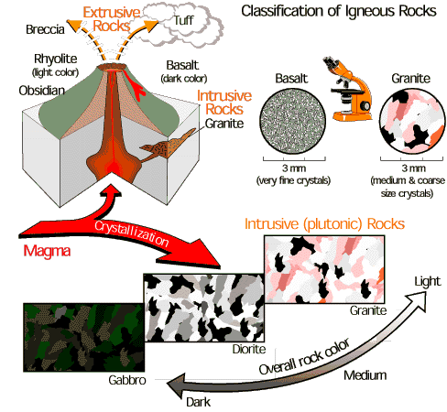

Slide 23
Classification of Igneous Rock
Igneous Rocks are classified by their grain size, which is effected by the rate of cooling.
Intrusive vs. Extrusive
Intrusive rocks: rocks made from magma
These rocks form inside the Earth, so they cool slowly, giving them larger crystals
These rocks cannot be seen until the rock that is around it is worn away.
Sometimes earthquakes will expose intrusive rocks.

Slide 24
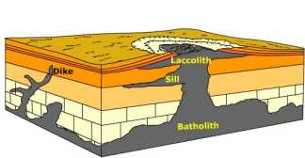
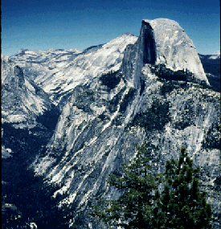
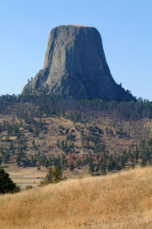
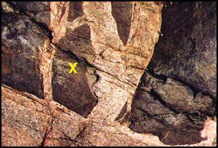
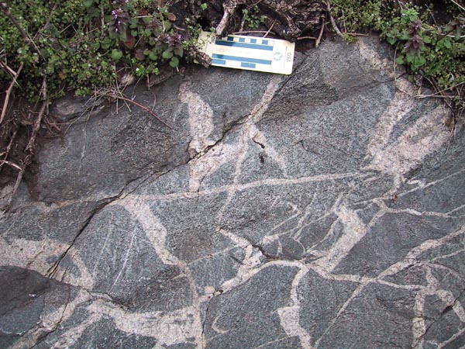
Intrusive Igneous Rocks

Slide 25
Classification of Igneous Rock
Intrusive vs. Extrusive
Extrusive Rocks – rocks formed from lava.
Created when lava cools and hardens on the surface
Because of exposure to the air and other elements (i.e. water) lava will cool quickly, keeping crystals small.
Volcanic glass forms this way.

Slide 26
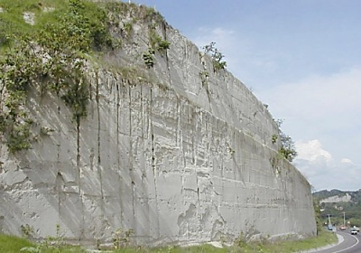
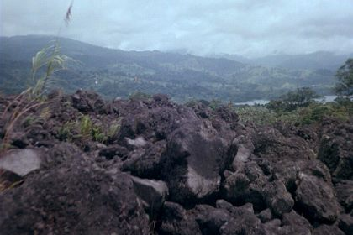
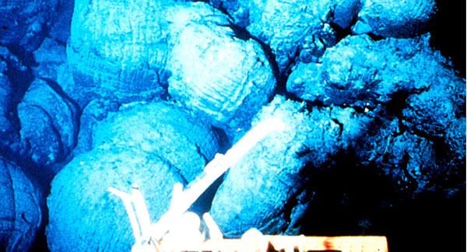
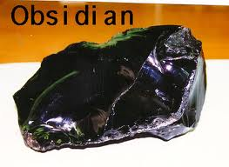
Extrusive Igneous Rocks
Tuff: formed from volcanic ash, pumice and scoria

Slide 27
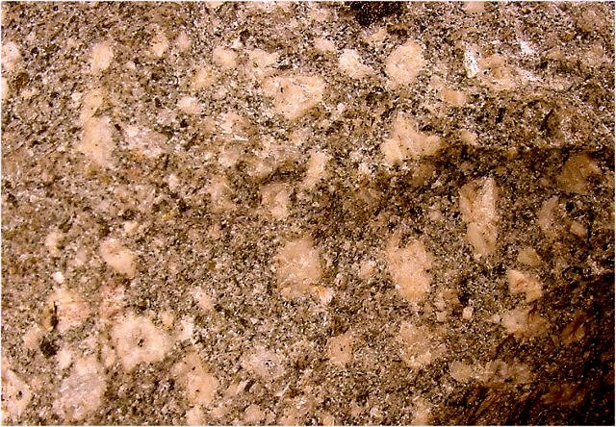
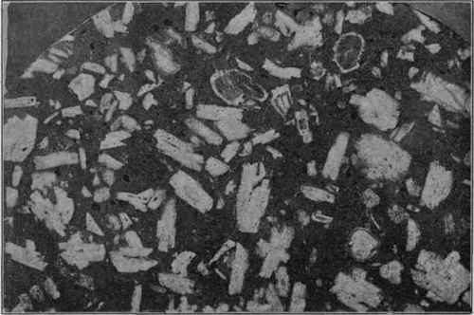
Classification of Igneous Rock
Igneous Rocks are also classified by their Texture
Porphyry – larger crystals surrounded by smaller crystals of the same mineral, and at times others too.

Slide 28
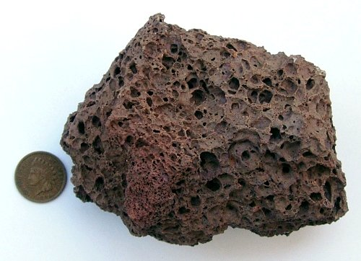
Classification of Igneous Rock
Igneous Rocks are also classified by their Texture
Vesicular – larger porous holes in and through rock. Looks spongy.
Pores are due to gasses trapped in the magma

Slide 29
Identifying Igneous Rocks
A classification scheme, like the one on the next slide and the one on page 119 in your book, are used to determine the identity of a specific rock.
Notice – there is not a definite composition for any specific rock, but rather a range of compositions.
Ex: Rock X

Slide 30
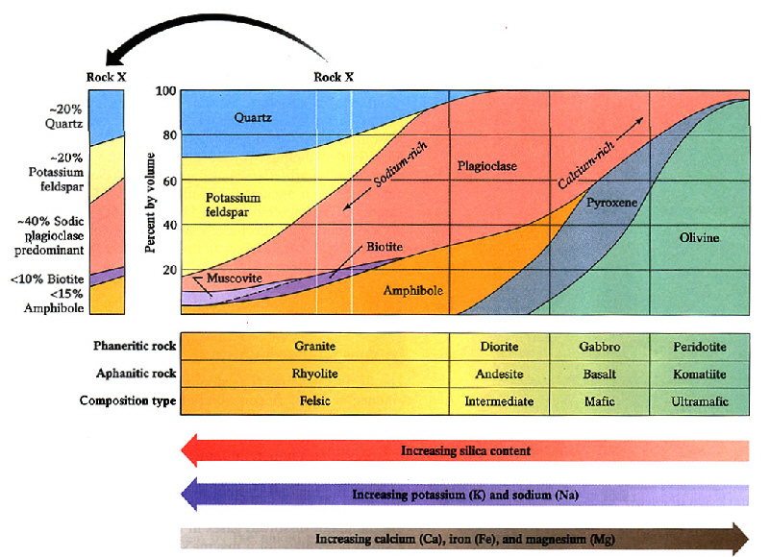

Slide 31
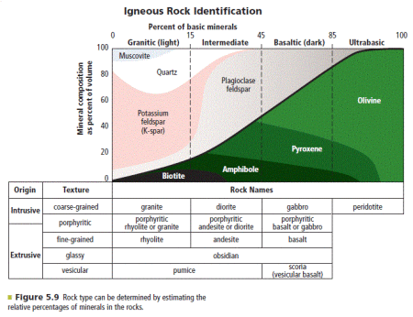

Slide 32
Assessment
Can I …
Define and describe Igneous Rocks
Explain how different Igneous Rocks are formed
Explain the process of Partial Melting and Fractional Crystallization
Classify and Identify Igneous Rocks

Slide 33
