Slide 1
Earth Science Notes
Oceanography

Slide 2
Objectives
I can…
Further describe the hydrosphere
Distinguish Oceans, Seas, Lakes, etc.
Identify the Oceans of the World
Explain how we know what we do about Earth’s Oceans.

Slide 3
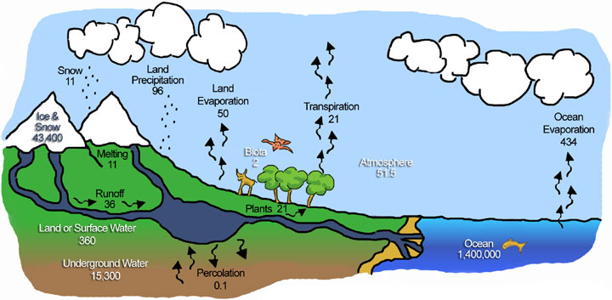
Terms to Review
Water Cycle – the cycle of processes by which water circulates between the earth's oceans, atmosphere, and land.

Slide 4
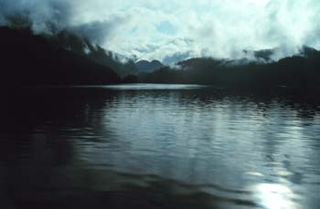
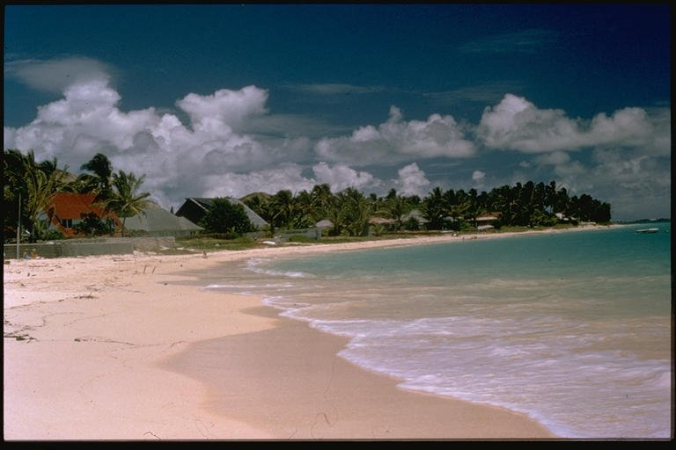
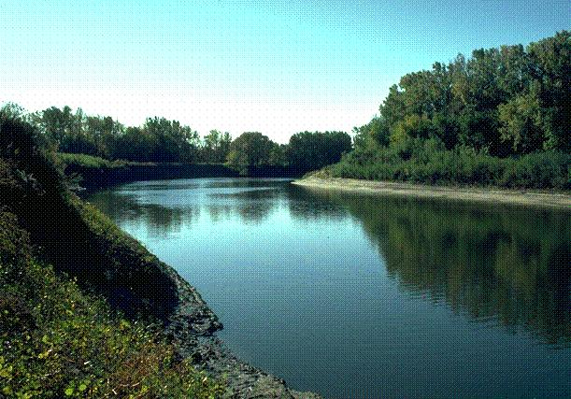
Terms to Review
Hydrosphere –the liquid water component of the Earth.
It includes the oceans, seas, lakes, ponds, rivers and streams.
The hydrosphere covers about 70% of the surface of the Earth and is the home for many plants and animals.

Slide 5
Earth’s Bodies of Water
The Earth’s Hydrosphere contains many types of Bodies of Water.
Many are easily confused with each other because they are so hard to distinguish.
It doesn’t help that a number of terms, like stream and rivers are used interchangeably.
It also doesn’t help that there are bodies of water that are misnamed.

Slide 6
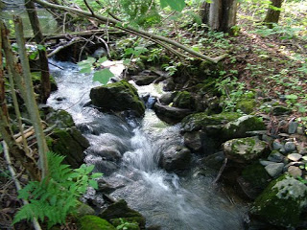
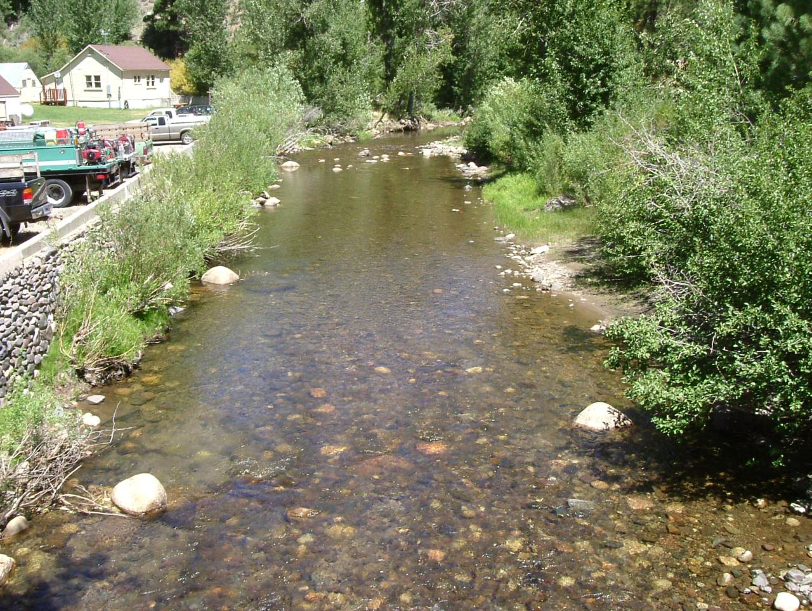
Earth’s Bodies of Water
Rivers vs. Streams vs. Creeks vs. Brooks
Generally, the difference is size: you can step over a brook, jump over a creek, wade across a stream, and swim across a river.
The distinction between them (especially creek and stream) is somewhat hazy, and depends on who named them and when they were named.

Slide 7
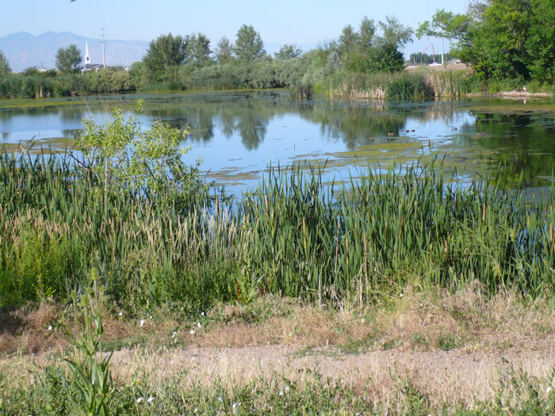
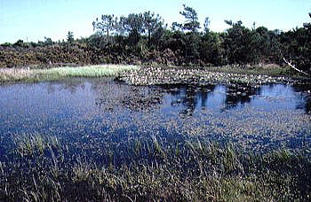
Earth’s Bodies of Water
Lakes vs. Ponds
Ponds are smaller than Lakes and are even less permanent.
Ponds can have more vegetation – even growing all the way across.
Ponds are generally warmer and may freeze all the way.

Slide 8
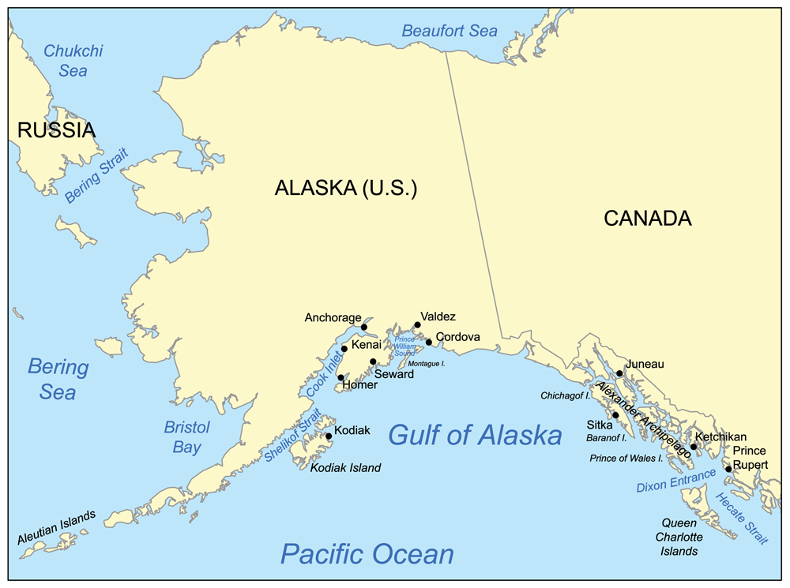
Earth’s Bodies of Water
Bays vs. Gulfs
Again, the difference is size. Gulfs are much larger than bays.

Slide 9
Earth’s Bodies of Water
Seas vs. Lakes
This can be confusing.
Real difference comes down to PERMANCE.
Seas are considered permanent, whereas Lakes are considered temporary in terms of geological time.

Slide 10
Earth’s Bodies of Water
Seas vs. Lakes
Lakes are considered temporary; they go through well defined life cycles
Indentations in Earth’s crust → fills with water → ecosystem formation → eventual draining
Lakes can be formed in a number of ways.
Collapsed volcano / kettle lakes or simply glacial erosion / etc.
Lakes tend to be Landlocked.

Slide 11
Earth’s Bodies of Water
Seas vs. Lakes
Seas are more permanent bodies of water generally attached to an ocean.
The coastline of a sea might change, but the body of water remains.
As a sea is connected to the oceans, which are salt water, most seas are also salt water.
NOT ALL ARE – Sort of (again – confusing)

Slide 12
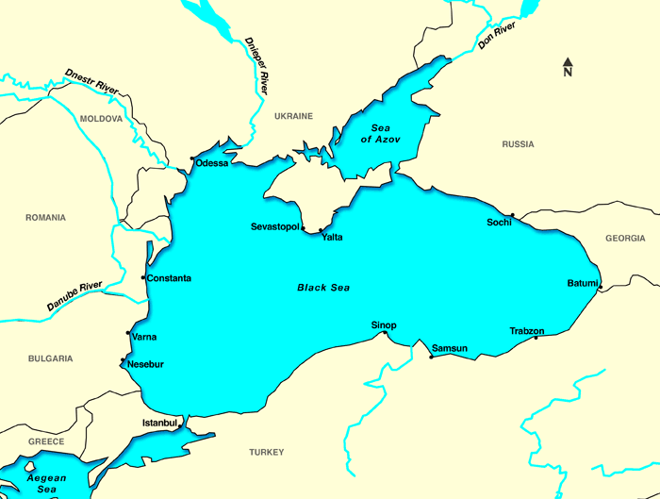
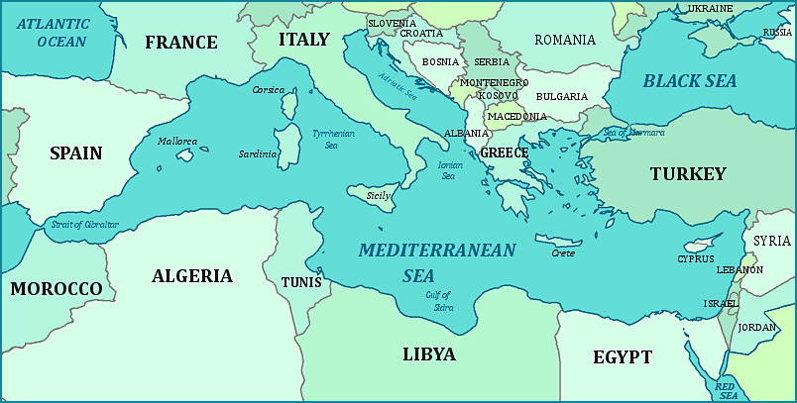
Earth’s Bodies of Water
Salinity is not a distinguishing feature between a sea and a lake
Lakes are more commonly freshwater but can be salty depending on their source and their surroundings.
Geological evidence shows that the freshwater or salt water status of a lake is subject to change, as in the Black Sea.

Slide 13
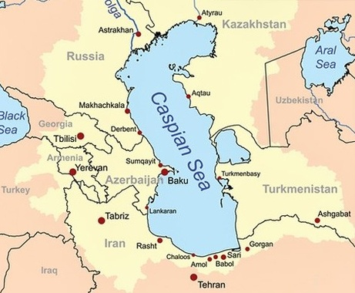
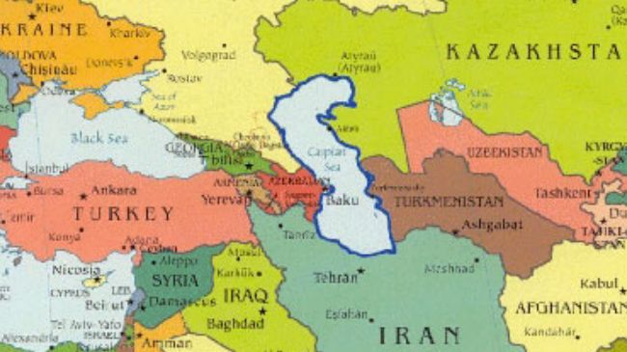
Earth’s Bodies of Water
Because the difference between lakes and seas is confusing there are a number misnamed seas.
Ex: the Caspian Sea is the largest landlocked body of water considered temporary because it is not connected to the ocean.
The Caspian Sea is like many lakes in that it is sensitive to pollution and invasive species.

Slide 14
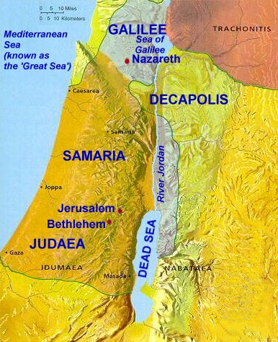
Earth’s Bodies of Water
Other misnamed Lakes and Seas
EX: Dead Sea – even though salty, not a sea but a lake because its not connected to an ocean nor is it considered permanent.
EX: Sea of Galilee – same as above.

Slide 15
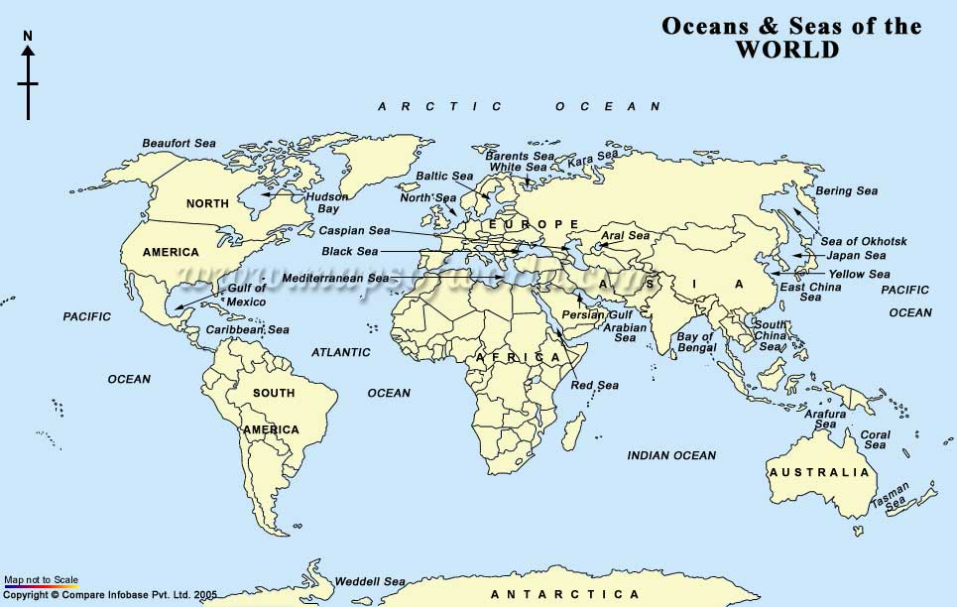
Lakes vs. Seas

Slide 16
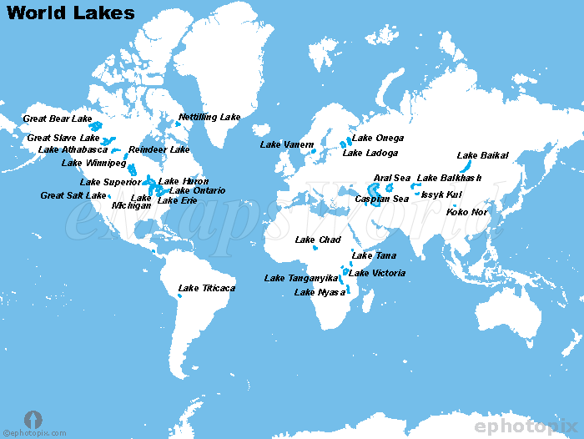

Slide 17
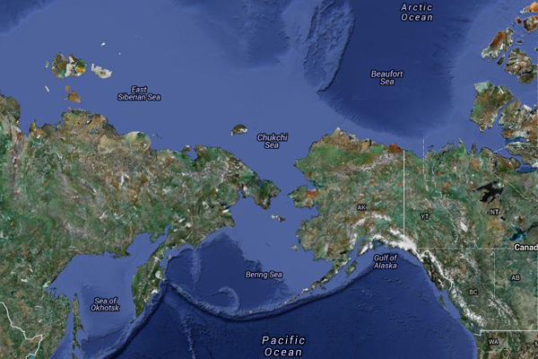
Earth’s Bodies of Water
Seas vs. Oceans
Seas are smaller than oceans and are usually located where the land and ocean meet. Typically, seas are partially enclosed by land.

Slide 18
Earth’s Bodies of Water
Oceans are the largest bodies of water on Earth.
Oceans are SALTY
There are Five (or seven) Oceans in the World
Atlantic
Pacific
The Atlantic and Pacific are at times divided into N and S
Arctic
Indian
Southern

Slide 19
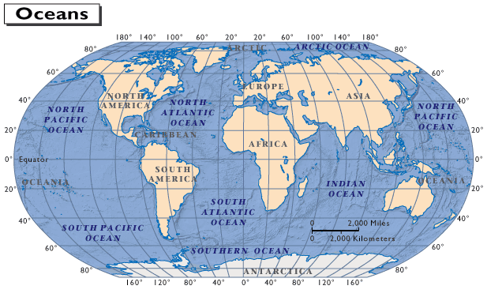
Earth’s Bodies of Water

Slide 20
How We Study The OCEAN
SONAR
BOUYS
UNDERWATER VEHICLES
SATALITTE
TRACKING ANIMALS

Slide 21
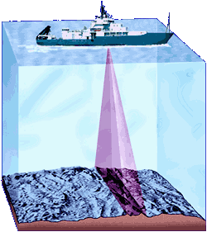
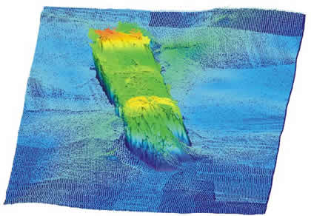
How We Study The OCEAN
Sonar
(originally an acronym for SOund Navigation And Ranging)
Mapping the ocean floor is done in two ways.
Multi-beam SONAR – sound is sent out from ship and the distance is determined by how long it takes the sound to return.

Slide 22
How We Study The OCEAN
How can we determine the depth of the ocean?
How can we map the ocean floor.
Knowing the speed of sound in water and using the time the sound takes to return to the ship we can simply solve for the depth.
What equation could we use?
V = d / t
Speed of sound is water = 1,481 m/s @ 20ºC

Slide 23
How We Study The OCEAN
If the Speed of sound is water is 1,481 m/s @ 20ºC and it takes 32 seconds for sound to hit the ocean floor and return, then…
V = d / t
1,481 = d / (32/2)
23,696 meter → approx. 77,742 feet
We had to divide 32s by 2 because the sound wave went down and back.

Slide 24
How We Study The OCEAN
Sonar
Side Scan SONAR - creates an image of the sea floor. It measures the strength of how "loud" the return echo is, and paints a picture.
Hard areas of the sea floor like rocks reflect more sound and have a stronger or louder return signal than softer areas like sand.
Areas with loud echoes are darker than areas with quiet echoes.
Objects or features that rise above the sea floor also cast shadows in the sonar image where no sound hit. The size of the shadow can be used to guess the size of the feature.

Slide 25
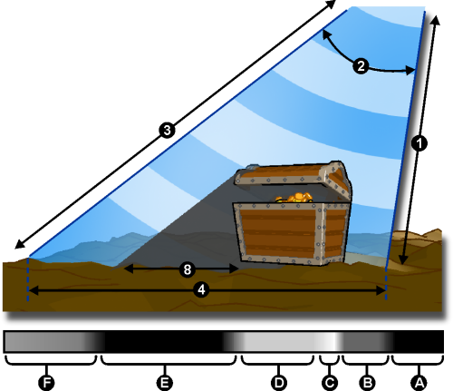
How We Study The OCEAN
Depth to inside of acoustic path.
Vertical beam angle.
Range setting in software (maximum acoustic range).
Swath width across seafloor.
Acoustic shadow length, corresponding to height of target.
Area before first "bottom" return (no sound = black).
Seabed texture.
Very reflective corner of object (brightest intensity).
Reflective object (target).
Acoustic shadow of target (no returns in here!).
Seabed texture.

Slide 26
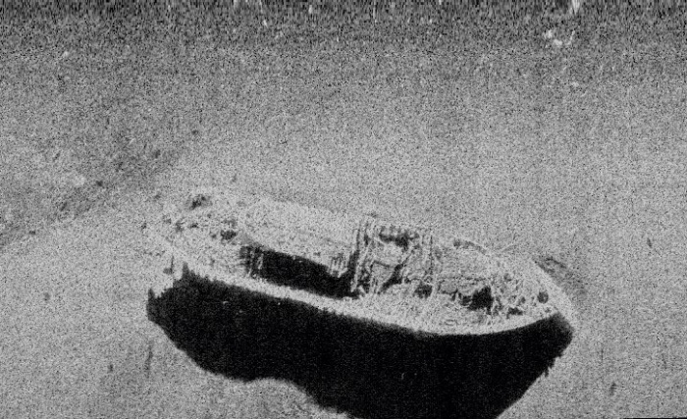
Image created by Side Scan Sonar

Slide 27
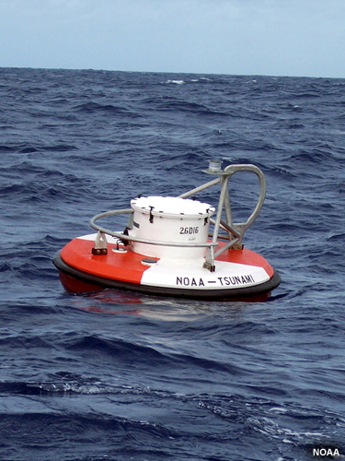
How We Study The OCEAN
Ocean Buoys are another method used to study oceans. They measure…
Air temperature
Barometric Pressure
Wind Speed
Water Temperature
Wave Height
Wave Period (frequency)
Data is transmitted via radio waves or by satellite to places like the National Oceanic and Atmospheric Administration’s (NOAA).
The National Buoy Center - http://www.ndbc.noaa.gov/

Slide 28
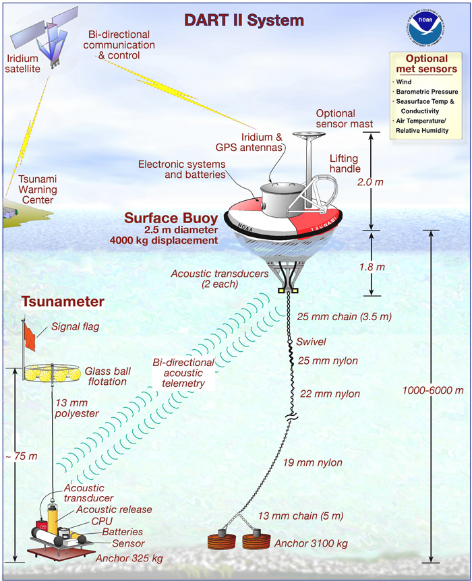
How We Study The OCEAN
Ocean Buoys can also be used to detect large ships, chemical spills, or even tsunamis.

Slide 29
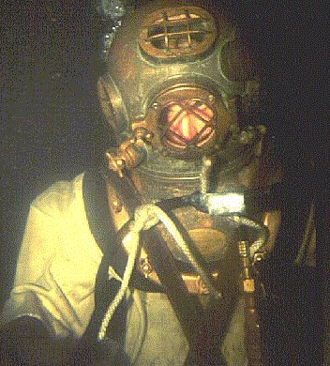
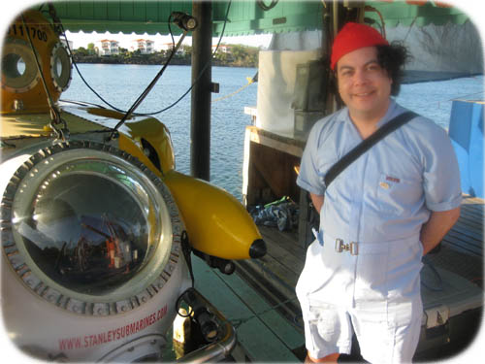
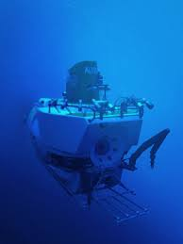
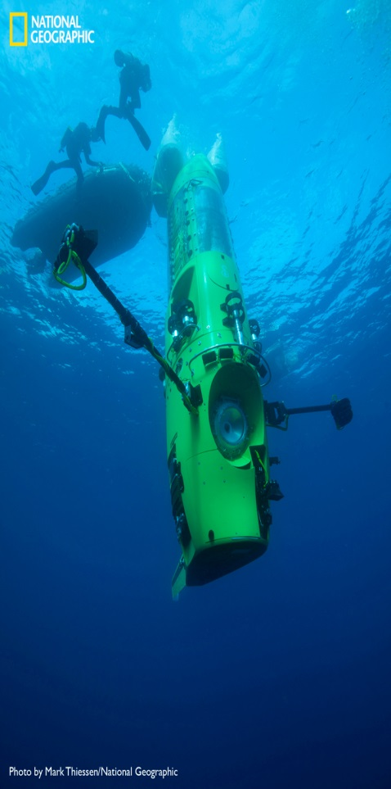
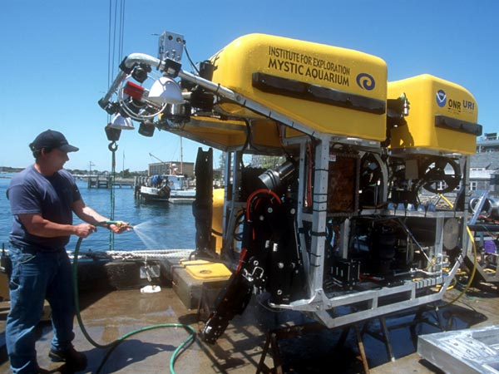
How We Study The OCEAN
Underwater Suites and Ocean Craft

Slide 30
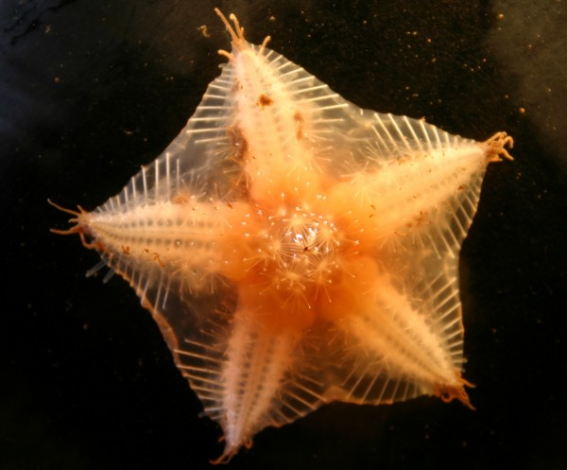
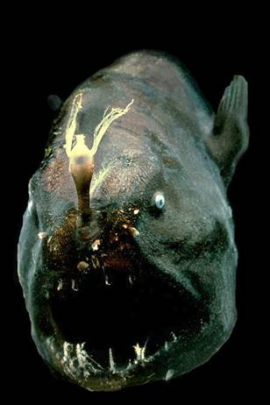
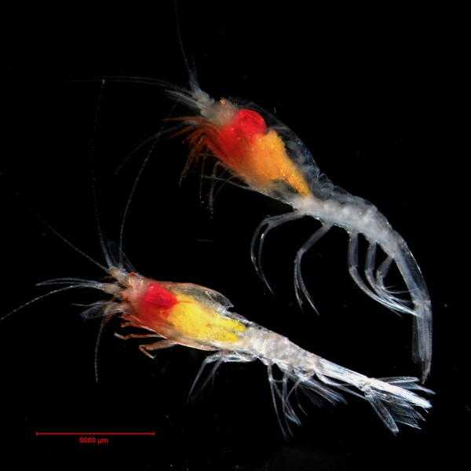
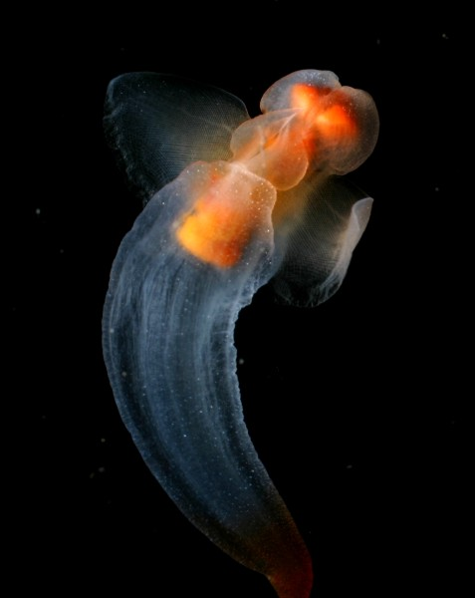
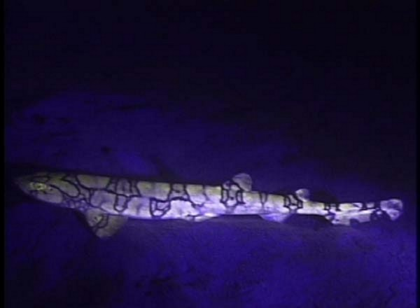
How We Study The OCEAN
Deep Ocean Discoveries

Slide 31
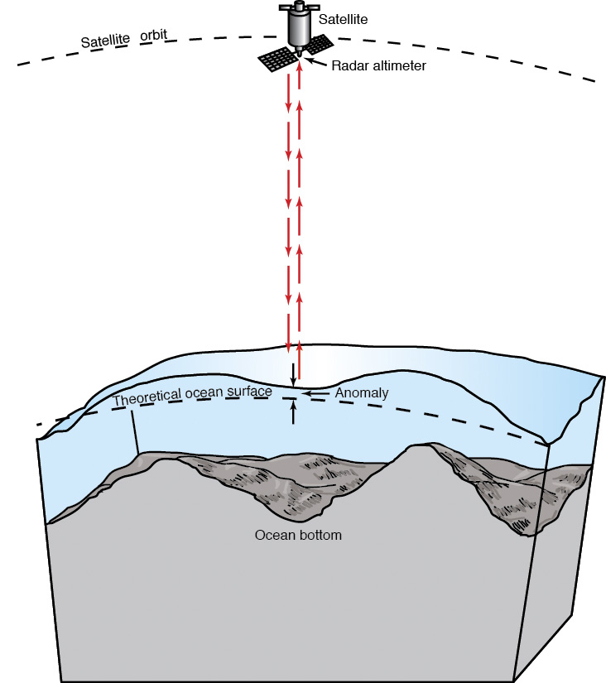
How We Study The OCEAN
Satellite Imaging has been used to study the oceans since 1978.
An Earth-orbiting radar cannot see the ocean floor, but it can measure ocean-surface height variations induced by the topography of the ocean floor. Mapping using satellite radars can cover a larger area in a short amount of time.

Slide 32
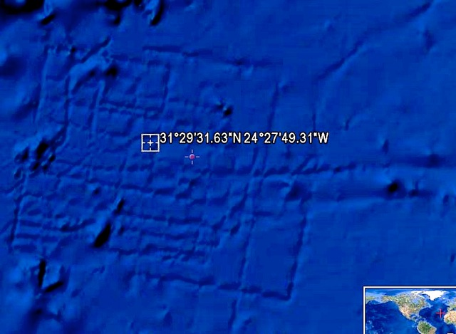
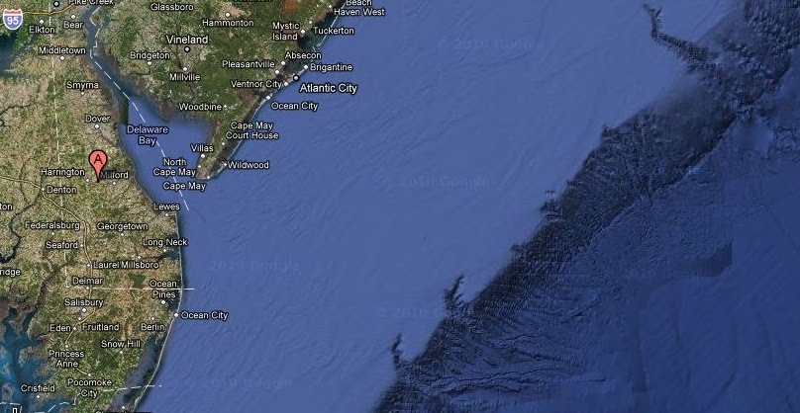
How We Study The OCEAN
Satellite Images of the Ocean Floor
This pattern was seen three miles down off the Coast of Africa.
Some have speculated that is this may be Atlantis… or geometrically advanced bottom sea-carp (:

Slide 33
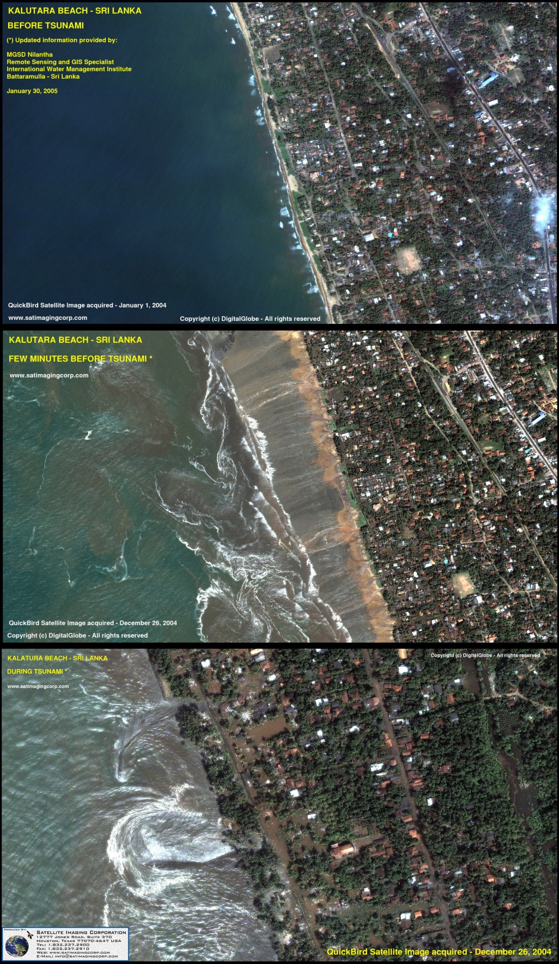
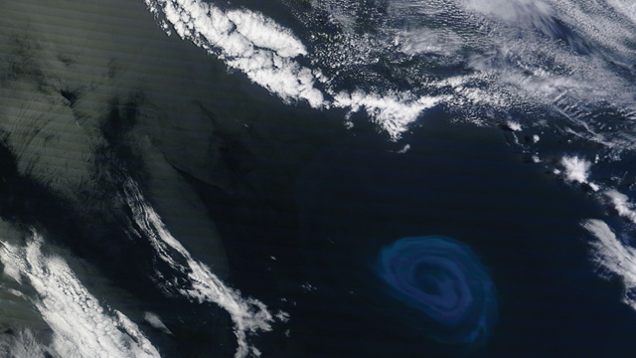
How We Study The OCEAN
Satellite Images of the Oceans

Slide 34
Assessment
Can I…
Further describe the hydrosphere
Distinguish Oceans, Seas, Lakes, etc.
Identify the Oceans of the World
Explain how we know what we do about Earth’s Oceans.

