Slide 1
Earth Science Notes
Our Natural Resources

Slide 2
Objectives
I can…
Explain what natural resources are.
Identify the major types of natural resources.
Distinguish between renewable and nonrenewable resources.
Identify and explain Earth’s most important natural resources.
Describe how resources are used from Earth’s crust, water, and the air.

Slide 3
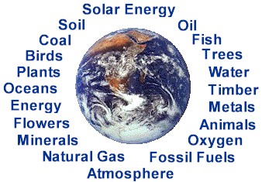
What are Natural Resources?
Natural resources are substances or materials that people obtain from nature and use to survive and thrive.
Natural resources include:
Rocks and minerals
Nutrients
Organisms
Water and Air

Slide 4
What are Natural Resources?
Renewable vs. Nonrenewable Resources
Renewable resources can be replaced at the same rate as the consumption of that resource.
When these renewable resources are replaced at the same rate at which they are used it is called a sustainable yield.

Slide 5
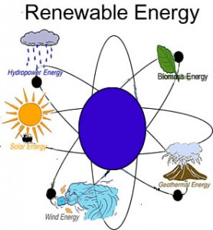
What are Natural Resources?
Examples of Renewable Resources:
Trees
Air
Water
Soil
Sunlight

Slide 6
What are Natural Resources?
Examples of NON-Renewable Resources:
Fossil fuels
Coal is usually found in Precambrian rock. For that reason its believed that it takes a very long time for coal to form.
We used 8,144,308,000 tons of coal a year (globally) in 2011 and the amount increases around 5% per year.
Estimated we will run out in the year 2202.

Slide 7
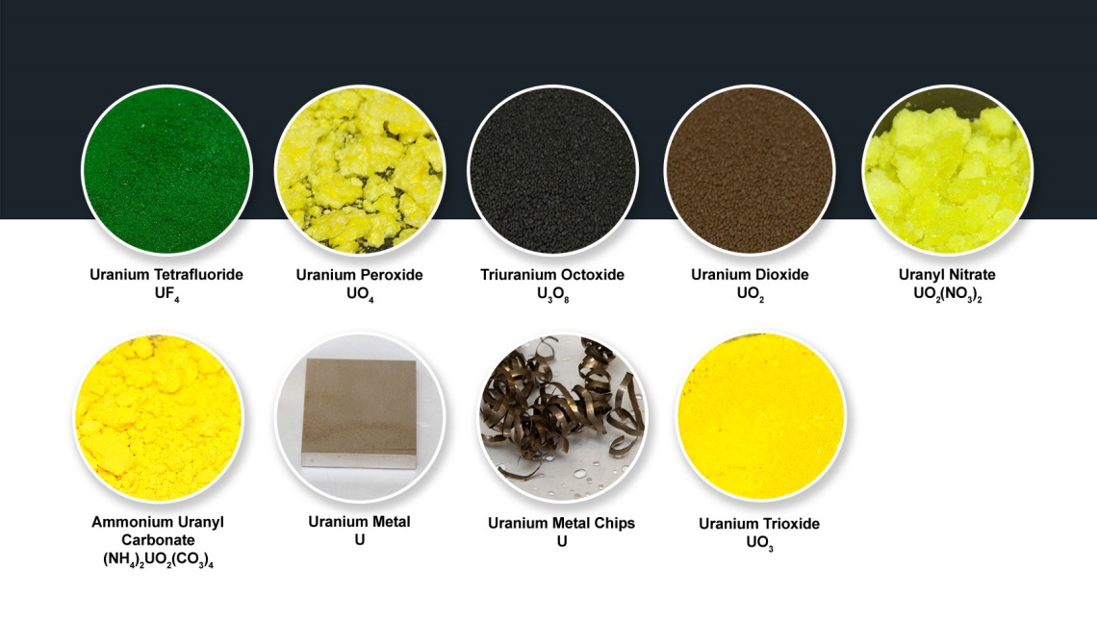
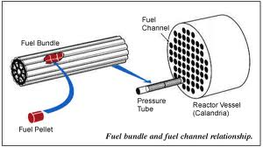
What are Natural Resources?
Examples of NON-Renewable Resources:
Radioactive Fuels
Uranium – the creation uranium is the result of extremely high temperature fusion reactions that take place in stars when they go supernova.
These fuels are not being “renewed,” just used.

Slide 8
What are Natural Resources?
The Most Important Natural Resources:
Water
Oil
Natural Gas
Phosphorus
Coal
Rare Earth Elements

Slide 9
What are Natural Resources?
The Most Important Natural Resources:
Water
Freshwater only makes 2.5% of the total volume of the world's water.
Most of the freshwater (70%) is ice and permanent snow cover.
We only have access to less than 1 percent of the worlds water.
The Food and Agriculture Organization is predicting that by 2025, 1.8 billion people will be living in countries or regions with extreme water scarcity.

Slide 10
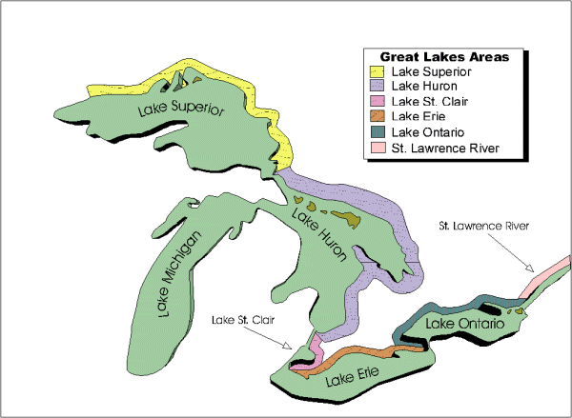
Yeah Michigan!!!
The Great Lakes are the largest surface freshwater system on the Earth. Only the polar ice caps contain more fresh water.

Slide 11
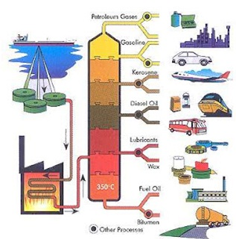
What are Natural Resources?
The Most Important Natural Resources:
Oil
Refined to produce gasoline and other useful derivatives.
The BP Statistical Review of World Energy, predicts there is only enough oil for the next 46 years should global production remain at the current rate.
This is based on proved oil resources at the end of 2010.

Slide 12
What are Natural Resources?
The Most Important Natural Resources:
Natural Gas
Used for heating homes and cooking.
Over 50% of homes are heated this way.
Used as a cleaner alternative to gasoline for cars.
Based on proven reserves (BP, 2010) we have enough natural gas to meet 59 years of global usage.

Slide 13
What are Natural Resources?
The Most Important Natural Resources:
Coal
Fuels 41% of global energy (world coal assn.)
This is currently our most abundant fossil fuel.
Currently a large demand for this fuel.
We have enough coal to meet 188 years of global usage.

Slide 14
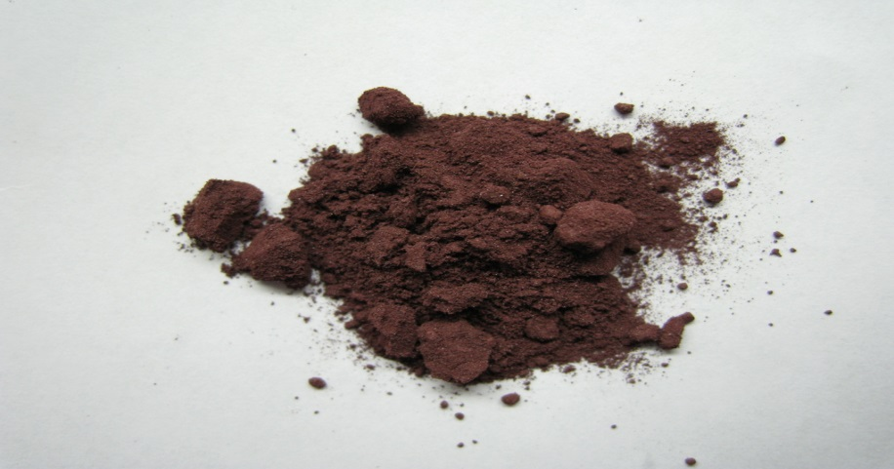
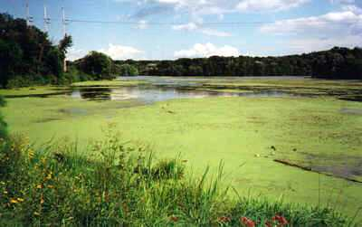
What are Natural Resources?
The Most Important Natural Resources:
Phosphorus
Extremely important nutrient for plant growth – without it there is no life.
Used in fertilizers in the form of phosphates.
Too much phosphorus

Slide 15
What are Natural Resources?
The Most Important Natural Resources:
Rare Earth Elements
In 2009, world production of rare earth elements totaled 126,230 metric tons, with China producing 95% of the world’s total.
The U.S. currently imports all of its rare earths from China, France, Japan and Austria.

Slide 16
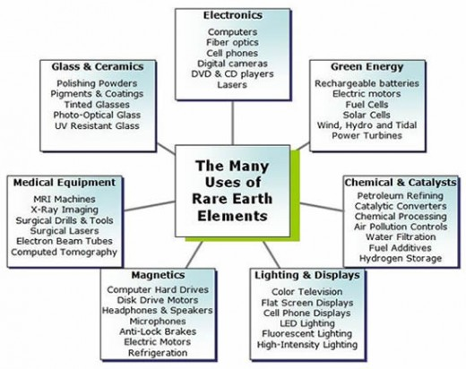

Slide 17
Distribution of Natural Resources?
We find natural resources all over the Earth but in some places natural resources are more abundant.
What resources are these places known for?
The Great Lakes
The Klondike
Pennsylvania
The Bering Sea
Kalamazoo?
Millwood, Westwood, Eastwood, Parchment, etc.

Slide 18
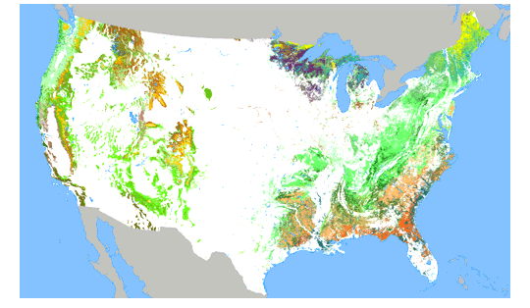
Where are Natural Resources Found?
Colored area represent major logging areas.

Slide 19
Where are Natural Resources Found?

Slide 20
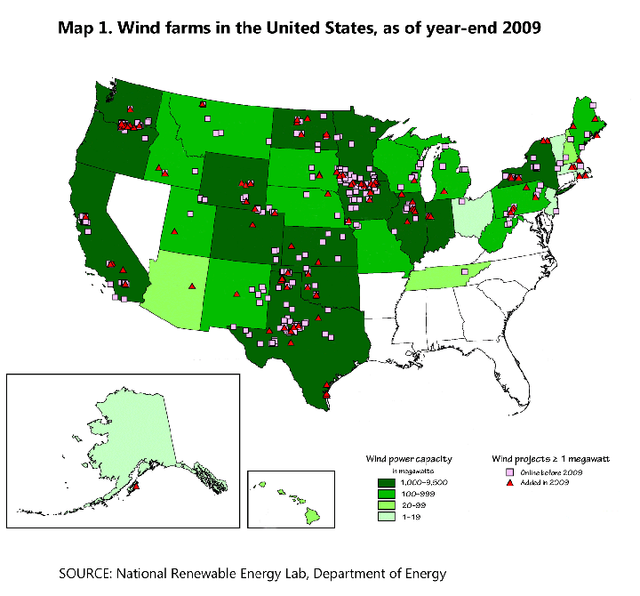
Where are Natural Resources Found?

Slide 21
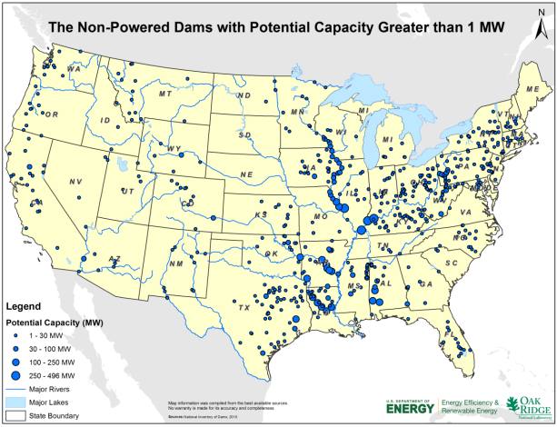
Where are Natural Resources Found?

Slide 22
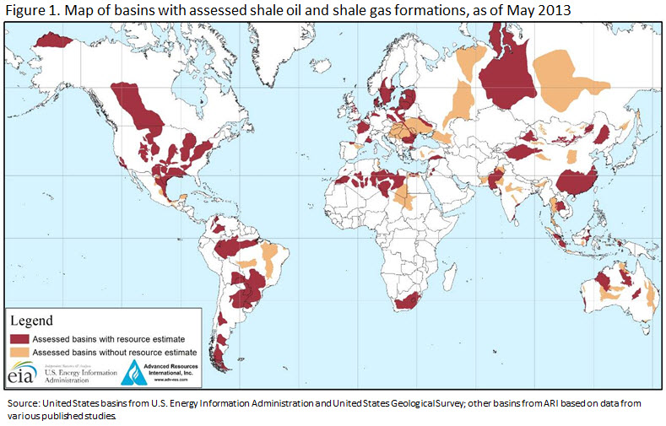
Where are Natural Resources Found?

Slide 23
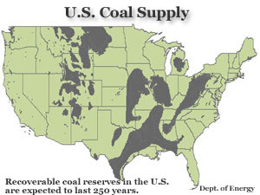
Where are Natural Resources Found?

Slide 24
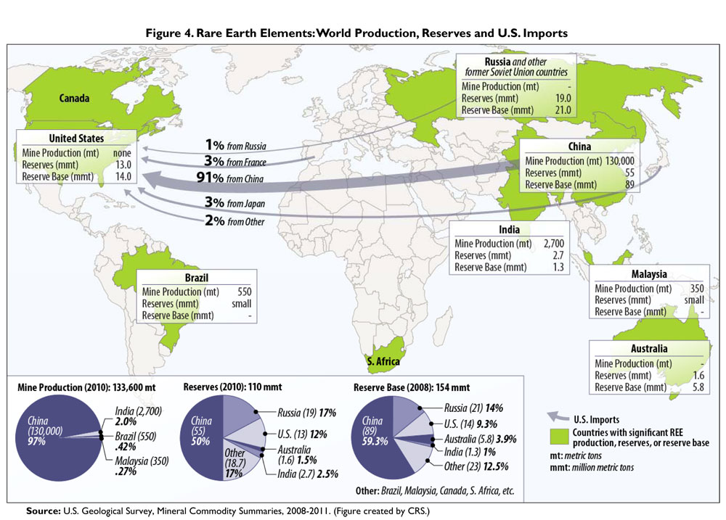
Where are Natural Resources Found?

Slide 25
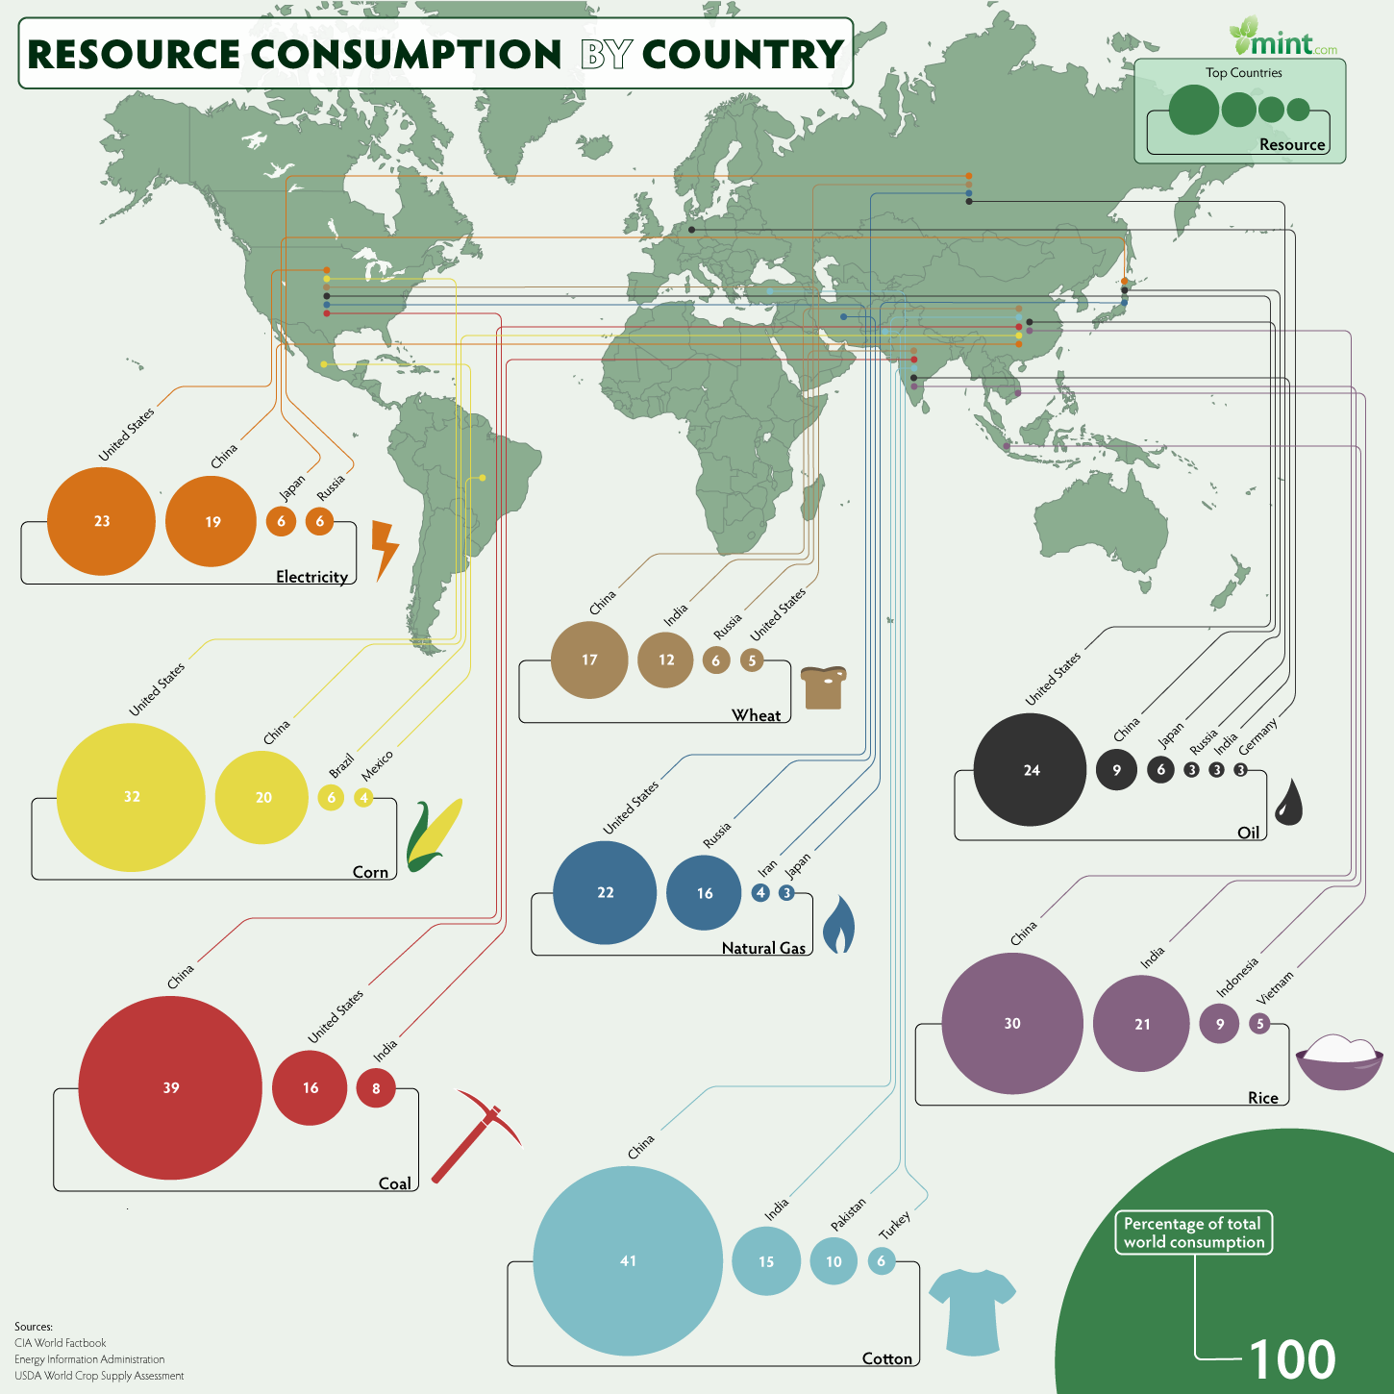
Consumption of Natural Resources

Slide 26
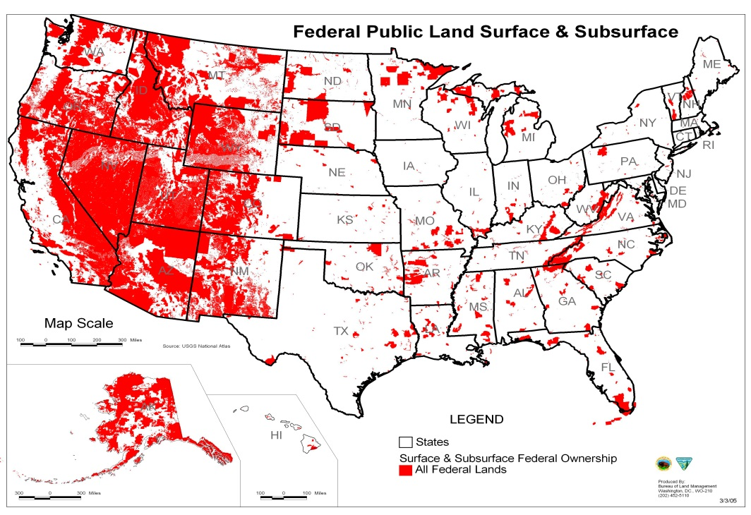
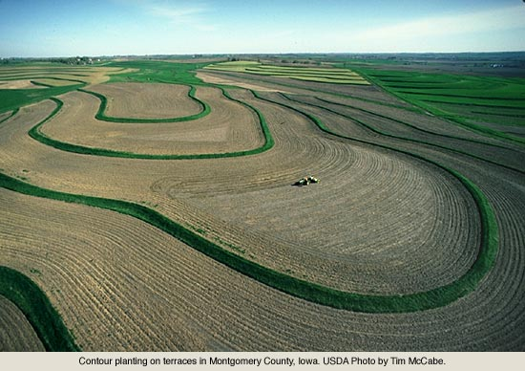
Where Natural Resources are Obtained From
The Crust
Land Resources
Publically Managed land – used for grazing of cattle, mining of minerals, and recreation.
Soil
Recall our unit on Soil

Slide 27
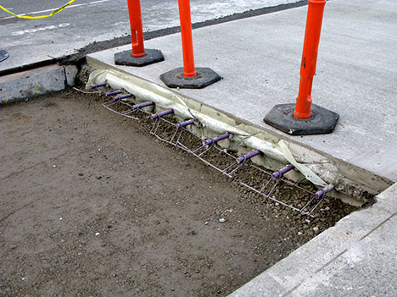
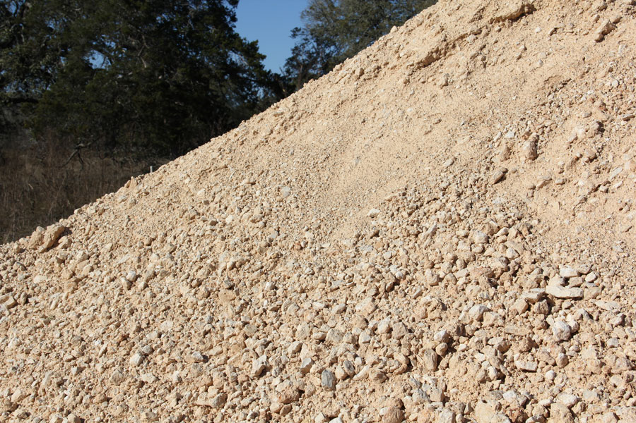
Where Natural Resources are Obtained From
The Crust
Aggregates – mixture of sand and gravel that have been deposited by glaciers. Often used in road construction.

Slide 28
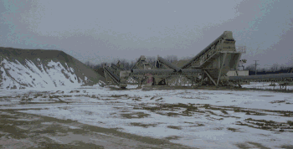
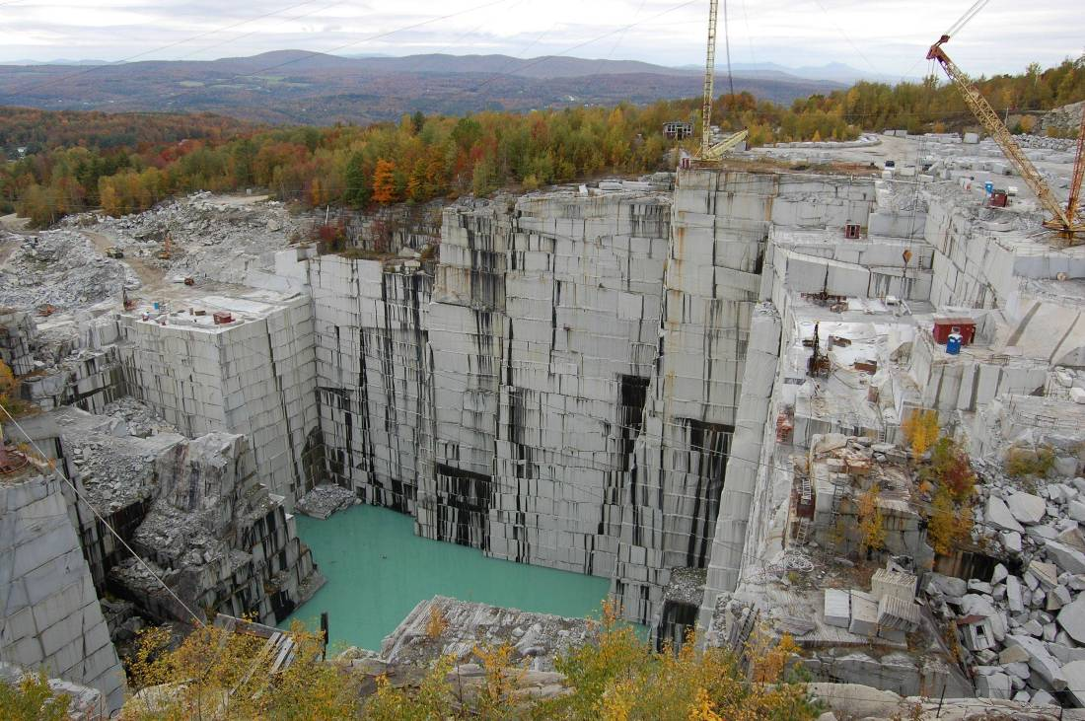
Where Natural Resources are Obtained From
The Crust
Bedrock – un-weathered parent rock that is chiseled from quarries.
Examples of quarried rock:
Limestone
Marble
Granite

Slide 29
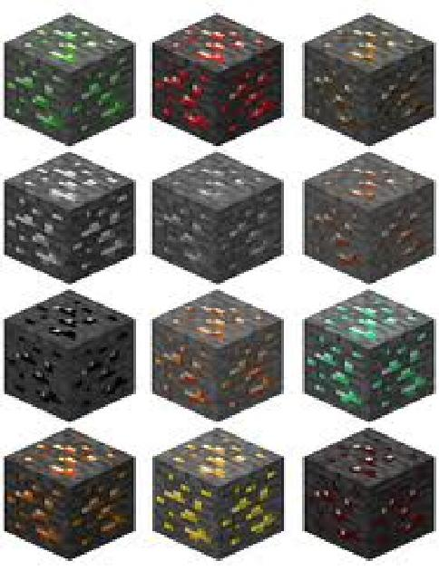
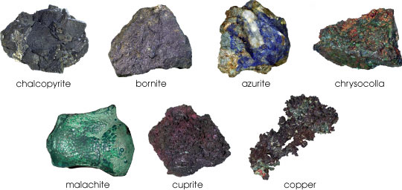
Where Natural Resources are Obtained From
The Crust
Ores – are raw materials that are refined to obtain pure minerals that are useful to us.
Ex: iron ores → Iron
Ex: uranium ores → Uranium
Ex: the minecraft ores
Many ores are from the common groups of minerals we studies in our unit on rocks and minerals
Sulfides / halides / oxides / carbonates / etc.

Slide 30
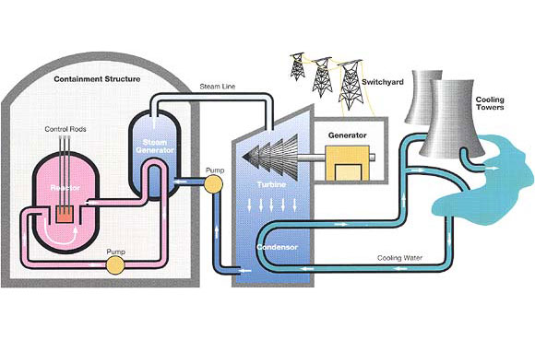
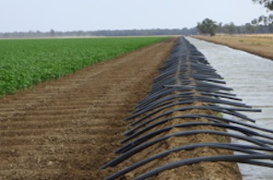
Where Natural Resources are Obtained From
The Water
Water has many properties and uses:
(obviously) water is needed to survive (3 days w/out = death).
Water facilitates aquatic and marine life.
Water has dissolved minerals
Water stores and transports thermal energy

Slide 31
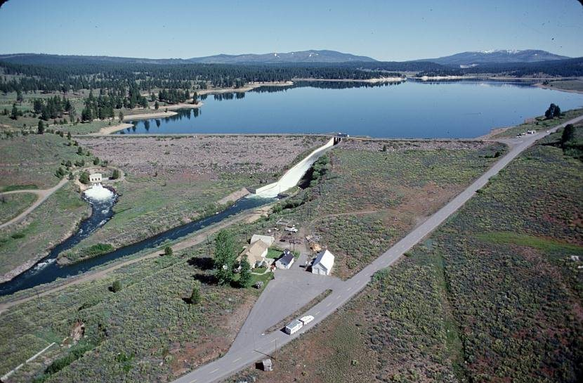
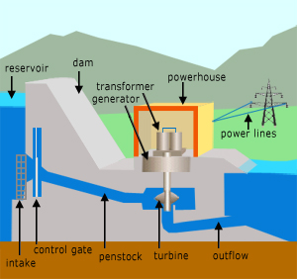
Where Natural Resources are Obtained From
The Water
Managing Water Resources:
Use of Dams and Reservoirs – dams are built on rivers and the result is a large build up of water (reservoir).
Reservoirs are a major source of freshwater.
When water is released through a dam, hydroelectric power is produced.
Reservoirs are great fishing spots!!!

Slide 32
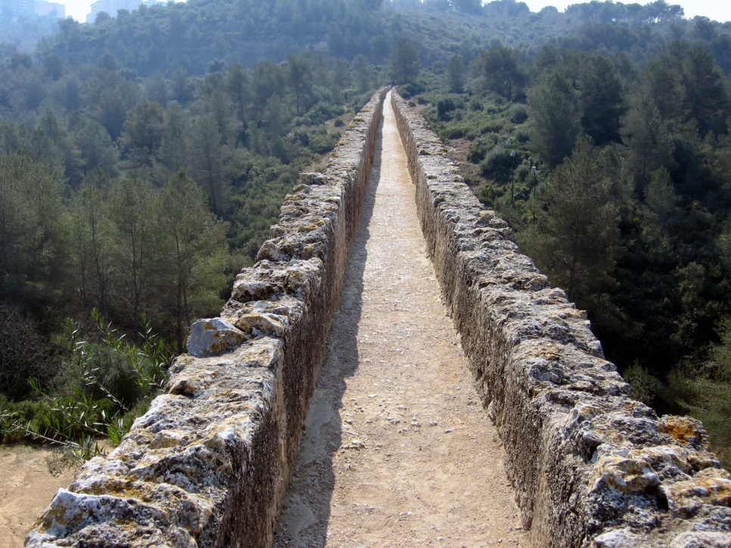
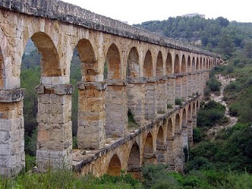
Where Natural Resources are Obtained From
The Water
Managing Water Resources:
Aqueducts – people have been building these since Roman times. These are basically pipes or ramps for water to move from the source to a city.

Slide 33
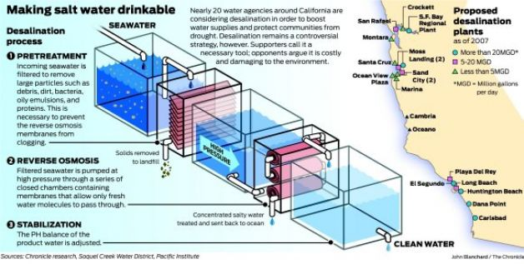
Where Natural Resources are Obtained From
The Water
Managing Water Resources:
Desalination Plants – many cities near the sea have desalination plants. These plants remove salt from the water and pipe the salt back to the sea.

Slide 34
Where Natural Resources are Obtained From
Earth Resources are obtained from:
The Air
(obviously) we need it to breath. 3 min without oxygen and you’re dead.
The air is a major source of nitrogen. Nitrogen is an essential nutrient for plants.
Nitrogen may get into the soil through rain or nitrogen fixing bacteria.

Slide 35
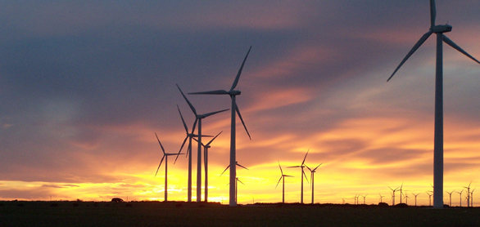
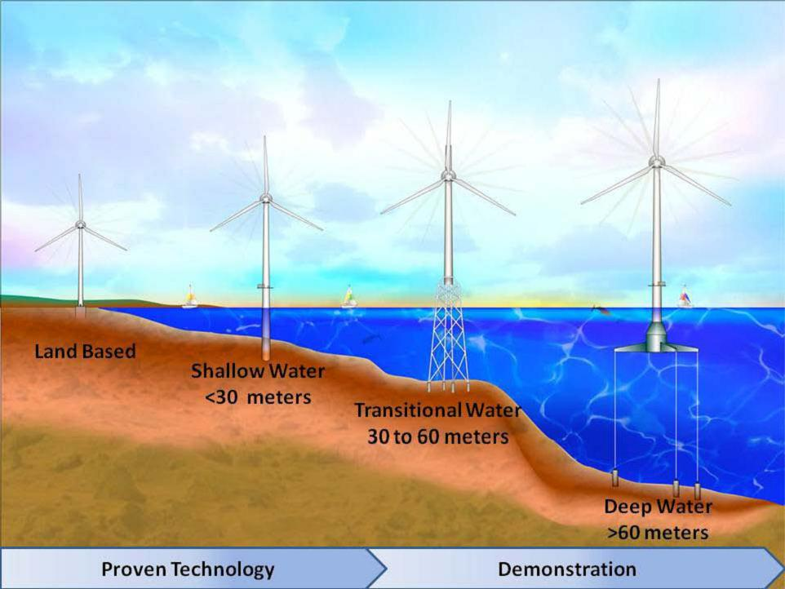
Where Natural Resources are Obtained From
Earth Resources are obtained from:
The Air
The wind is a source of clean energy that provides power.

Slide 36
Assessment
Can I …
Explain what natural resources are.
Identify the major types of natural resources.
Distinguish between renewable and nonrenewable resources.
Identify and explain Earth’s most important natural resources
Describe how resources are used from Earth’s crust, water, and the air.

