Slide 1
PHYSICS NOTES
Review of Good Methodology

Slide 2
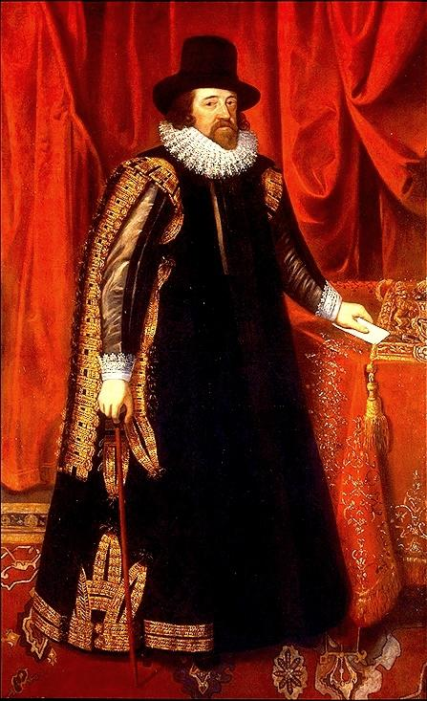
WHO IS THIS GUY?
"If a man will begin with certainties, he shall end in doubts; but if he will be content to begin with doubts, he shall end in certainties."
What do you think this means?

Slide 3
WHO IS THIS GUY?
Bacon (pictured) and Descartes formalized Science into a Methodology.
However, many people have contributed to the SM over time.
Karl Gauss David Hume John Locke Ernst Mach John Dewey Humphry Davy Isaac Newton Robert Boyle Abraham Wolf Morris Cohen Karl Pearson William James | Gregor Mendel John Herschel Immanuel Kant William Wells Charles Darwin Claude Bernard William Jevons Charles Pierce William Jevons William Harvey Michael Faraday William Whewell | Johannes Kepler Albert Einstein Henry Armstrong John Stuart Mill Joseph Priestley Bertrand Russell Benjamin Franklin Antoine Lavoisier Joseph Gay-Lussac Ernest Rutherford James Clerk Maxwell Albert North Whitehead

Slide 4
Objectives
I can…
Recall the general steps of the SM
describe the criteria for good questions, hypotheses, tests, results, and conclusions.
describe the different types of testing methods
apply ST to the Scientific Method.

Slide 5
REMEMBER
Problem → Hypothesis → Testing → Results → Conclusion
Problem or question: what do you want to know, what problem do you want to solve, or what decision do you need to make
A stated problem provides focus and structure for the remaining steps of the scientific method

Slide 6
REMEMBER
Problems must:
Be researchable – can be investigated via data collection and analysis
Within the limitations of science
Dealing with the physical universe
Dealing with issues that are not philosophical or ethical in nature
Be meaningful – leads to reliable knowledge that has application

Slide 7
REMEMEBER
Problem → Hypothesis → Testing → Results → Conclusion
Hypothesis: a statement that is a prediction of research findings or supposed description of some relationship between variables
Hypothesis must:
Be based on sound logic and consistent with previous theories
Be a brief and clear statement
Cleary state relationships between variables
Testable within a reasonable time frame

Slide 8
You Should Also Know…
Some Types of Hypotheses
Inductive hypothesis: comes from previous observation (footprints example)
Deductive hypothesis: derived from previous theories (most HS labs)
Null hypothesis: states there is no relationship between variables (always want to disprove)*** will always use this.

Slide 9
REMEMBER
Problem → Hypothesis → Testing → Results → Conclusion
Testing: List of all materials and explanation of the procedures that were used to carryout the tests. A list of statistical methods and equations used is also appropriate.
Testing must:
Be Repeatable
Steps must be clear and sequential
Be Valid
This means that the test is measuring what it is supposed to measure
Be Reliable
This means that people who perform the test should get similar results

Slide 10
YOU SHOULD ALSO KNOW...
Quantitative Testing – uses numerical data, addresses very specific questions, all methods developed before you do the research
Types
Causal Comparative Method
Correlation Method
Experimental Method

Slide 11
You Should Also Know…
Causal Comparative Method – researcher attempts to determine cause, or reason for existing differences or circumstances
Start with effect and works toward cause
Compares averages between groups to see if there is a difference
Ex: average height between ethnic groups
Uses statistical test to determine if event appears in one group more than others
Ex: the overweight group of individuals has a high frequency of heart disease.

Slide 12
You Should Also Know…
Correlation Method – involves collecting data to determine whether or to what degree a relationship exists (i.e relationship between variables).
Degree of relatedness is measured as the correlation coefficient (r)
Experimental Method – uses a control group and an experimental group
Only one variable is changed in the experimental group while the rest art controlled
Only method of testing that can establish cause
Uses statistical data (means, modes, SD, etc.) to determine difference in groups
Used much more in the hard sciences (physics, chemistry)

Slide 13
YOU SHOULD ALSO KNOW…
Qualitative Methods – uses data collected from observation and personal narratives and analyzes it, usually takes a long time, methods developed during or even after research.
Types
Narrative Research Methods
Ethnographic Research Methods

Slide 14
YOU SHOULD ALSO KNOW…
Narrative Research Methods – studies how different human beings experience the world around them
Ex: Sociologists, Physiologist, etc.
Ethnographic Research Methods – looks at cultural patterns and participants in a natural setting
Ex: Anthropologists, etc.

Slide 15
REMEMBER
Problem → Hypothesis → Testing → Results → Conclusion
Results: An organized representation and description of what the data says.
Results must:
Be clearly described!
Must consider both accuracy and precision of measurements
Have clearly labeled and easy to read charts, tables, graphs, etc.

Slide 16
REMEMBER
Problem → Hypothesis → Testing → Results → Conclusion
Conclusion: An explanation of what the data means.
Conclusions must:
Tell whether the hypotheses were retained (tentatively accepted) or rejected.
Explain the evidence used to retain or reject the hypotheses (be empirical and Rational)
Identify and possibly justify any influencing factors and Suggest improvements and be open to other explanations (be skeptical)
Make possible generalizations or applications

Slide 17
Assessment
Can I…
Recall the general steps of the SM
I can describe the criteria for good questions, hypotheses, tests, results, and conclusions.
I can describe the different types of testing methods
I apply ST to the Scientific Method
I can start thinking about my independent lab.

Slide 18
REMEMBER

